Slide 1
1791

Slide 2
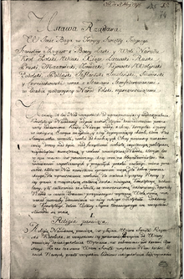
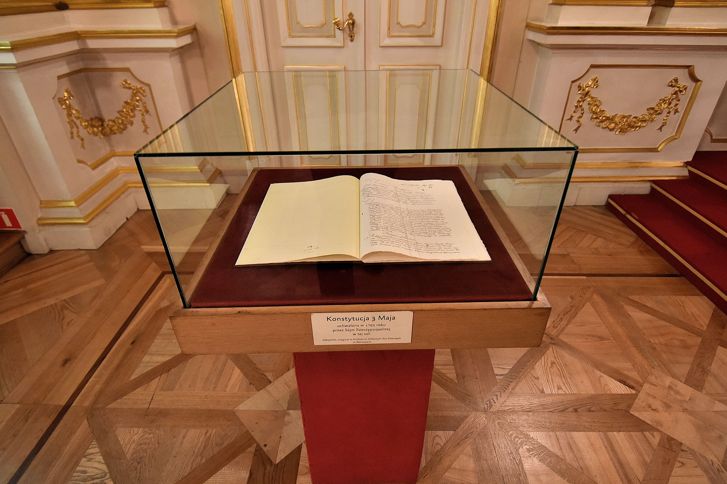
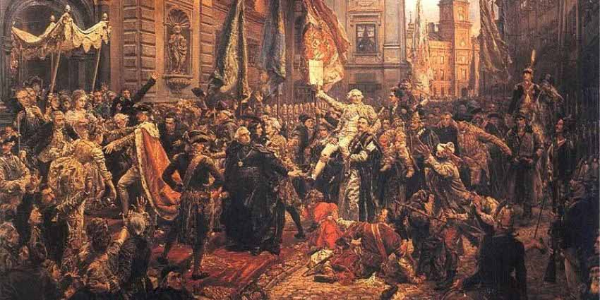
Constitution of May 3, 1791
The Constitution of May 3 1791 was adopted by The Great Sejm (parliament) of the Polish–Lithuanian Commonwealth First constitution in Europe and the second in the world

Slide 3
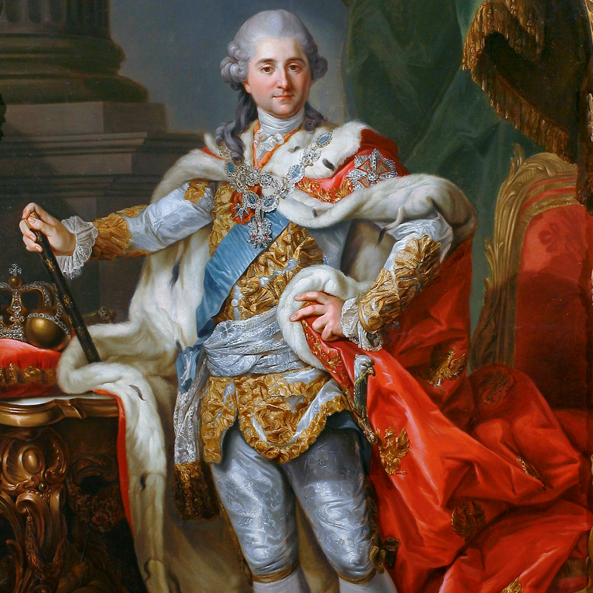
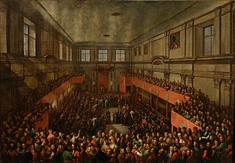
Constitution of May 3, 1791
The legalisation was designed to redress the Commonwealth's political defects
The constitution sought to supplant the prevailing anarchy
Montesquieu's separation of powers system There are three sorts of power: the legislative the executive and the judiciary

Slide 4
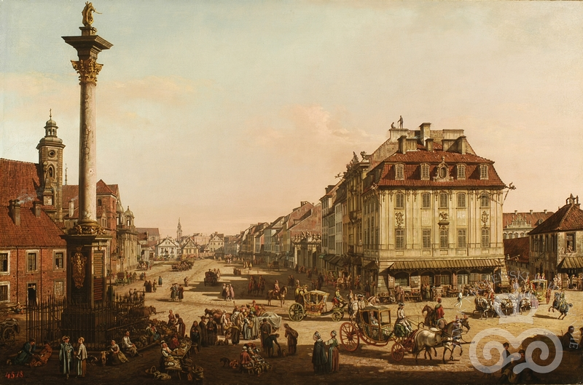
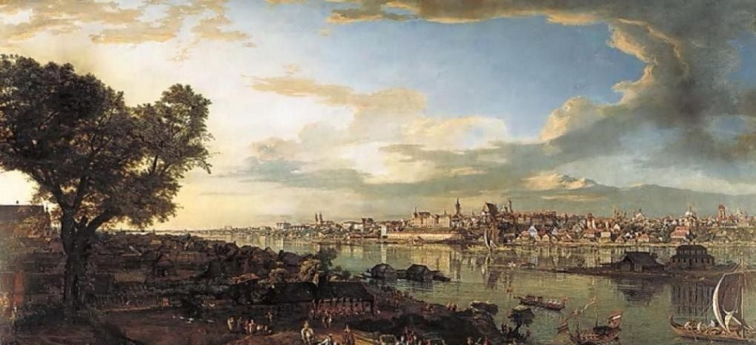
Bernardo Bellotto (Canaletto)
Bellotto accepted an invitation in 1764 from Poland's newly elected King Stanisław August Poniatowski to become his court painter in Warsaw Here he remained some 16 years, for the rest of his life, as court painter to the King, for whom he painted numerous views of the Polish capital and its environs for the Royal Castle in Warsaw

Slide 5
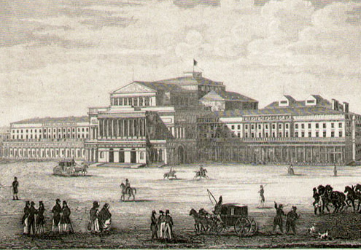
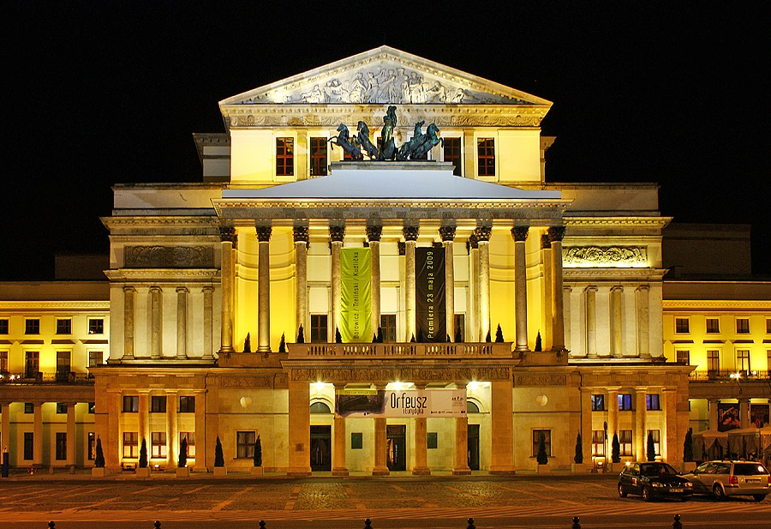
National Theatre, Warsaw
The National Theatre in Warsaw, Poland, was founded in 1765, during the Polish Enlightenment, by that country's last monarch, Stanisław August Poniatowski

Slide 6
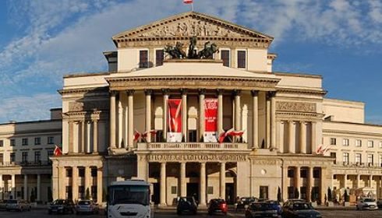
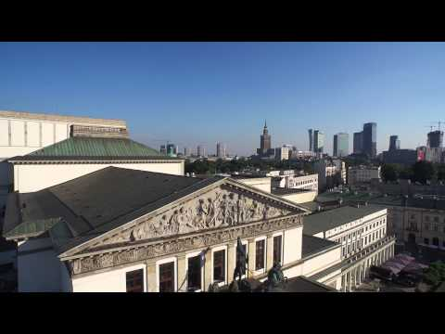
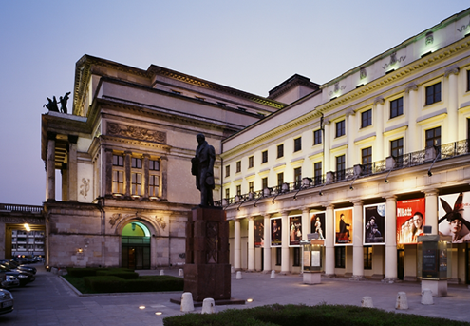
National Theatre

Slide 7
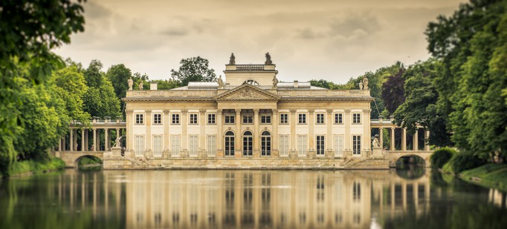
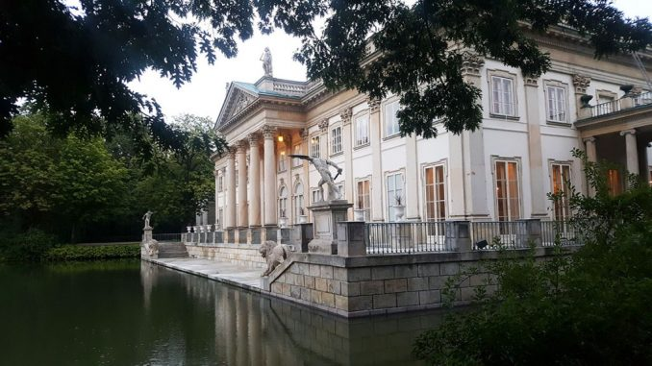
Łazienki Park
It is the largest park in Warsaw, Poland, occupying 76 hectares of the city center
Originally designed in the 17th century as a baths park (hence the name), in the 18th century Łazienki was transformed by Poland's King Stanisław August into a setting for palaces, villas, classicist follies, and monuments

Slide 8
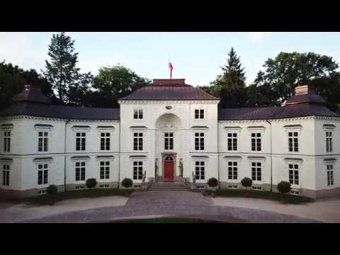
Łazienki Park

Slide 9
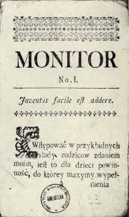
Monitor (Polish newspaper)
The Monitor was one of the first newspapers in Poland, printed from 1765 to 1785, during the Polish Enlightenment
It was founded in March 1765 by Ignacy Krasicki and Franciszek Bohomolec, with active support from King Stanisław August Poniatowski
It came out weekly, later semi-weekly

Slide 10
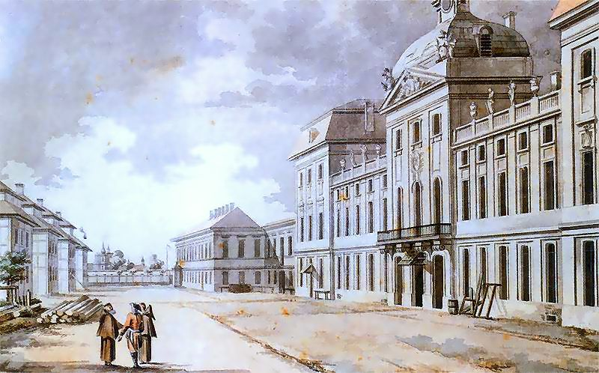
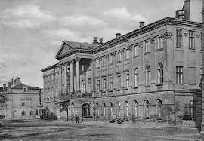
Corps of Cadets (Warsaw)
The state Corps of Cadets was established in Warsaw on 15 March 1765 by King Stanisław August Poniatowski
It was the first state school in the Polish-Lithuanian Commonwealth

