Slide 1
In the year
1859
Poland

Slide 2
01
The Carrington Event

Slide 3
The Carrington Event
Powerful geomagnetic storm on September 1-2, 1859
On these days, one of the largest geomagnetic storms occured, auroras were seen around the world. Telegraph systems all over the Europe failed, in some cases giving telegraph operators electric shocks. Telegraph pylons threw sparks. Some telegraph operators could continue to send and receive messages despite having disconnected their power supplies.

Slide 4
02
Literature

Slide 5
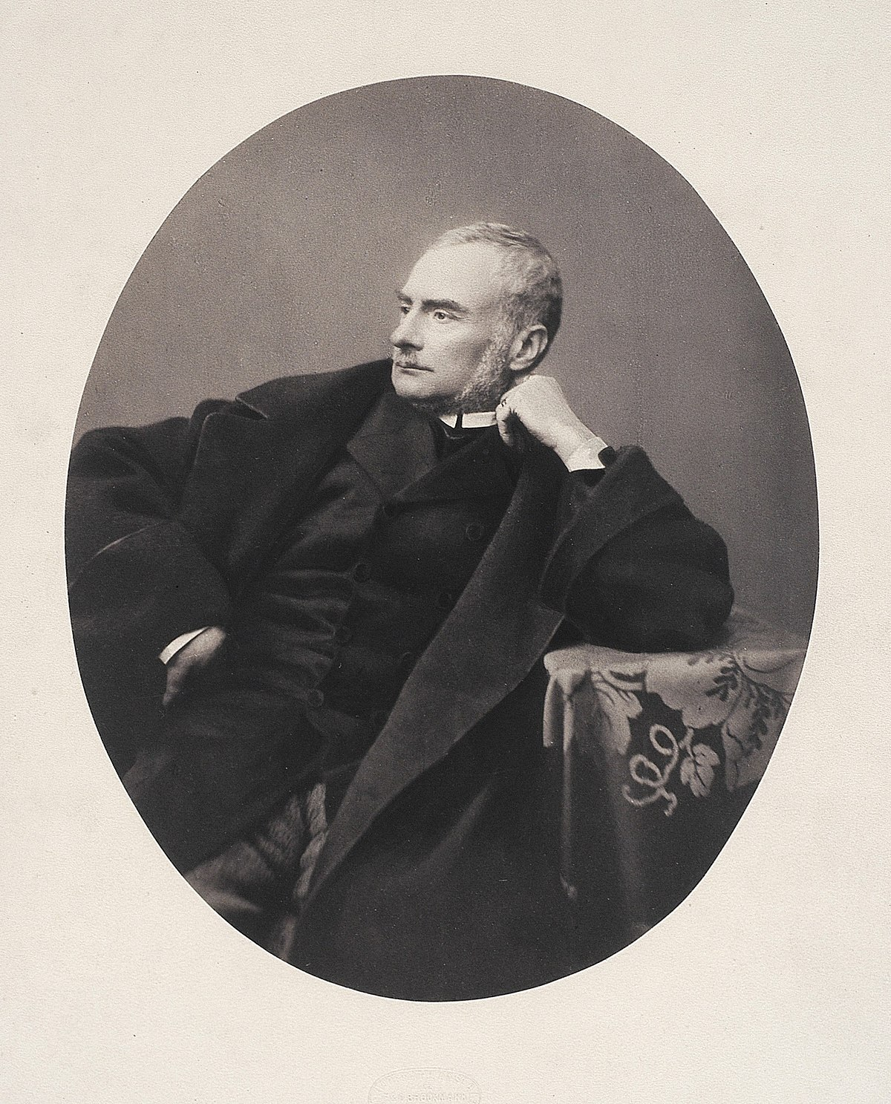
Zygmunt Krasiński
On 23 February 1859 died Zygmunt Krasiński, polish poet, who is named as one of Poland’s Three Bards, who influenced national consciousness during Partitions of Poland.
As his most important works are considered poems Przedświt (Predawn) and Psalms of the Future. However, dramas The Undivine Comedy and Irydion became his best known compositions.

Slide 6
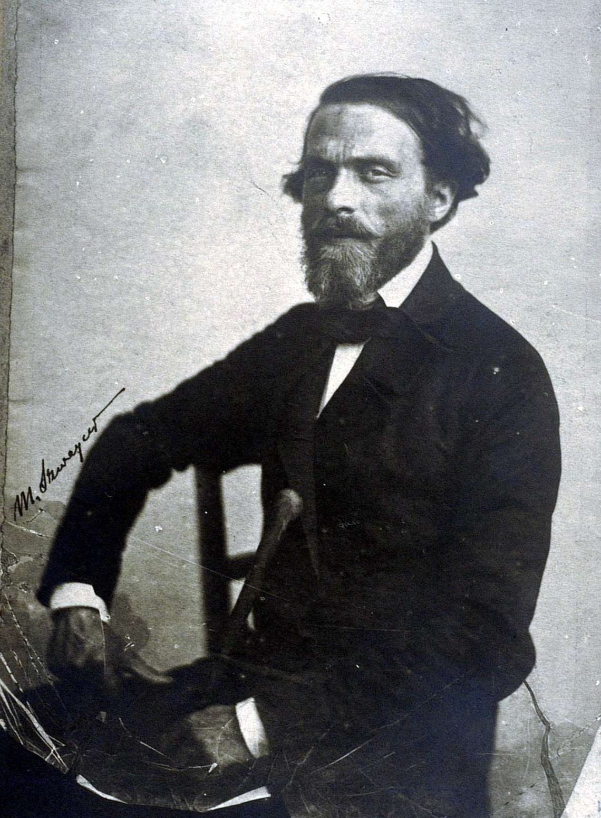
Cyprian Kamil Norwid
“Do obywatela Johna Brown” (To citizen John Brown) was Norwid’s poem published in 1859. Cyprian Kamil Norwid was a nationally esteemed Polish poet, dramatist, painter and sculptor. Some of his well-known poems are Fortepian Szopena (“Chopin’s Piano”), Moja piosenka (My Song), Bema pamięci żałobny rapsod (A Funeral Rhapsody in Memory of General Bem). His maternal ancestor was the Polish King John III Sobieski.He led a tragic and often poverty-stricken life. He experienced increasing health problems, unrequited love, harsh critical reviews, and increasing social isolation. Most of his life, he live abroad, especially in London and in Paris. He was excluded from high society, because of his non-conformist style, among other things. His genius was only discovered by the Young Poland art movement.

Slide 7
is a name of a novel written by Walery Łoziński and published in 1859. This is the first polish thriller novel.
“Zaklęty dwór” (Accursed manor)

Slide 8
03
Art and Music

Slide 9
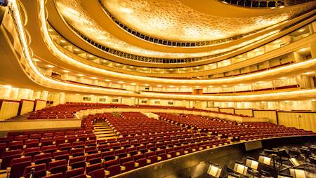
is a name of operetta, written by Jacques Offenbach, which was performed as first operetta in polish theatre history, and was directed by Leopold Matuszyński
“Małżeństwo przy latarniach” (Married Couple by the lanterns)

Slide 10
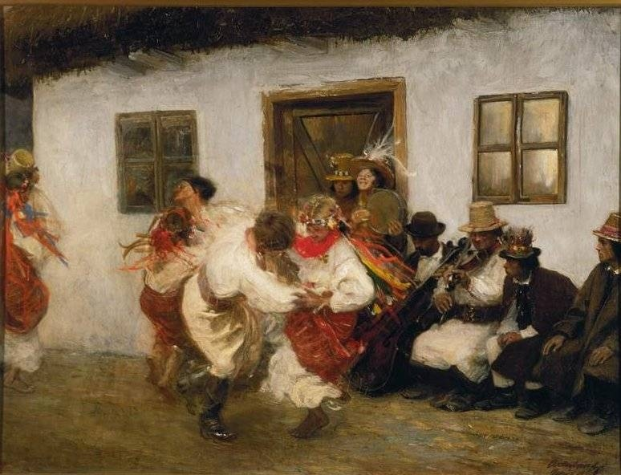
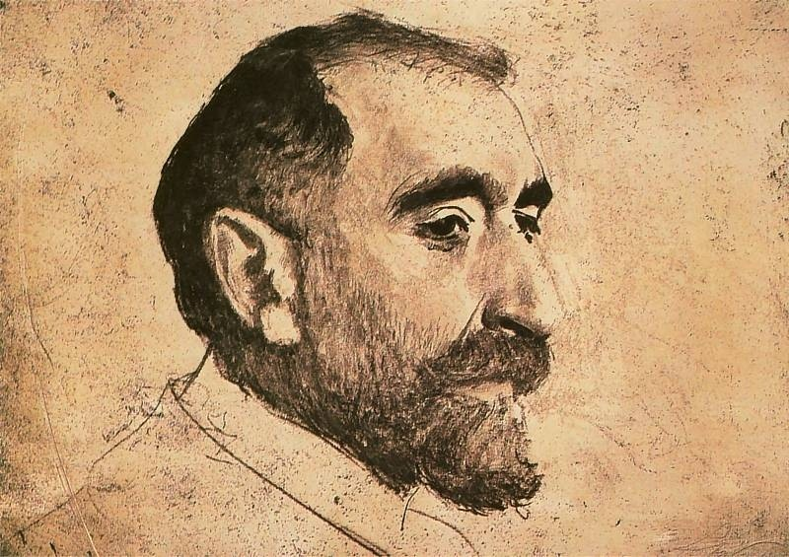
Teodor Axentowicz
On 13 May 1859 was born Teodor Axentowicz, a Polish-Armenian painter and university professor. A renowned artist of his times, he was also the rector of the Academy of Fine Arts in Kraków. As an artist, Axentowicz was famous for his portraits and subtle scenes of Hutsul life, set in the Carpathians.

Slide 11
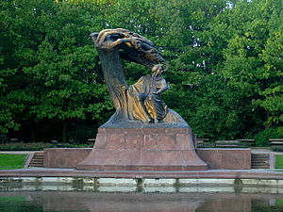
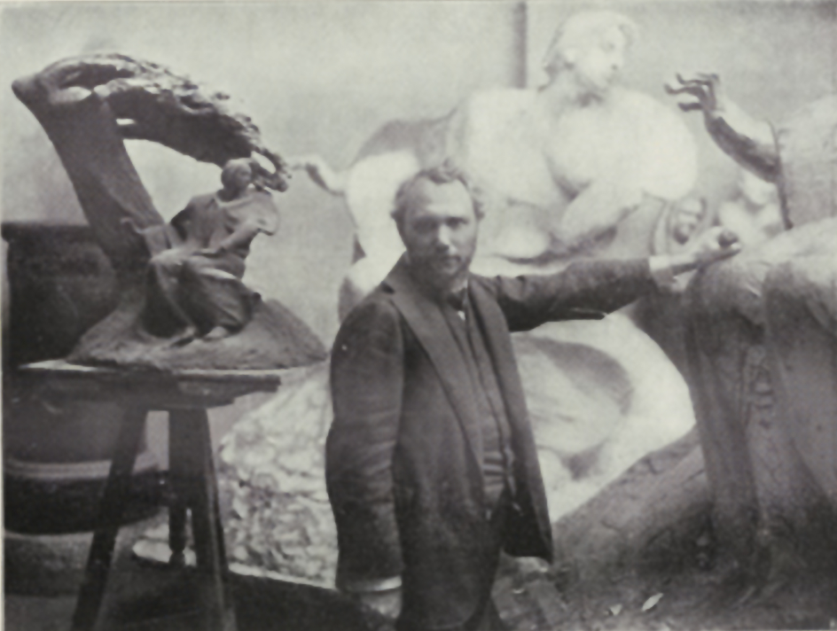
Wacław Szymanowski
On 23 August 1859 was born Wacław Szymanowski, a Polish sculptor and painter, best known for his statue of composer Fryderyk Chopin in Warsaw’s Royal Baths Park (Łazienki Park)

Slide 12
03
Important Events

Slide 13
A few dates from 1859
“Tygodnik Ilustrowany”
15.12
Ludwik Zamenhof
1.10
Monument of Adam Mickiewicz
Railway line (Stargard-Koszalin)
1.06
7.05
doctor and creator of esperanto language was born.
was published for the first time.
was put into service.
was unveiled in Poznań.

Slide 14
Thank you for your attention
Marysia Broncel IIE

Slide 15
Bibliographic References
Zygmunt Krasiński - Wikipedia
11175-Article Text-25614-1-10-20200504.pdf
Cyprian Norwid - Wikipedia
Zaklęty dwór – Wikipedia, wolna encyklopedia
Carrington Event - Wikipedia
Teodor Axentowicz - Wikipedia
Wacław Szymanowski - Wikipedia
Kalendarz dat | dzieje.pl - Historia Polski
1859 – Wikipedia, wolna encyklopedia

Slide 16
Resources
Photos
https://upload.wikimedia.org/wikipedia/commons/thumb/c/cb/Zygmunt_Krasi%C5%84ski_portrait.jpg/1200px-Zygmunt_Krasi%C5%84ski_portrait.jpg
https://upload.wikimedia.org/wikipedia/commons/b/bd/Cyprian_Kamil_Norwid_foto.jpg
https://1.bp.blogspot.com/-l8O0i9quJ-w/VuQxQXlvcpI/AAAAAAAADvY/JRpEYQ_MA3oHRz3ZwqQUGLik1EYExZzrg/s1600/178%2BZakl%25C4%2599ty%2Bdw%25C3%25B3r.jpg
https://ebilet-media.azureedge.net/media/8438/biel0848450.jpg
https://api.culture.pl/sites/default/files/styles/1920_auto/public/images/imported/sztuki%20wizualne/portrety/axentowicz%20teodor/axentowicz%20kolomyjka_4987898.jpg?itok=dGto9LuN
https://upload.wikimedia.org/wikipedia/commons/thumb/4/43/Wac%C5%82aw_Szymanowski_w_pracowni.jpeg/250px-Wac%C5%82aw_Szymanowski_w_pracowni.jpeg
https://upload.wikimedia.org/wikipedia/commons/thumb/9/99/Chopin_denkmal_wwa.jpeg/300px-Chopin_denkmal_wwa.jpeg

