Slide 1
Poland in 1908

Slide 2
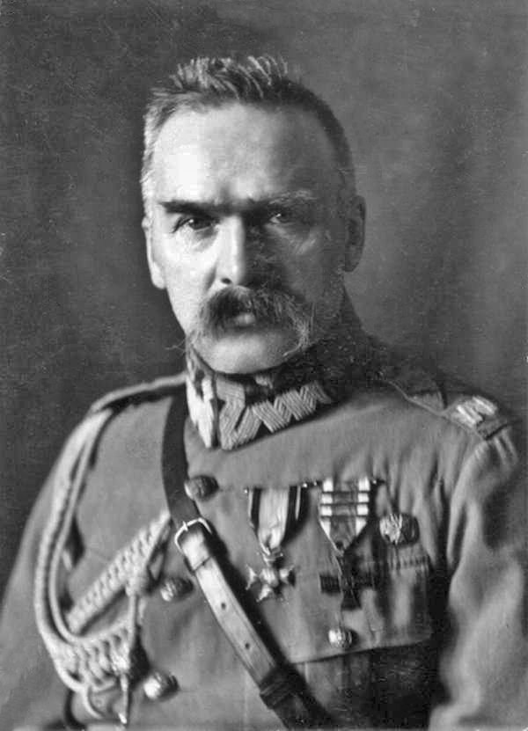
1.
September 26
In Bezdany near Vilnius, the PPS combat organisation led by Józef Piłsudski, carried out an action on the Russian postal wagon, where they get 200,000 rubles.

Slide 3
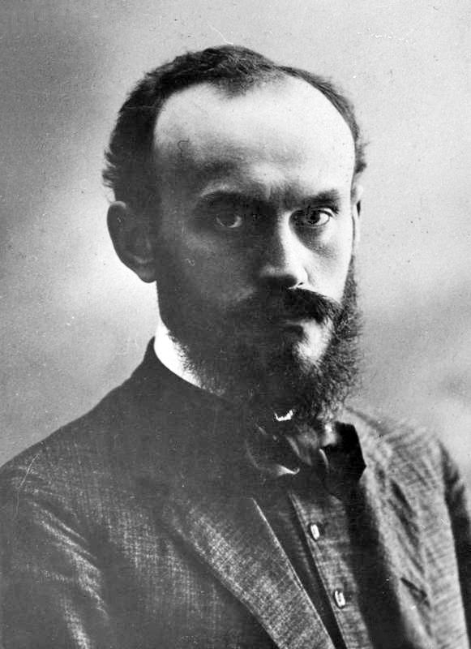
2.
October 09
In Warsaw on the slopes of the citadel, the tsarist authorities executed Józef Mirecki who was a member of PPS organisation.

Slide 4
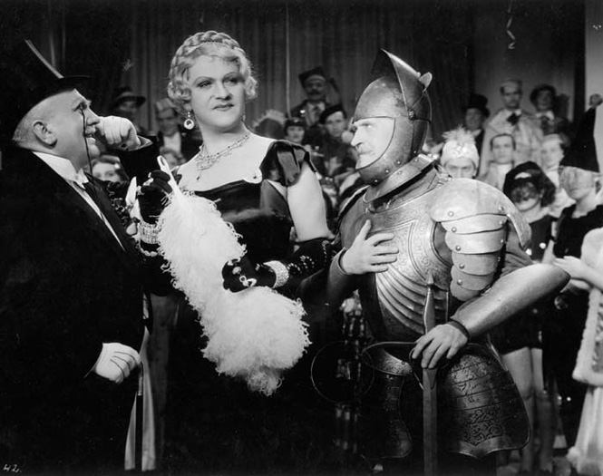
3.
October 22
Premiere of the film “Antoś po raz pierwszy w Warszawie”, directed by Jerzy Meyer

Slide 5
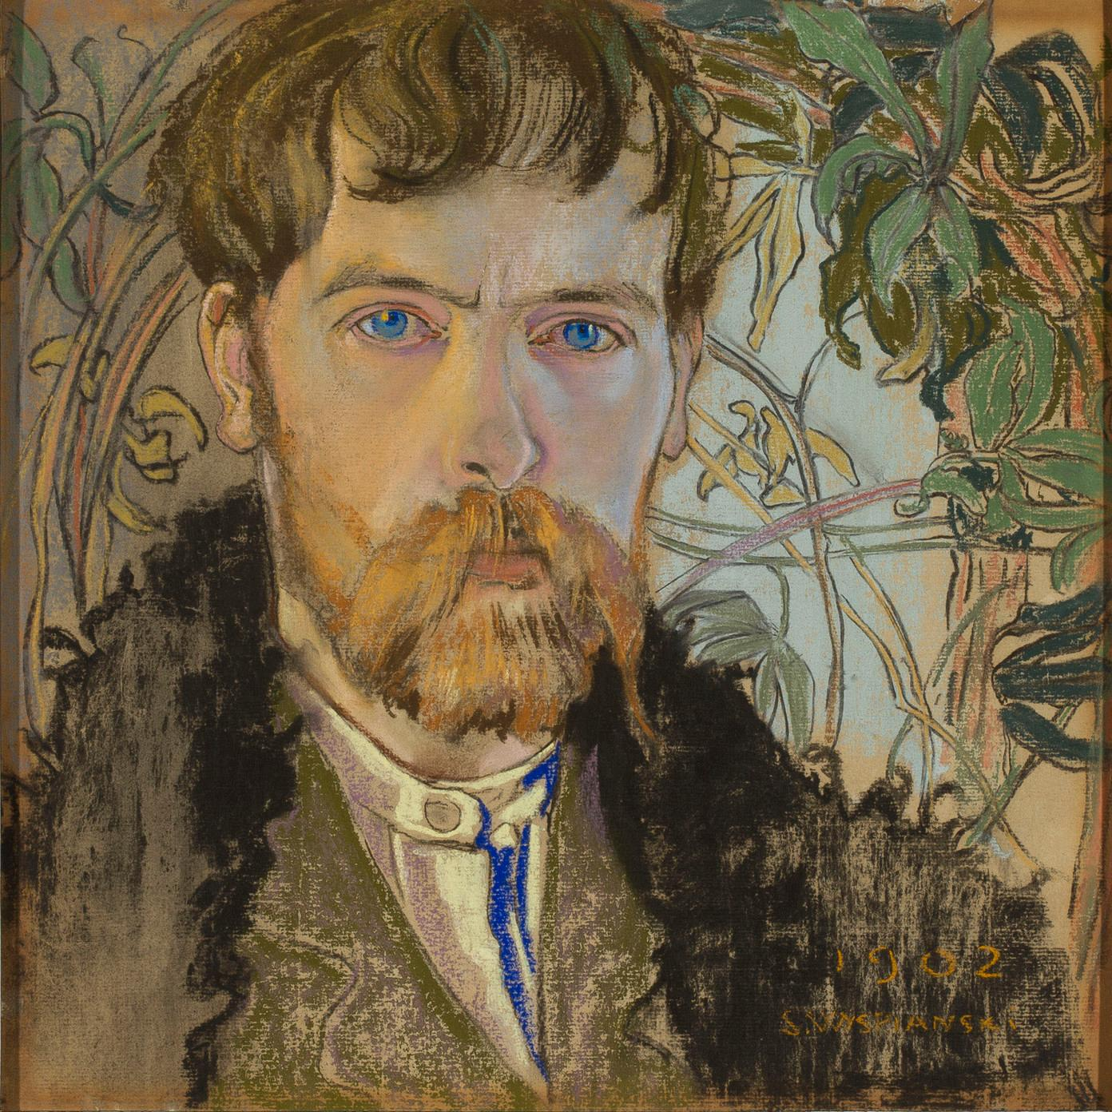
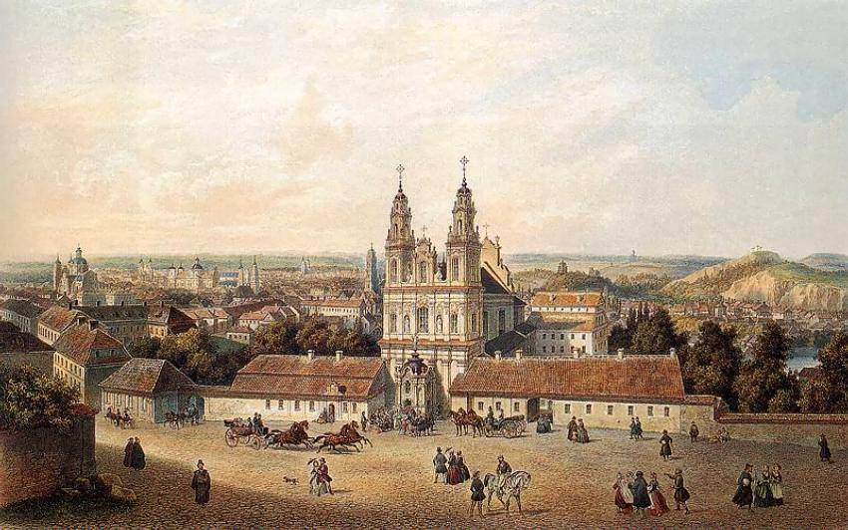
4.
The world premiere of Stanisław Wyspiański’ s “November Night” took place at the municipal theater in Kraków.

Slide 6
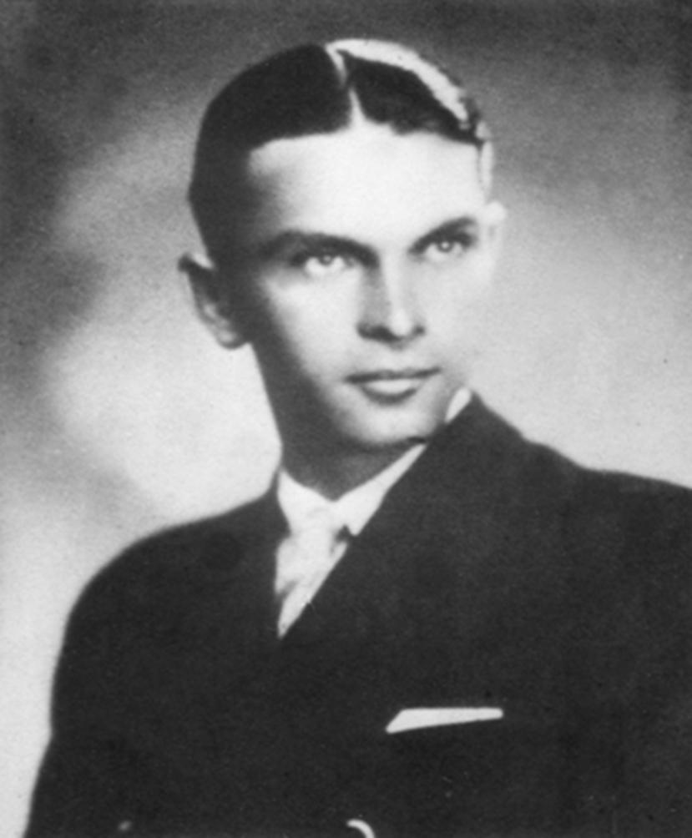
5.
December 14
In Warsaw was born Eugeniusz Lokajski - an athlete. In the 1930s he was one of the world’ s leading javelin throwers. He was an olympian in Berlin. He died in Warsaw Uprising.

Slide 7
6.
This year, a film “Prussian culture” was created, modeled on the present partitions.

Slide 8
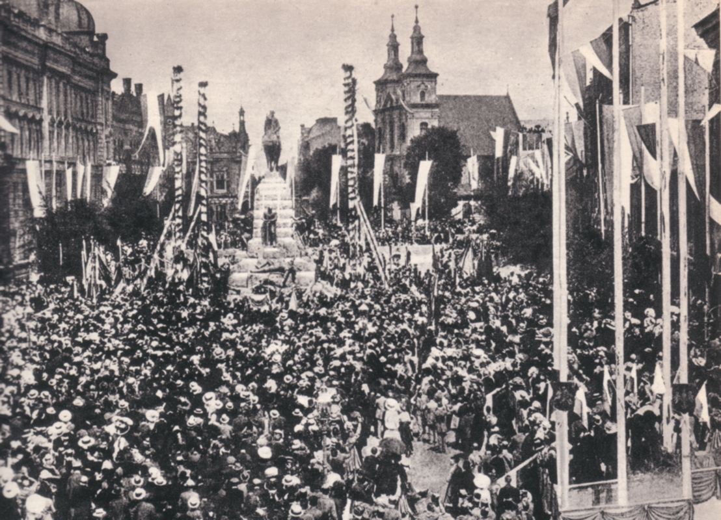
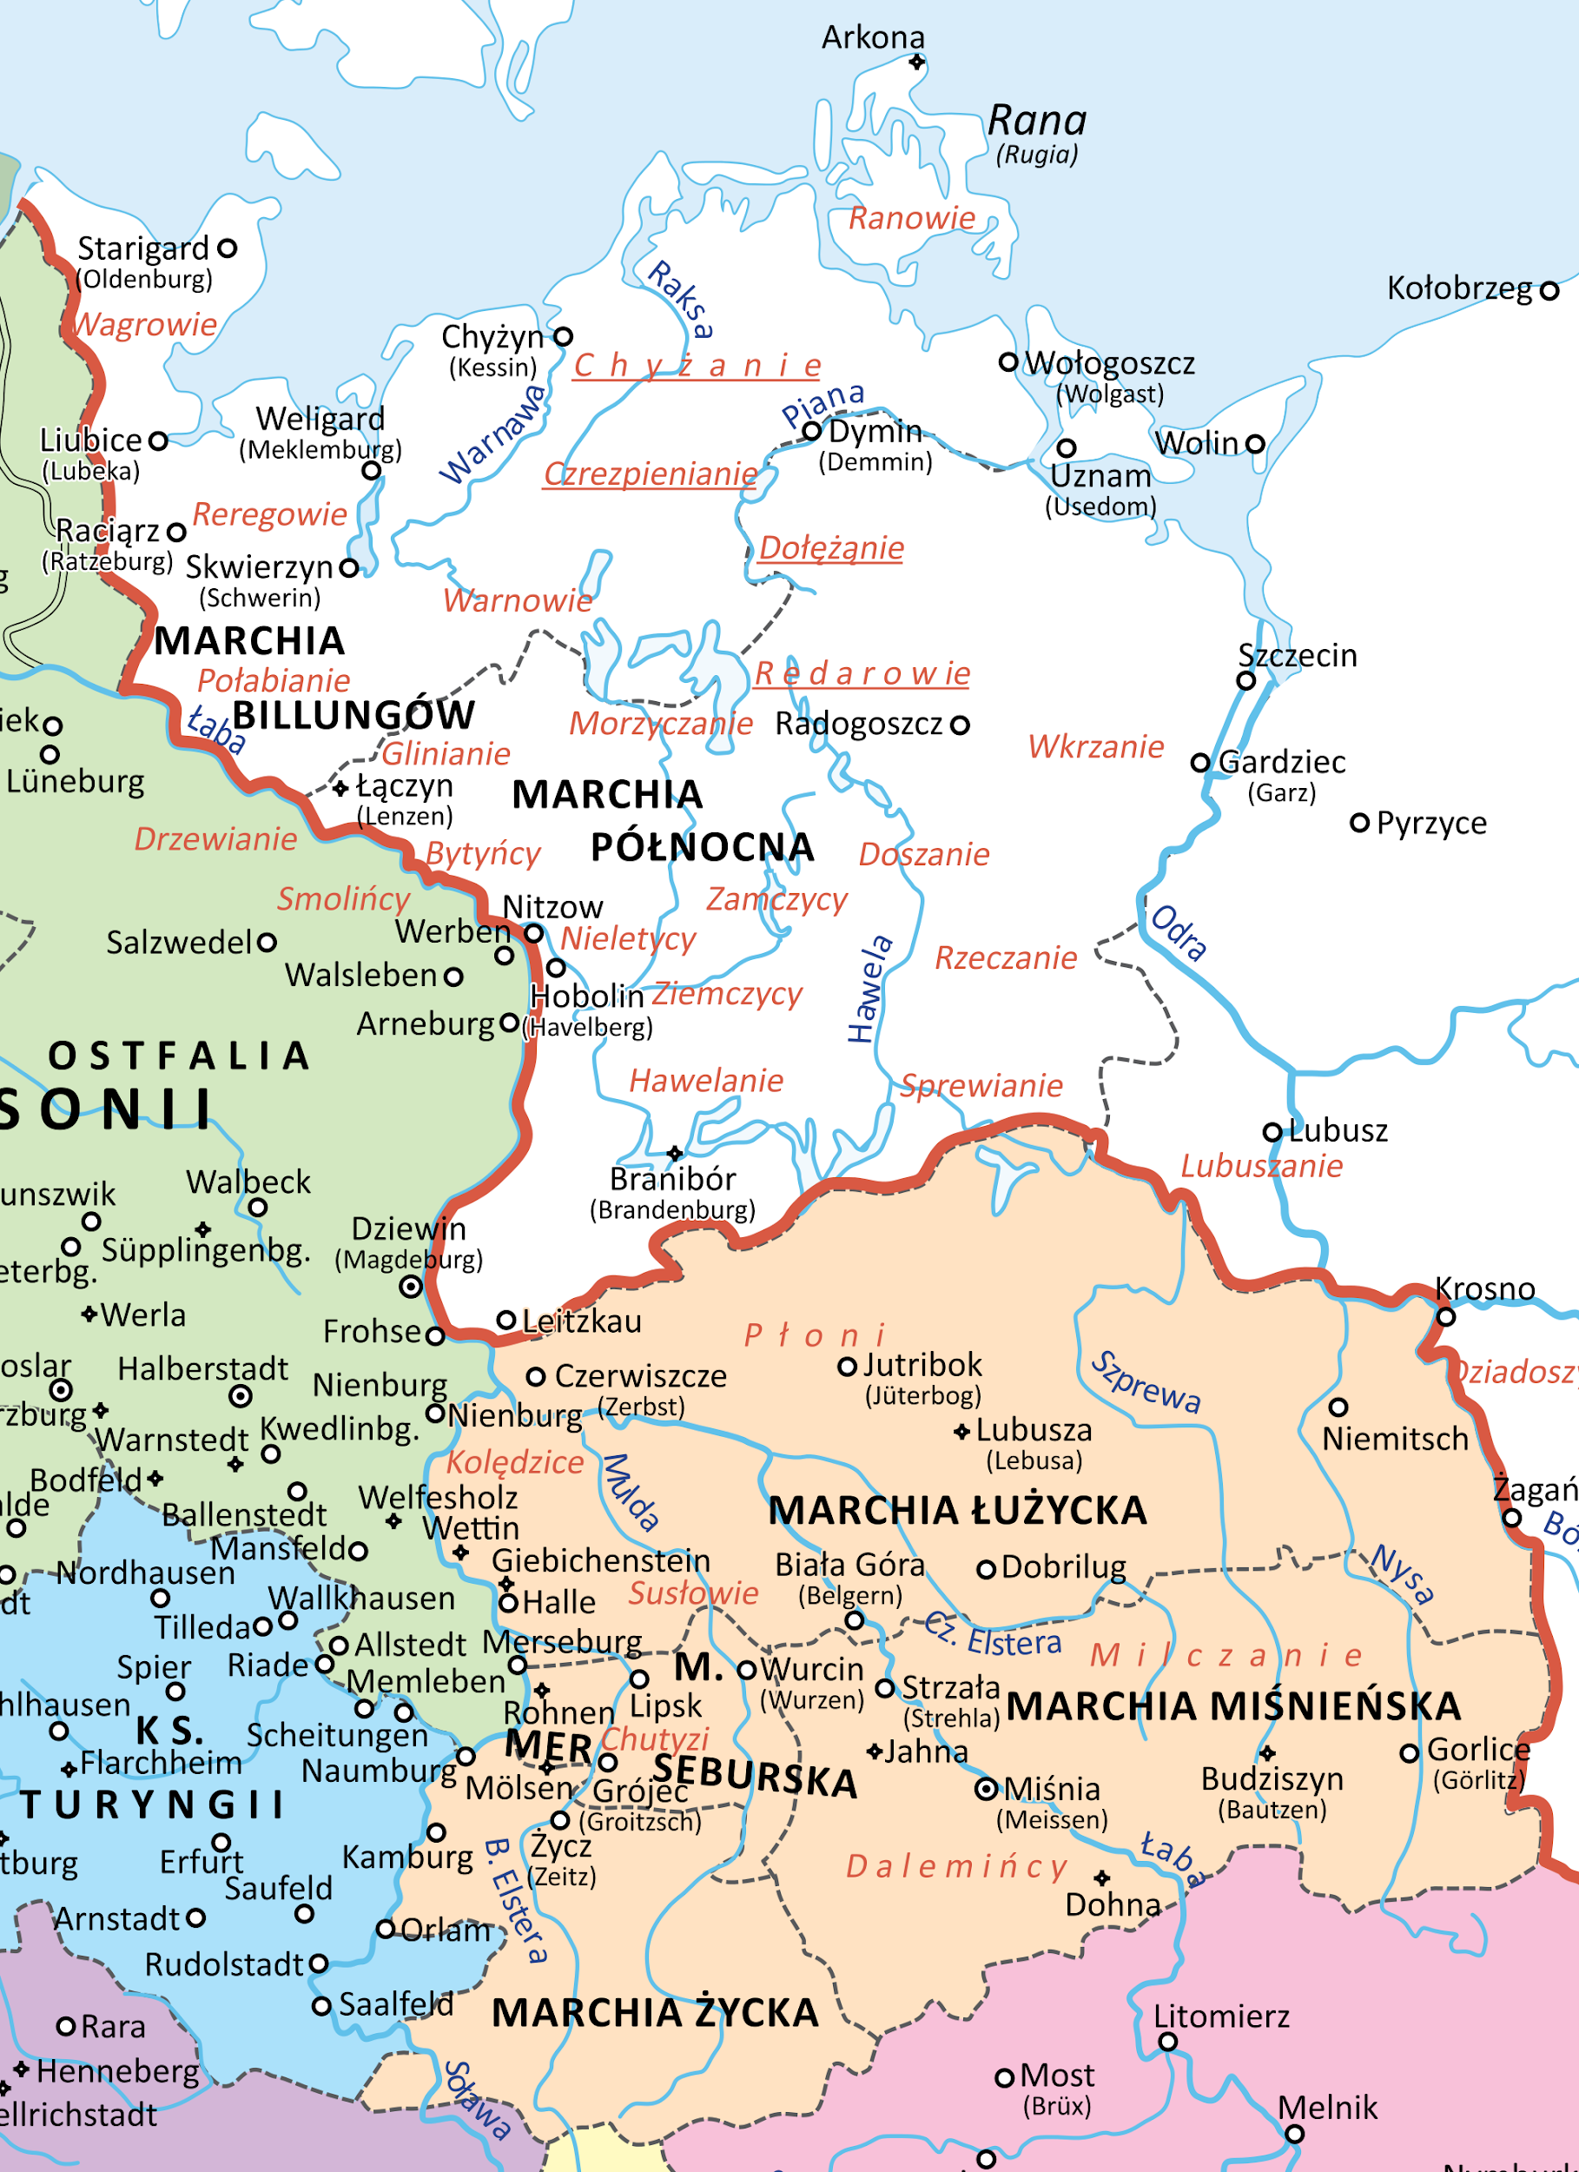
7.
The Prussian government issued the muzzle act which forbade the common using Polish language at meetings in places where are less 60% Polish people. It was a process of germanization.

Slide 9
Sources:
-https://dzieje.pl/kalendarz-dat/1908
-https://pl.wikipedia.org/wiki/Historia_Polski_(1831%E2%80%931914)
-https://sztetl.org.pl/en/glossary/germanizacja-na-ziemiach-polskich-w-xix-w

Slide 10
Thank you for your attention!!
Marcel Mikoda IIe

