Slide 1
The 1918 year
Politics, economy and art – all in one

Slide 2
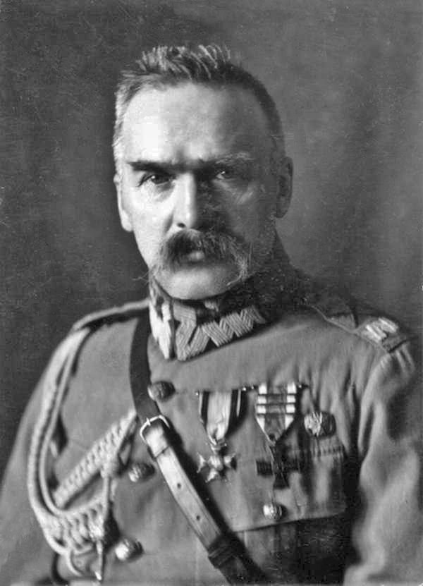
POLITICS
Poland regained independence
The First World War was ended
Józef Piłsudski was the head of state
There was still fights for the land
The beginning of the Polish – Bolshevik war
November 11 is the Polish Independence Day

Slide 3
ECONOMY
Poverty caused by war
The Spanish flu epidemic
Inflation has occurred
Development of private plants
Śląsk and Wielkopolska were the most economically developed

Slide 4
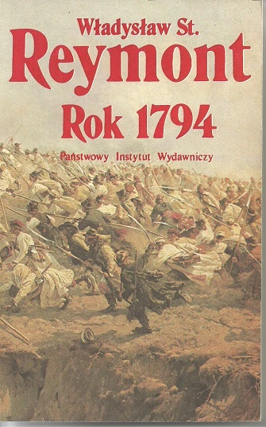
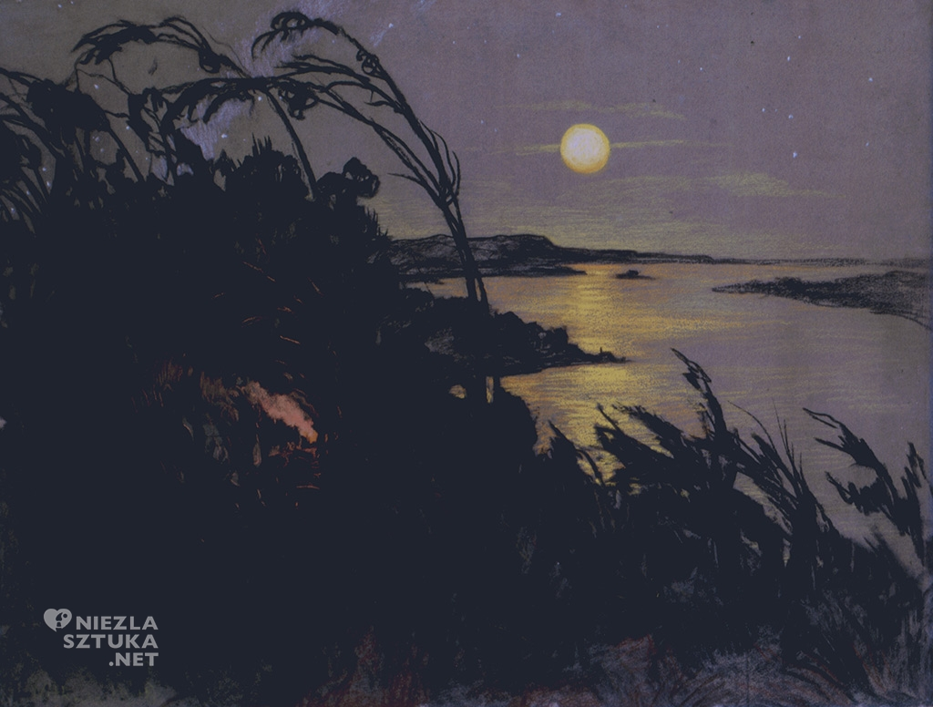
ART
The literary works were created by, among others, Maria Dąbrowska, Władysław Reymont, Witold Gombrowicz, Stefan Żeromski and Witkacy
In 1918, Witkacy created the concept of Pure Form and lots of paintings
Famous poets such as Julian Tuwim, Leopold Staff and Jan Brzechwa

Slide 5
Thank you for your attention!
Karolina Gryl
Agata Kaczmarzyk
Aleksandra Kłósek

