Slide 1
Year- 1913
Tymoteusz Czelakowski and Aleksander Drosik

Slide 2
Table of contents
1913 in fine arts
Polish annexations
Opening of the Polish theater in Warsaw
OPENING OF THE CITY MUSEUM IN SZCZECIN
ONE OF THE FIRST AVIATION DISASTERS IN EUROPE
SPLIT OF THE PSL

Slide 3
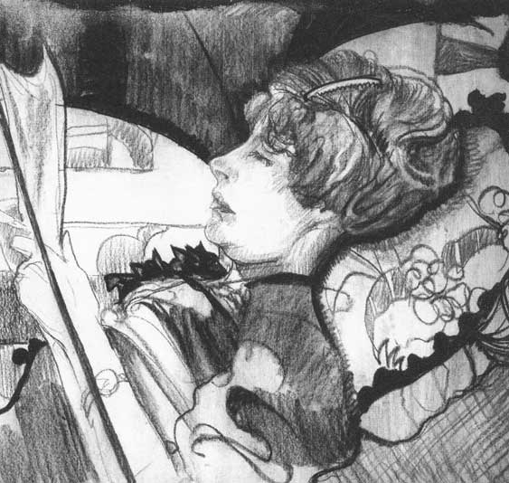
1913 in fine arts
Stanisław Ignacy Witkiewicz
Udzielny BYK na urlopie, portret Leon Chwistek
Furia Adormentata

Slide 4
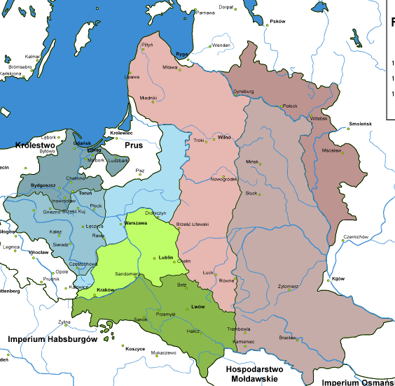
Polish annexations
From 1795, Poland was under the annexation of three neighboring countries: Russia, Prussia, and Austria.
It lasted until 1918, which gives the number of 123 years of the lack of independence, however, as a nation, Poland continued to operate and develop.

Slide 5
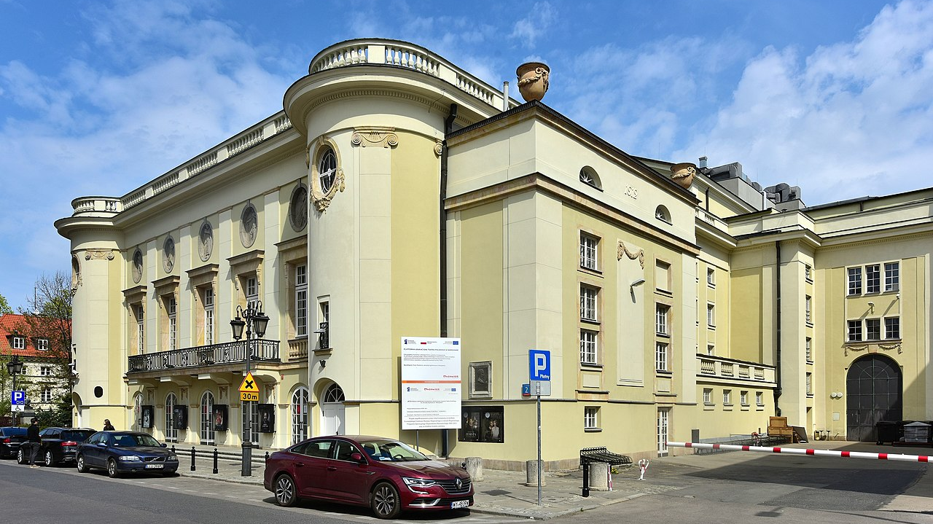
Opening of the Polish theater in Warsaw
Irydion Zygmunt Krasiński was staged at the opening of the Polish Theater in Warsaw; the director was Arnold Szyfman, and the leading actors of the Polish scene of that time also performed - Jerzy Leszczyński, Józef Węgrzyn …

Slide 6
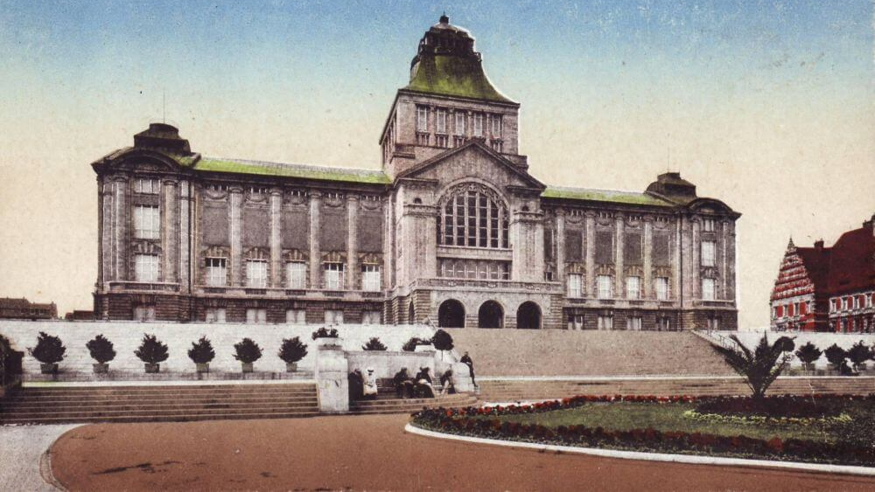
OPENING OF THE CITY MUSEUM IN SZCZECIN
On June 23, 1913, the City Museum in Szczecin was opened

Slide 7
ONE OF THE FIRST AVIATION DISASTERS IN EUROPE
September 4, 1913. During the maneuvers related to the 100th anniversary of the war in 1813, in the town of Gać 5 km from Oława in Lower Silesia, two pilots of the German army died.

Slide 8
SPLIT OF THE PSL
On December 13, 1913, the PSL split between PSL "Piast" and PSL "Lewica"

Slide 9
SOURCES
-wikipedia

Slide 10
THANK YOU FOR ATTENTION

