Slide 1
1910-1913

Slide 2
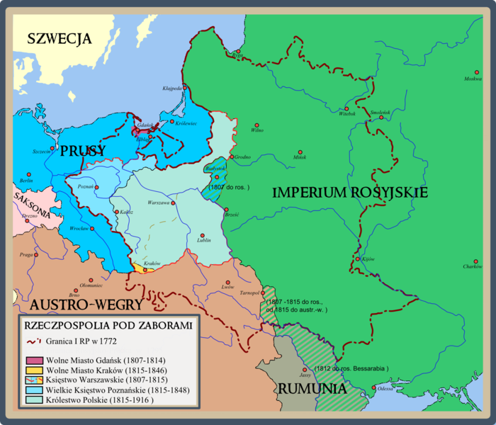
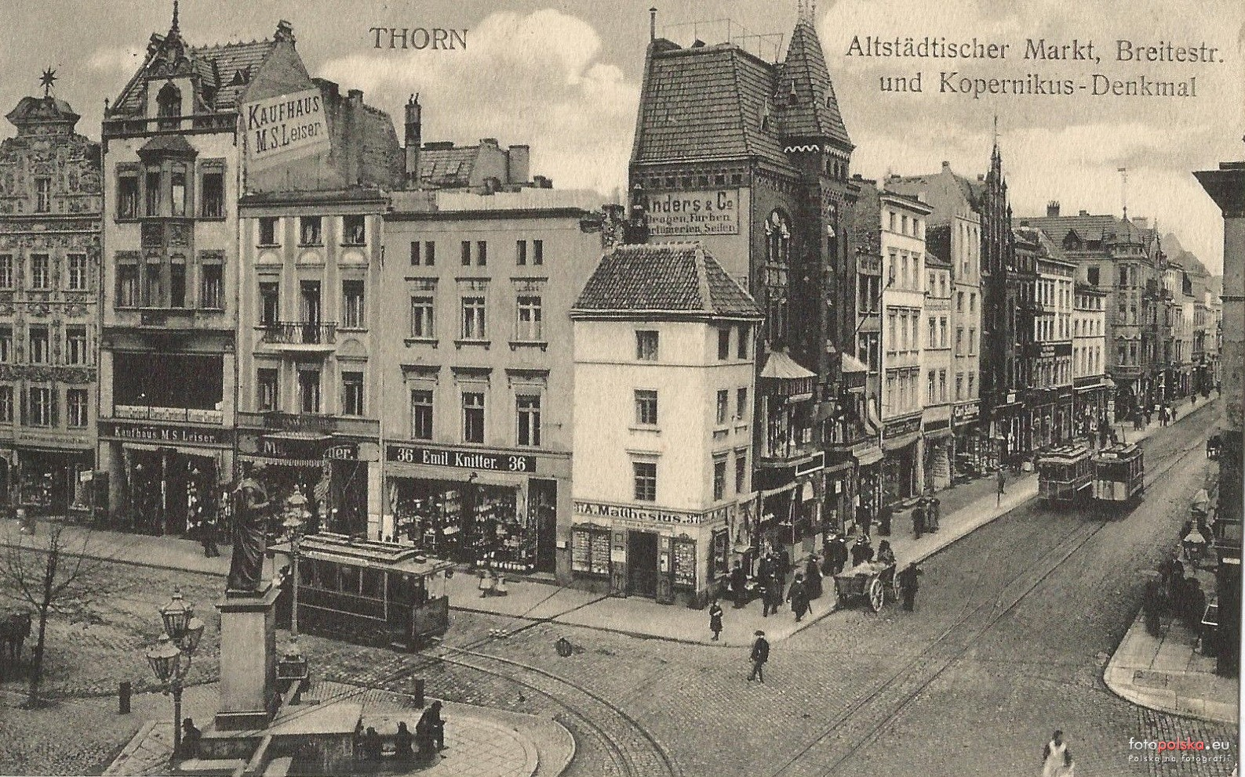
Indeed Poland wasn’t free country then. We were still occupied by Germany but Poland was in Our dreams, culture and traditions. In this time was epoch called “Młoda Polska” (Young Poland).

Slide 3
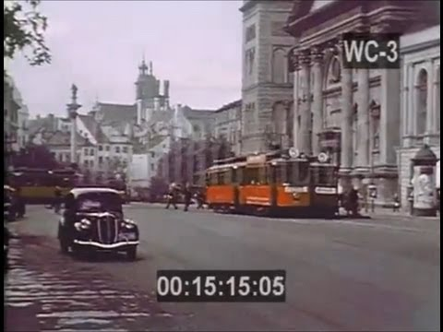

Slide 4
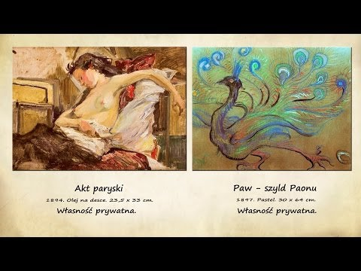
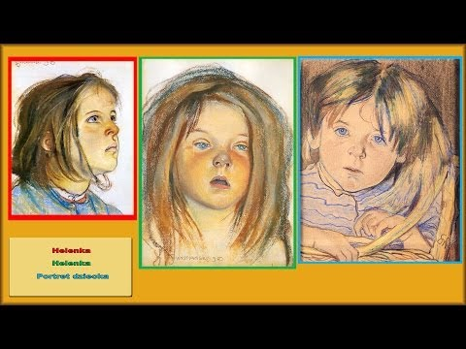
Stanisław Wyspiański
Then appeared paintings of Stanisław Wyspiański, like “macierzyństwo” and “portret dziewczynki”, (motherhood, portrait of the girl) and his books like “wesele” and “warszawianka”.

Slide 5
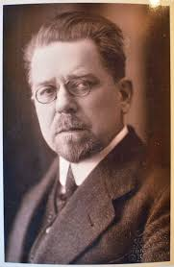
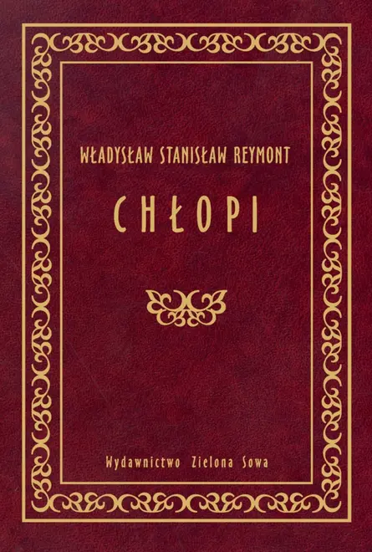
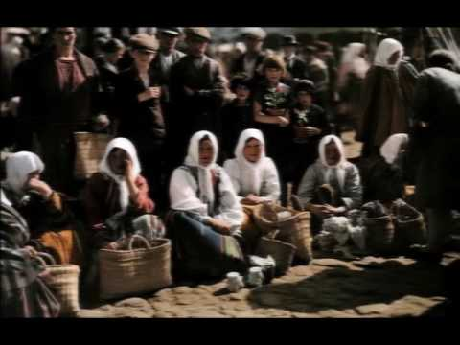
Władysław Reymont
The next person is Władysław Reymont- polish noblist. He won these prize by novel-”Chłopi”. Book was filmed in 1973 and that’s famous music from this movie.

Slide 6
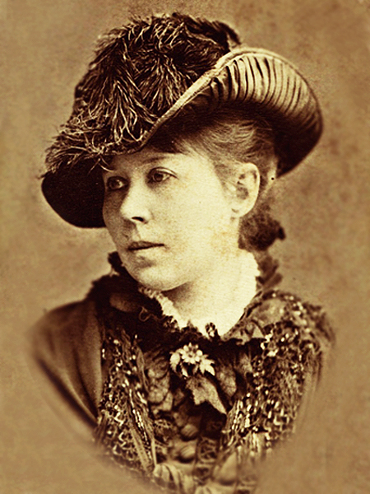
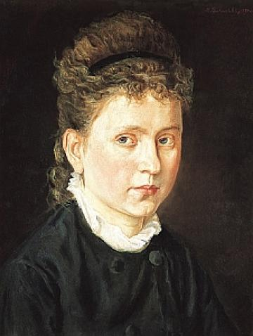
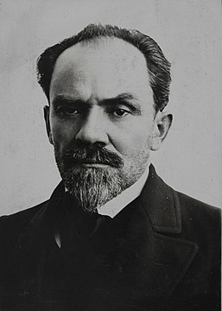
1910
In 1910 have died two important for Polish people writers-1)Maria Konopnicka and 2)Eliza Orzeszkowa.
3)Stefan Żeromski-famous writer- wrote novel “sułkowski” in 1910.
1
2
3

Slide 7
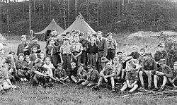
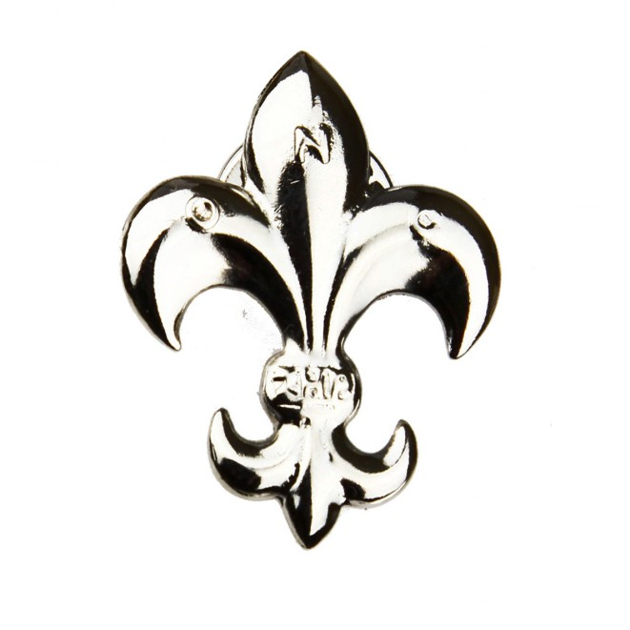
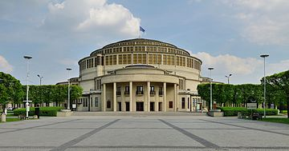
1913
Opening ceremony of Hala Stulecia (Hall of the century) - symbol once of the biggest polish cities - Wrocław.
In this year in Poland appear Harcerze (polish form of skauting). It were teenagers who wanted created free Poland, they learnet patriotic songs, polish history and traditions.
symbol of Harcerstwo

Slide 8
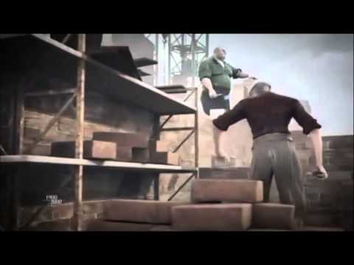
History of Poland in XX century

