Slide 1
Year 1889

Slide 2
Table of Contents
Poland suppressed by annexations
Henryk Sienkiewicz and Bolesław Prus, great Polish writers
The first surgeon's meeting in Poland
Jan Matejko and the art of his brush
Bibliography

Slide 3
Poland suppressed by annexations

Slide 4
Polish annexations
From 1795, Poland was under the annexation of three neighboring countries: Russia, Prussia, and Austria.
It lasted until 1918, which gives the number of 123 years of the lack of independence, however, as a nation, Poland continued to operate and develop.

Slide 5
Henryk Sienkiewicz and Bolesław Prus, great Polish writers

Slide 6
Henryk sienkiewicz
Henryk Adam Aleksander Pius Sienkiewicz's Polish novelist and journalist; Nobel laureate in the field of literature for the whole of the creative career, one of the most popular Polish writers of the 19th and 20th centuries
b. May 5, 1846 d. November 15, 1916

Slide 7
Bolesław Prus
Bolesław Prus, in fact, Aleksander Głowacki of the Prus coat of arms - Polish writer, prose writer, novelist and columnist of the period of positivism, co-creator of Polish realism, chronicler of Warsaw, thinker and popularizer of knowledge, social activist
b. August 20, 1847 d. May 19, 1912

Slide 8
The first surgeon's meeting in Poland

Slide 9
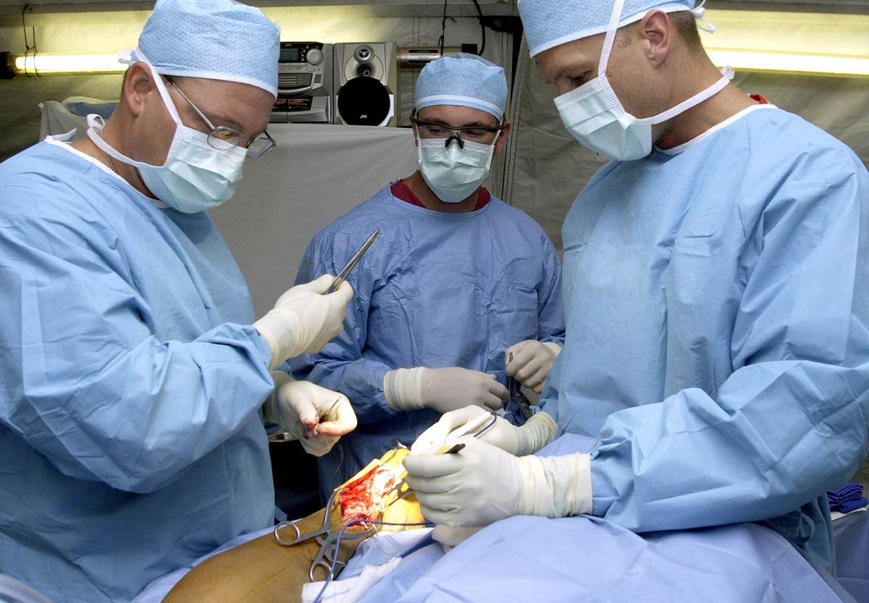
Meeting of surgeons in Poland
It took place in 1889 and was the first one in Poland. It was an important thing for the Polish culture because of the difficult political situation at this time.

Slide 10
Jan Matejko and the art of his brush

Slide 11
Jan Matejko
Jan Alojzy Matejko - Polish painter, creator of historical and battle paintings, historiosophy. He was the author of over three hundred oil paintings and several hundred drawings and sketches.
b. June 24, 1838 d. November 1, 1893

Slide 12
Paintings of Jan Matejko
Battle of Grunwald
Astronomer Copernicus, conversation with God

Slide 13
The end

Slide 14
Bibliography
https://upload.wikimedia.org/wikipedia/commons/thumb/3/38/Jan_Matejko%2C_Bitwa_pod_Grunwaldem.jpg/1024px-Jan_Matejko%2C_Bitwa_pod_Grunwaldem.jpg
https://upload.wikimedia.org/wikipedia/commons/thumb/8/88/Jan_Matejko-Astronomer_Copernicus-Conversation_with_God.jpg/1024px-Jan_Matejko-Astronomer_Copernicus-Conversation_with_God.jpg
https://pl.wikipedia.org/wiki/Ziemie_polskie_pod_zaborami
https://pl.wikipedia.org/wiki/Boles%C5%82aw_Prus
https://pl.wikipedia.org/wiki/Henryk_Sienkiewicz
https://pl.wikipedia.org/wiki/1889
https://pl.wikipedia.org/wiki/Jan_Matejko
https://en.wikipedia.org/wiki/Boles%C5%82aw_Prus
https://en.wikipedia.org/wiki/Henryk_Sienkiewicz
https://en.wikipedia.org/wiki/Jan_Matejko

