Slide 1
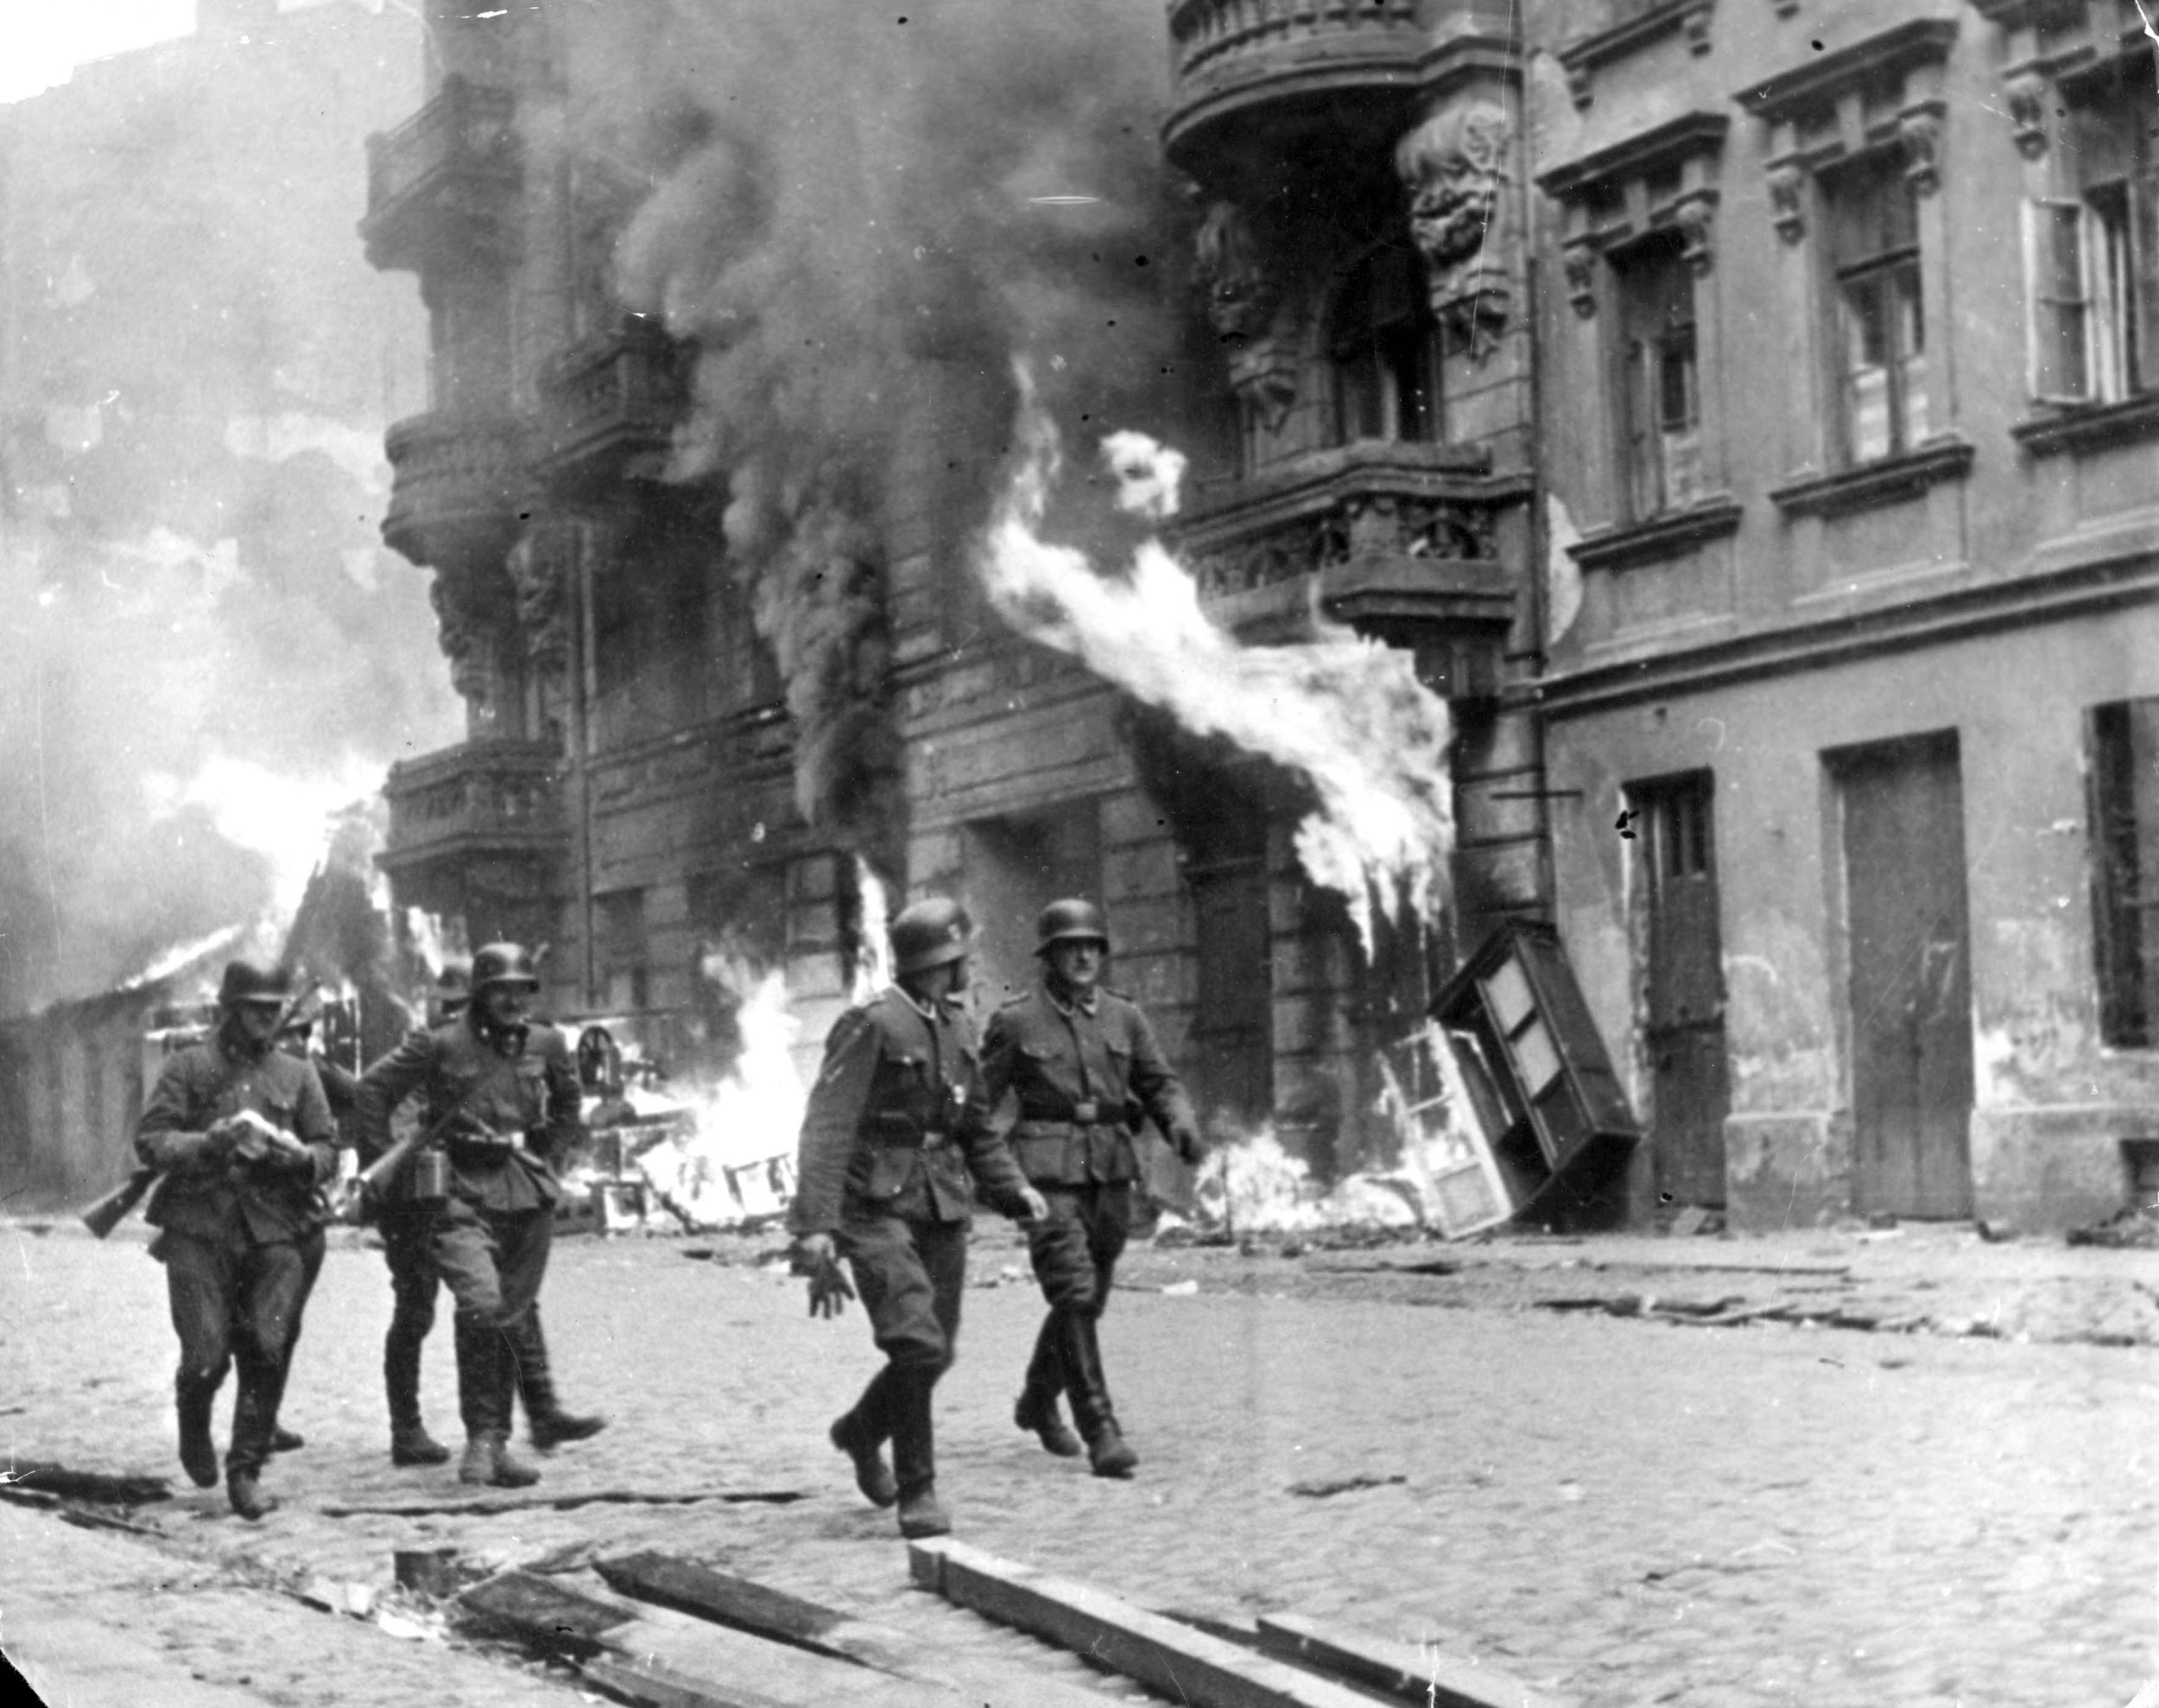
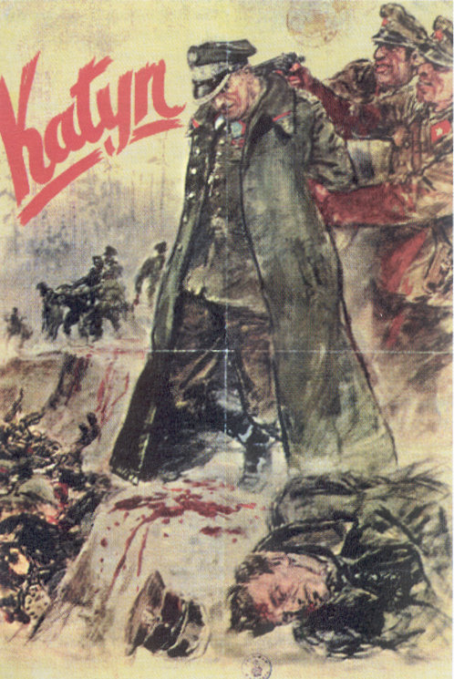
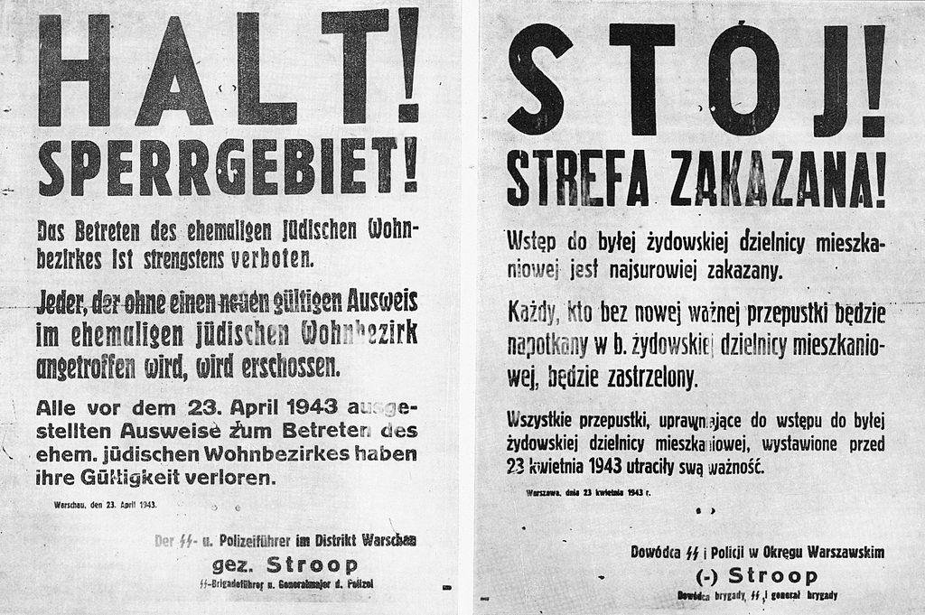
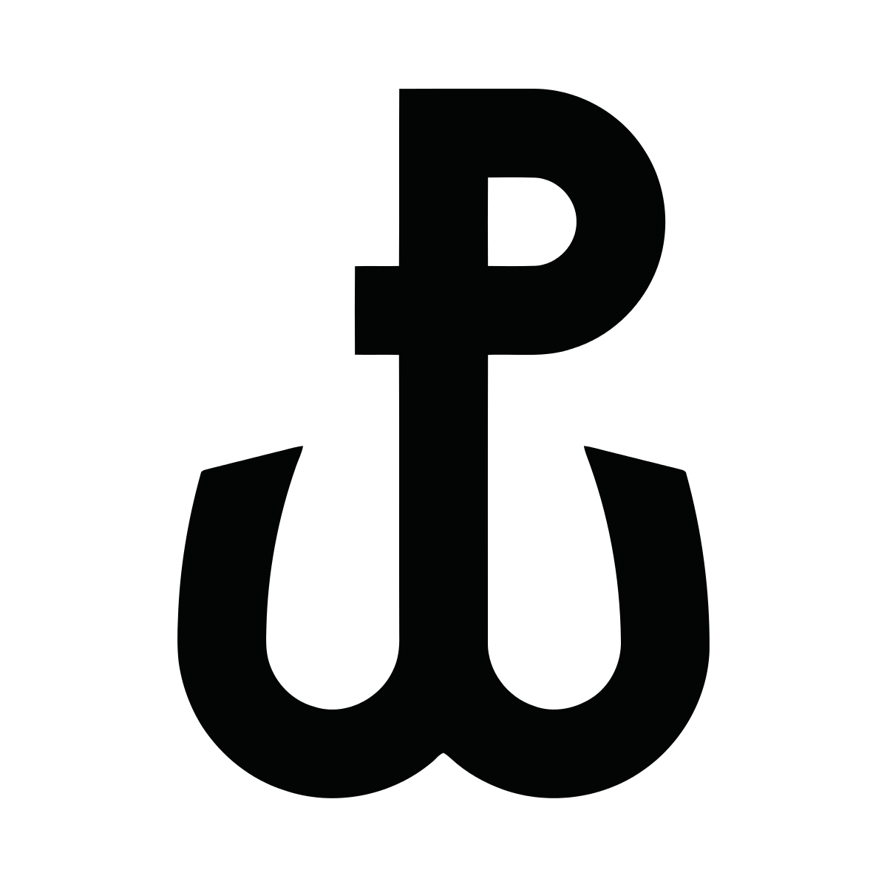
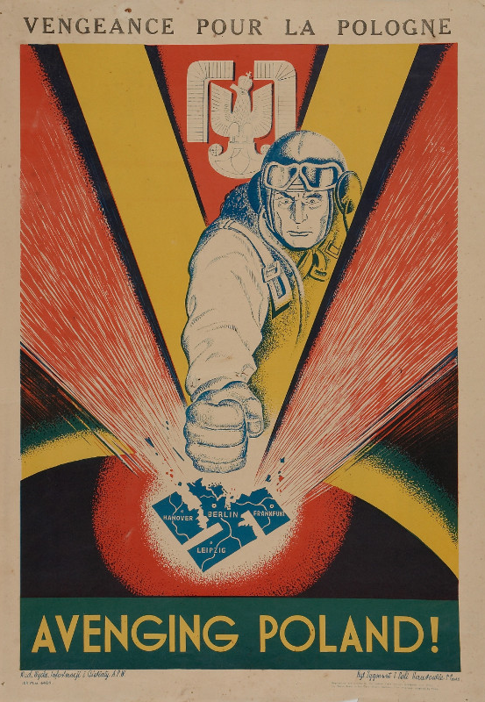
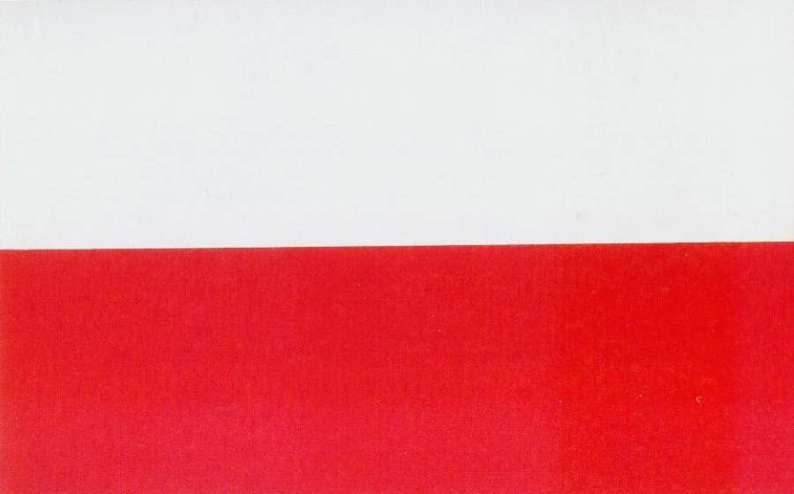
Poland
in 1943

Slide 2
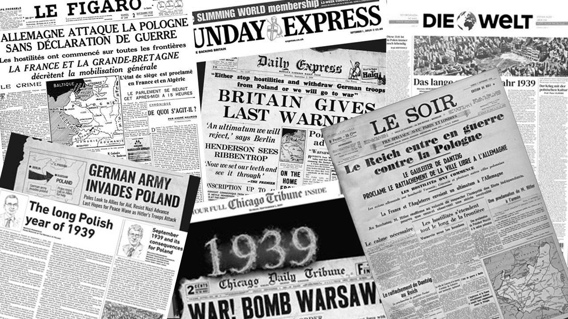
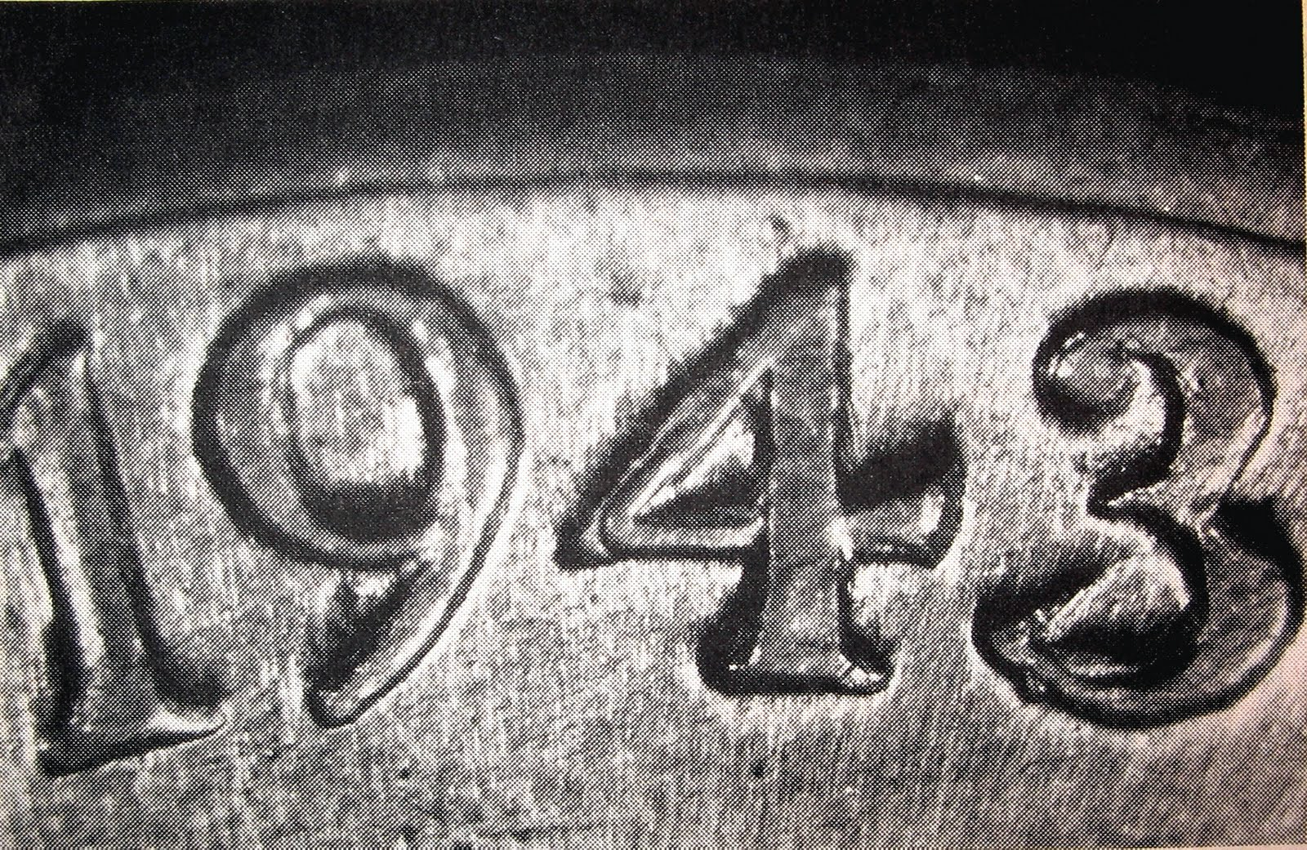
Table of Contents
Introduction - World War II
Warsaw Ghetto Uprising
Operation Arsenal
Volhynian Massacre
Culture (Censorship and propaganda, Destruction, Underground, Religion)

Slide 3
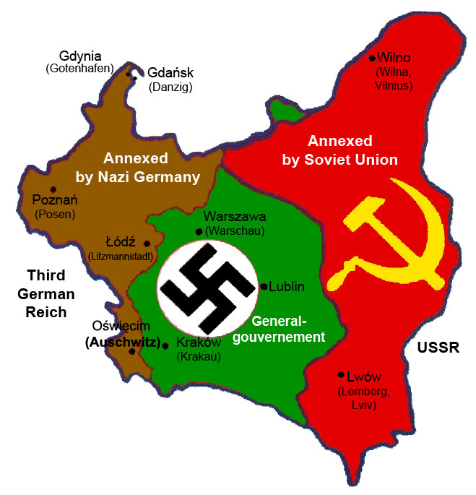
Introduction
Political situation during World War II
The history of Poland from 1939 to 1945 includes the occupation of Poland by Nazi Germany and the Soviet Union. Many od Nazi concentration camps were in Poland, including one of the largest and most infamous Auschwitz (Oświęcim).
The Nazis aimed for the complete germanization - full cultural, political, economic and social assimilation. Polish people were controlled in many ways, but they never stopped fighting the occupiers. They started several underground formations such as Armia Krajowa.
Around 6 million Polish citizens—nearly 21.4% of Poland's population died as a result of the occupation.

Slide 4
The most important events

Slide 5
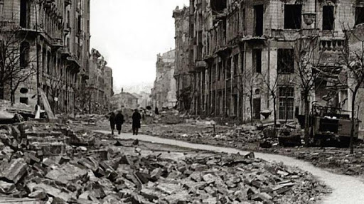
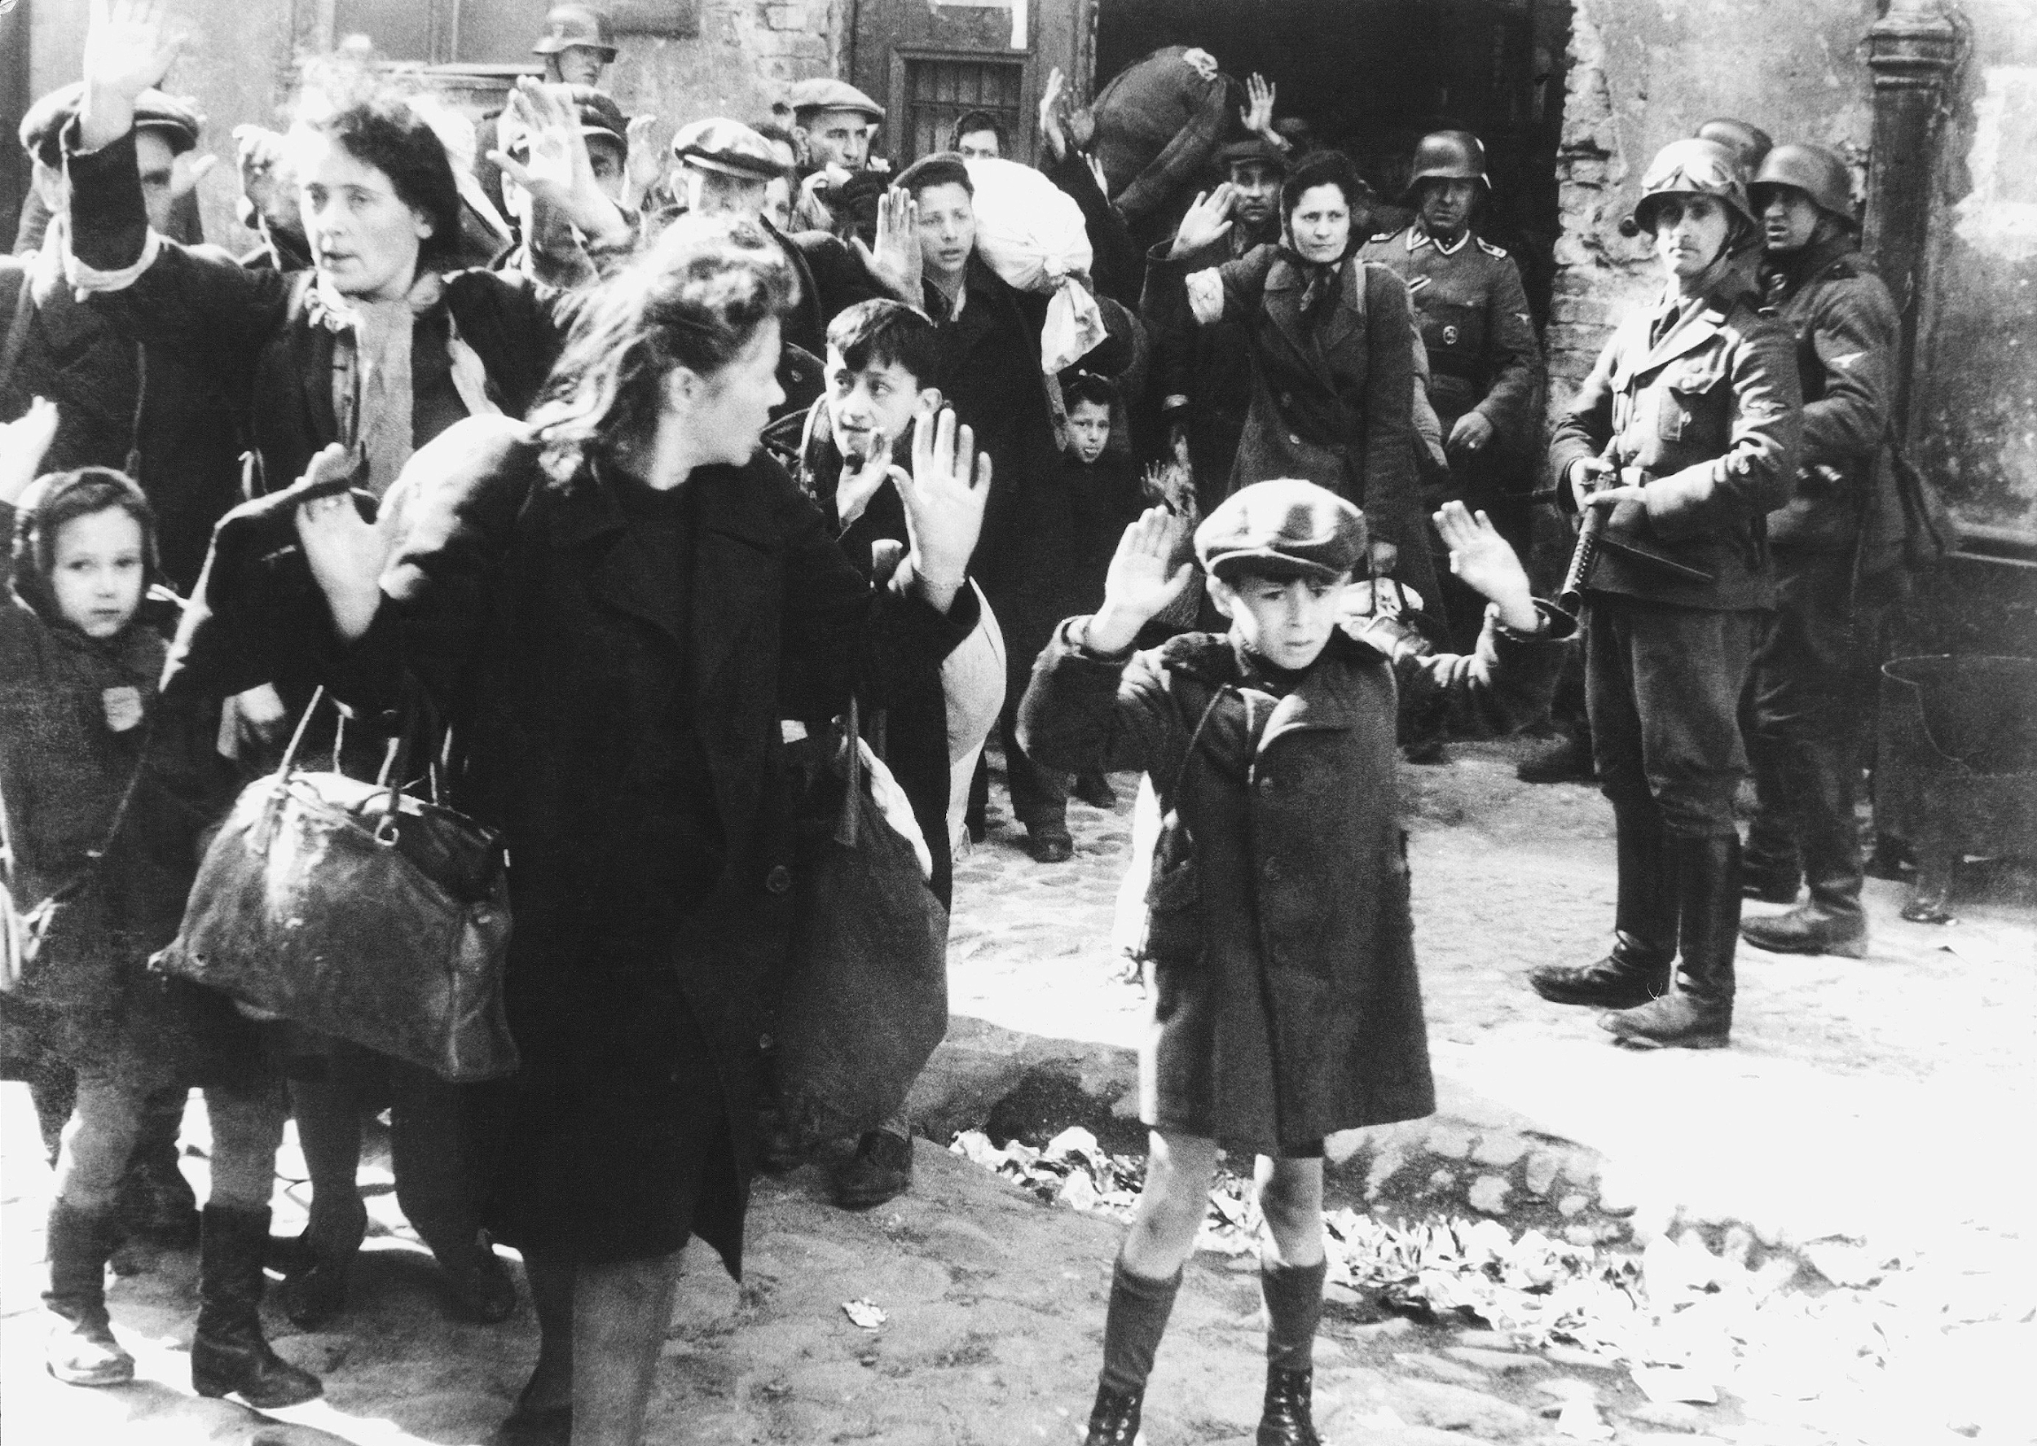
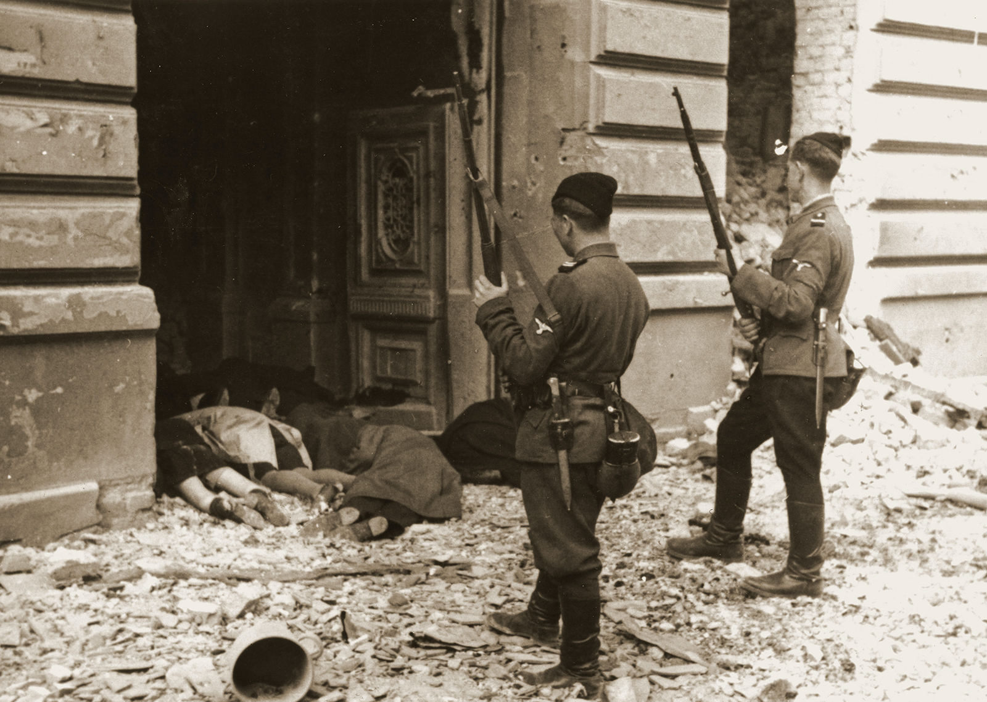
19th April – 16th May 1943
Warsaw Ghetto Uprising
It all started in 1942 when the German authorities deported or murdered around 300 000 Jews in the Warsaw ghetto. More than 250 000 Jews were deported to the Treblinka Killing Center.
In response to the deportations several Jewish underground organizations created an armed self-defense units known as the “Żydowska Organizacja Bojowa” (Jewish Combat Organization) and “Żydowski Związek Wojskowy” (Jewish Military Union).
The uprising started on 19th April when the ghetto refused to surrender to the police commander, who ordered the burning of the ghetto, block by block, ending on 16th May. A total of 13 000 Jews died, about half of them burnt alive or suffocated. It was the largest single revolt by Jews during World War II. Although the Jews knew that the uprising was doomed and their survival was unlikely, they still didn’t surrender and tried to fight their enemies.

Slide 6
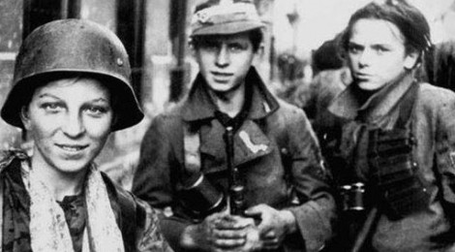
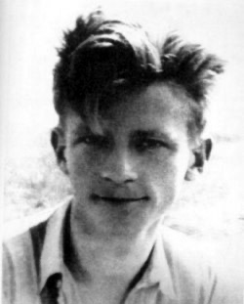
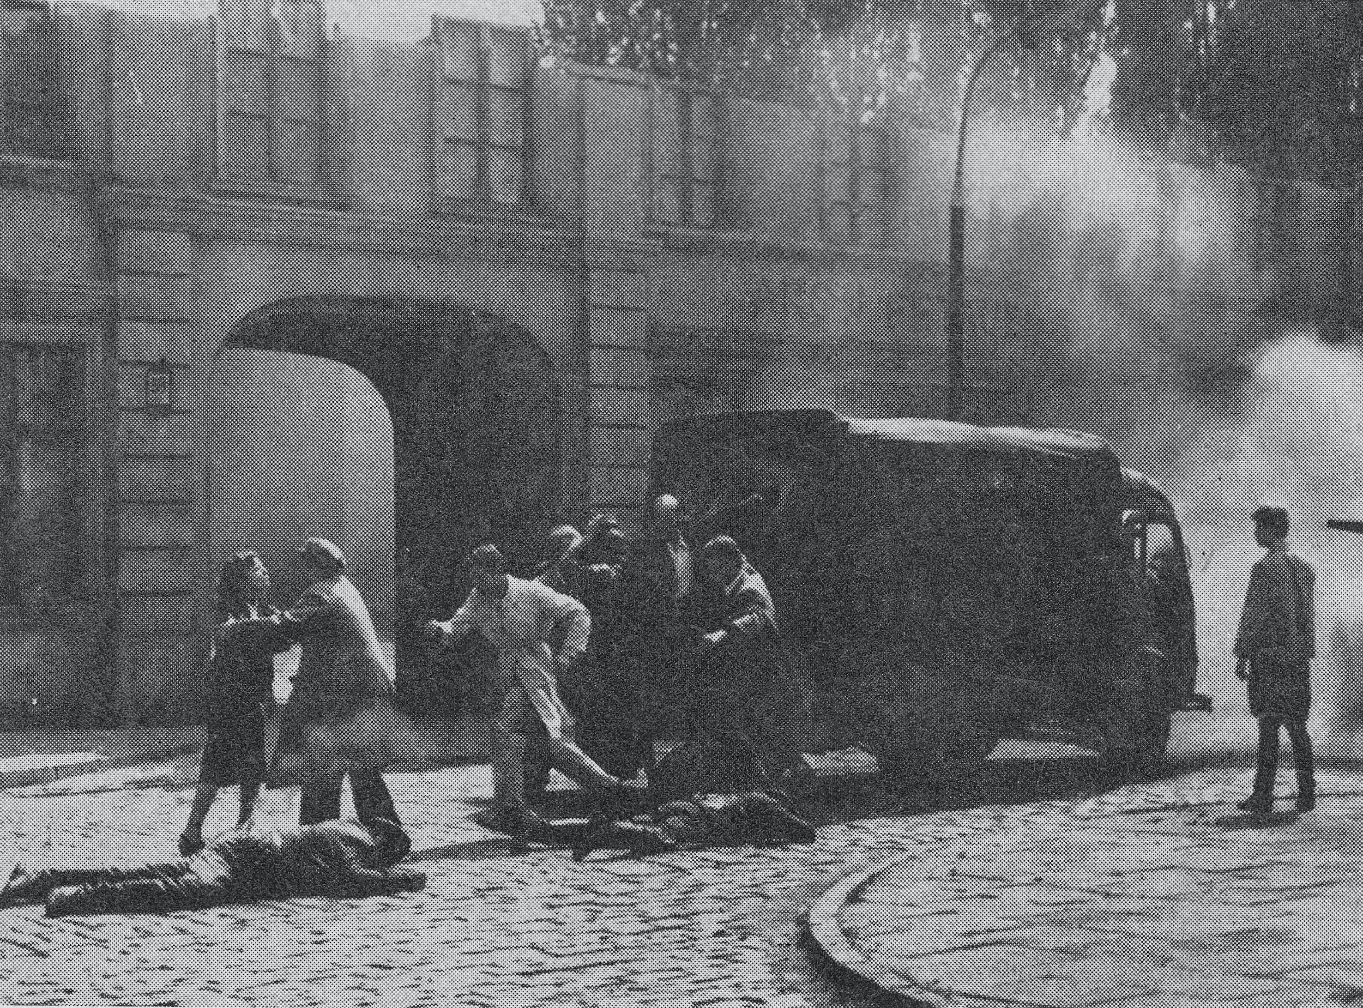
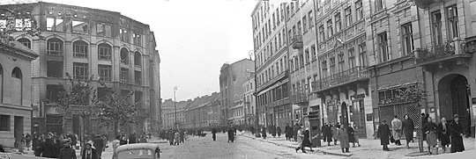
26th March 1943
Operation Arsenal
Polish Underground formation during the Nazi occupation of Poland
In 1943 “Szare Szeregi” (Gray Ranks) prepared several actions against German. The Operation Arsenal was the first major one. It took place on 26th March in Warsaw. The plan was to free the troop leader Jan Bytnar "Rudy" (Ginger), who was arrested together with his father by the Gestapo. The operation succeeded and led to the release of Jan Bytnar and 24 other prisoners in an attack on the prison van that was taking the inmates from Pawiak Prison to Gestapo Headquarters.
Jan Bytnar was a scoutmaster, a member of Szare Szeregi. He died four days after the action on account of injuries sustained due to tortures.

Slide 7
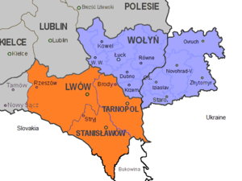
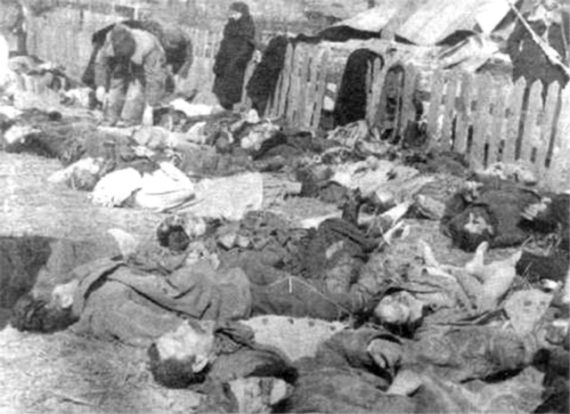
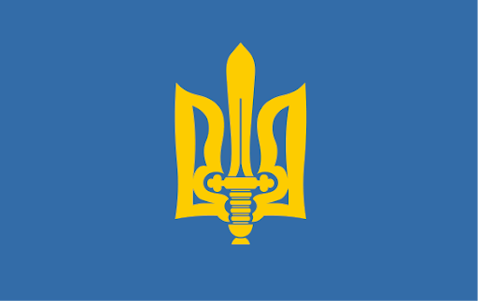
11th July 1943
Volhynian Massacre
Ukrainian nationalists conducted anti-Polish genocidal ethnic cleansings. They took place within Poland’s borders, and not only in Volhynia, but also in other areas with a mixed Polish-Ukrainian population
The violence reached its peak on 11th July in 1943 known to many Poles as “Bloody Sunday” when the UPA carried out attacks on 100 Polish villages in Volhynia. The Volhynian Massacre is considered as a genocide. Most of the victims were women and children. The UPA's actions resulted in between 50 000 and 100 000 deaths.

Slide 8
Culture

Slide 9
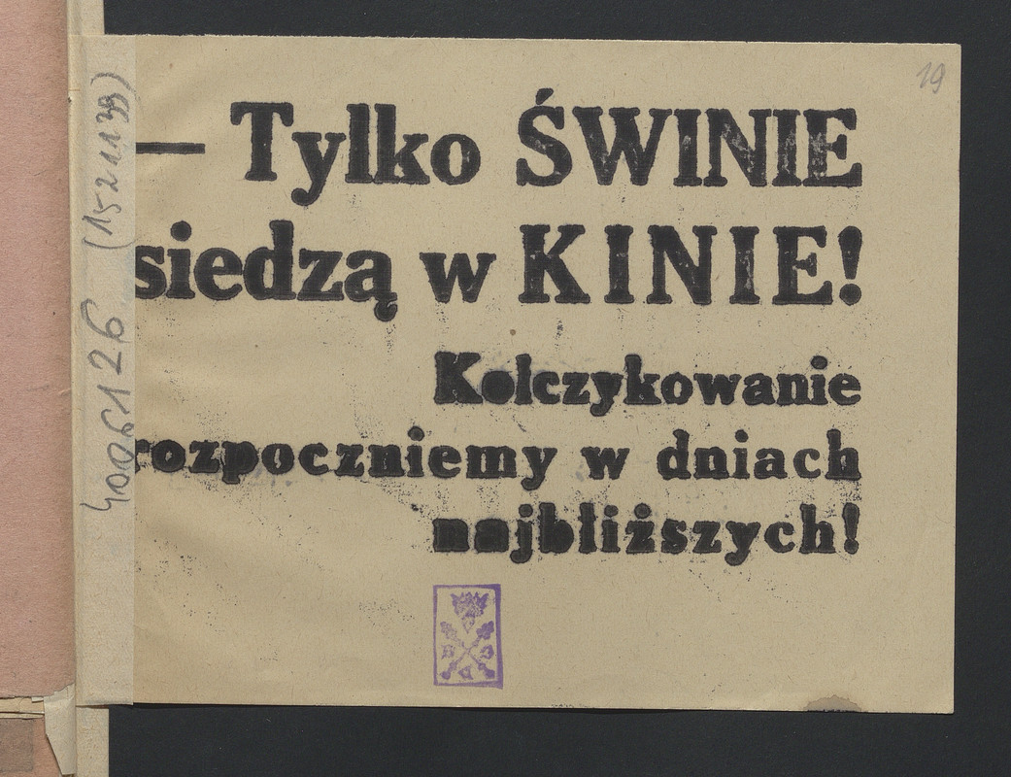
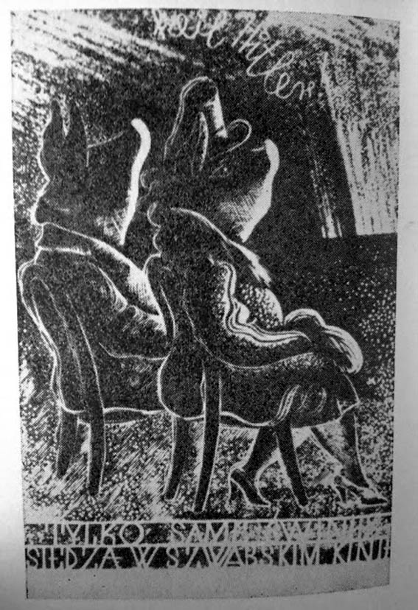
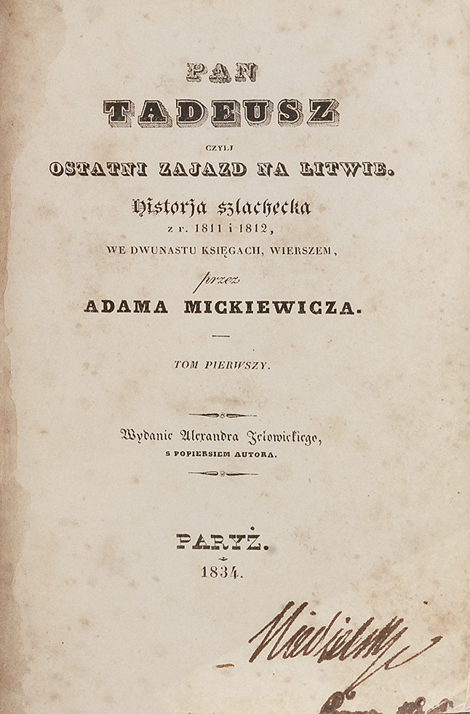
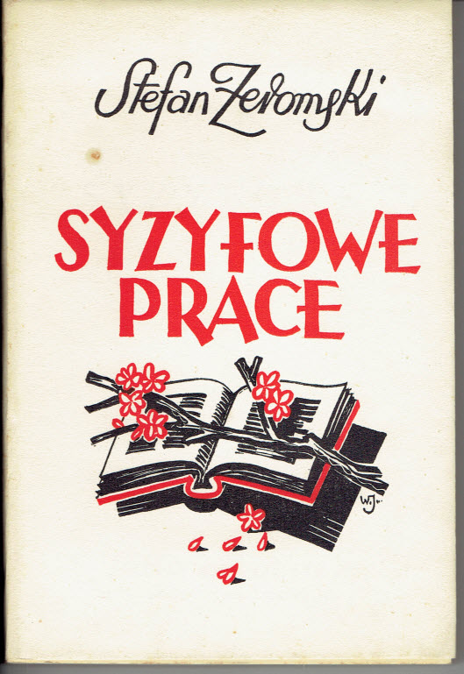
Censorship
and propaganda
Censorship targeted books that were thought to promote Polish patriotism or were educational. Possession of such books was illegal. Over 1 500 Polish writers were declared "dangerous to the German state and culture".
Polish cinemas were under control of German propaganda machine. After 1943 no Polish films were shown and all the profits were toward German war production. Underground created a famous slogan which discouraged people to go to the cinemas. It said “Tylko świnie siedzą w kinie” (“Only pigs attend the movies”).
The index of banned authors included such Polish authors as Adam Mickiewicz, Juliusz Słowacki, Stanisław Wyspiański, Bolesław Prus, Stefan Żeromski, Maria Konopnicka.

Slide 10
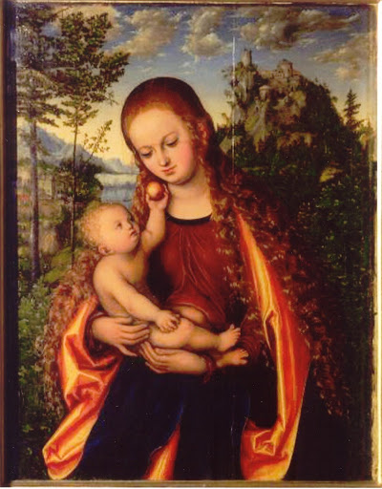
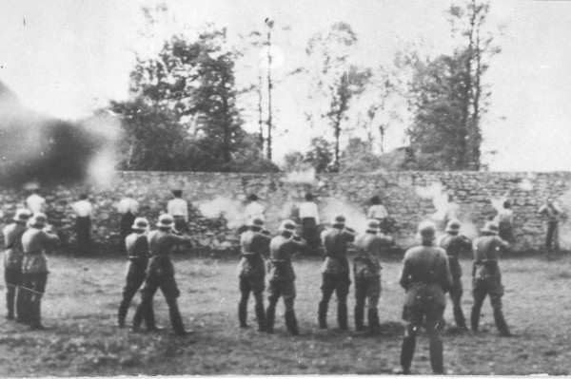
Destruction
A significant portion of Poland's cultural heritage, estimated at about half a million art objects, was plundered by the occupying powers. During War Poland lost 13 000 paintings, 15 mln books and 1 500 thousand sculptures.
Many university professors,teachers, lawyers, artists, writers and priests were arrested and executed, or transported to concentration camps. During World War II Poland lost 40% of physicians, 26% to 57% of its lawyers, 15% to 30% of its teachers, 35% of its scientists

Slide 11
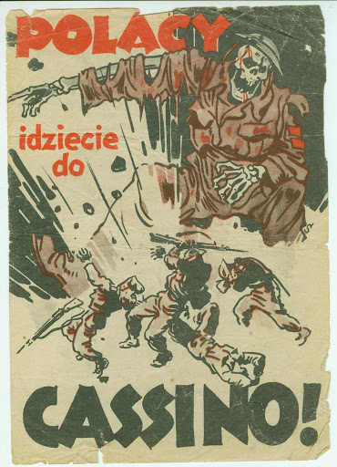
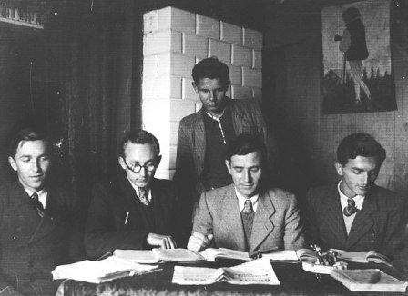
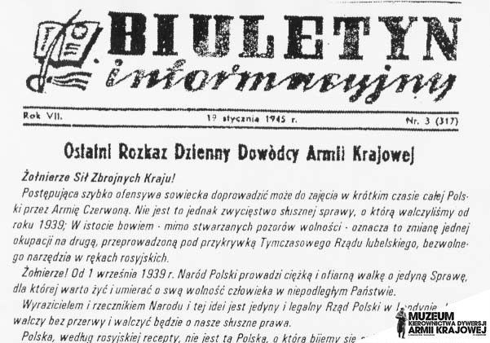
Underground culture
Despite severe retribution by the Nazis and Soviets, Polish underground cultural activities, including publications, concerts, live theater, education, and academic research, continued during the war. As a result of the closure of schools, a Secret Teaching Organization was established and classes were usually held in private homes. There were over 1000 underground newspapers (e.g. Biuletyn Informacyjny of Armia Krajowa and Rzeczpospolita ). Many artists left Poland and created their works in exile.Books and propagandist posters were also printed

Slide 12
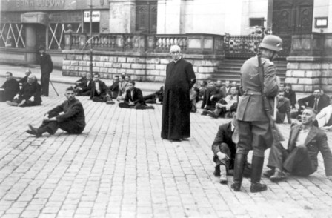
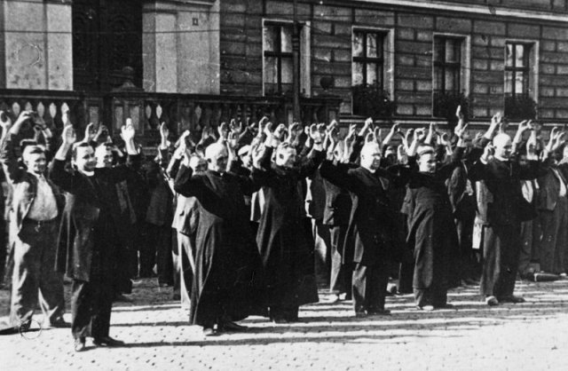
Religion
The German Nazis attempted to destroy Christianity in Poland . In some parts of occupied Poland, Poles were restricted, or even forbidden, from attending religious services. Church property was confiscated, prohibitions were placed on using the Polish language in religious services, organizations affiliated with the Catholic Church were abolished, and it was forbidden to perform certain religious songs. During the war died 3000 priests.

Slide 13
Thank you!
Magda Borówka
Maja Majewska

