Slide 1
Poland between 2019 and 2020

Slide 2
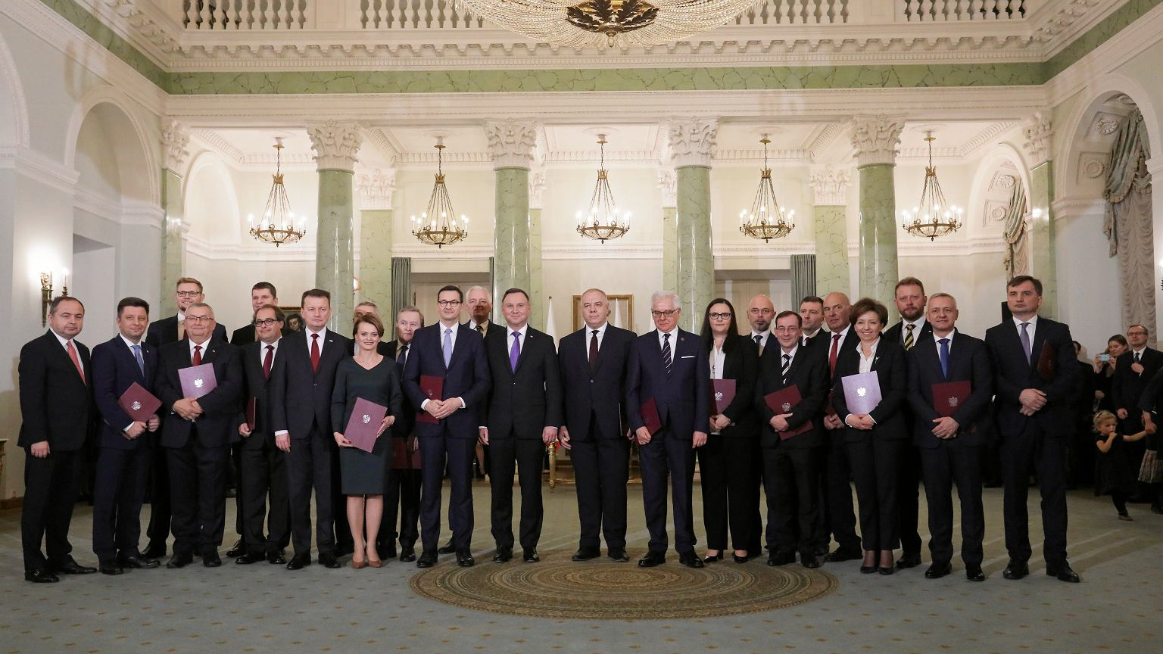
Mateusz Morawiecki's second row
The Council of Ministers, headed by Prime Minister Mateusz Morawiecki, was appointed by the President of the Republic of Poland Andrzej Duda and sworn in on November 15, 2019.
The government's backbone is the Law and Justice Parliamentary Club, which has a majority in the Sejm. The Council of Ministers includes representatives of PiS, the Alliance and Solidarity Poland. On November 14, 2019, President Andrzej Duda re-appointed Mateusz Morawiecki as Prime Minister, entrusting him with the mission of forming a new government. On November 19, 2019, the exposé of Prime Minister Mateusz Morawiecki was held, and the government obtained a vote of confidence in the Sejm with 237 votes in favor, 214 votes against and 3 abstentions.

Slide 3
2019 gave us great films, here are a few of them:

Slide 4
’’Boże Ciało’’
’’Proceder’’
’’Piłsudski’’

Slide 5
Polish economy in 2019

Slide 6
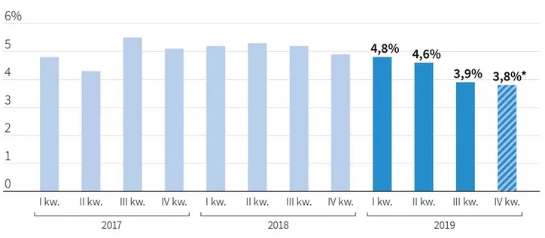
The Polish economy ended 2019 with GDP growth of 3.8%. (in quarterly terms, seasonally unadjusted GDP), it follows from preliminary data. This is a 1 point decrease. percent compared to the first quarter of last year. In turn, inflation at the end of the year was initially 2.9%, and registered unemployment - 5.2%. These are the most basic indicators describing the state of the economy in 2019.

Slide 7
registered unemployment rate in voivodships

Slide 8
in 2019, Polish musicians left us with nothing

Slide 9
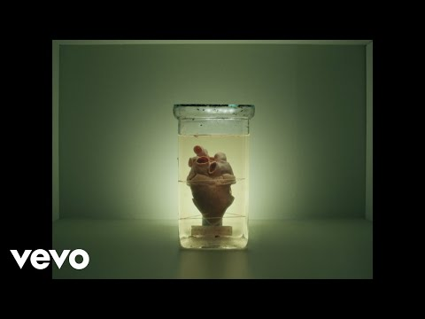
’’GOLEC uORKIESTRA - Górą Ty’’
’’Cleo - Za Krokiem Krok’’
’’Dawid podsiadło – trofea’’

Slide 10
Poland in 2020

Slide 11
Poland, like the rest of the countries in the world, has been hit by the covid-19 crisis

Slide 12
Poland, like the rest of the countries in the world, has been hit by the covid-19 crisis

Slide 13
2020 did't depart from the previous year's step in film production

Slide 14
’’jak zostałem gangsterem’’
’’365 dni’’
’’Zenek’’

Slide 15
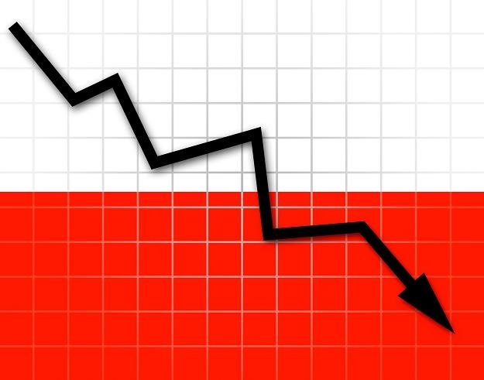
Polish economy 2020
According to the EC data, the decline in GDP in Poland was one of the lowest in the European Union. The smallest recession was recorded in Lithuania - GDP dropped by 0.9%, followed by Poland with a drop of 2.8%. In 2020, the decline in GDP below the 3% threshold. Estonia and Sweden also recorded (2.9% each).
The European Commission forecasts that in 2022 Poland's GDP will increase by 5.1%. According to estimates, inflation in 2021 in Poland will amount to 2.3%, and in 2022 it will be 2.9%. According to the European Commission, in 2020 this indicator amounted to 3.7%.

Slide 16
women's strikes

Slide 17
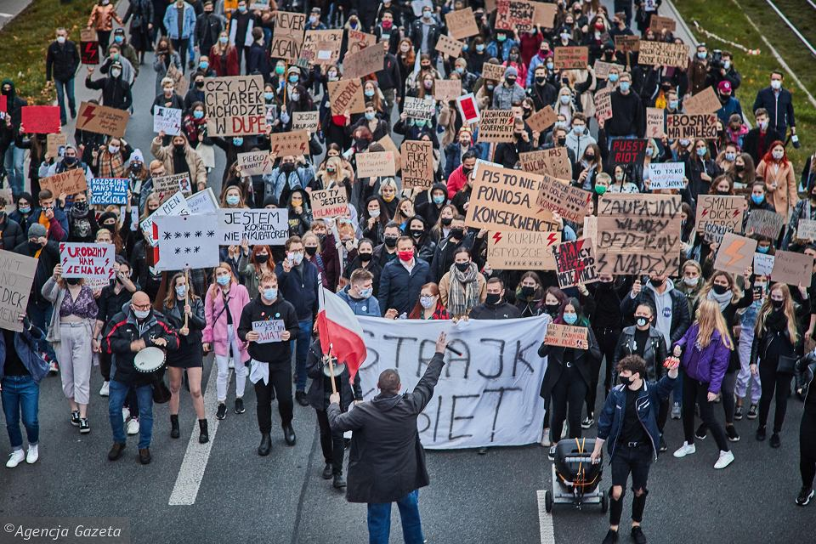
Protests against the tightening of abortion law in Poland - mass, anti-government social protests that began in Poland after the judgment of the Constitutional Tribunal of October 22, 2020.
Protests were held in several hundred cities in Poland and over a hundred cities outside Poland. Demonstrators used, inter alia, road blocks. On October 28, the police registered 410 protests across the country in which over 430,000 people took part. About 100,000 people took part in the Great March to Warsaw on October 30th. People. These were the largest demonstrations in Poland since the political transformation in 1989 and, according to some commentators, the largest street protests in Polish history.

Slide 18
Thank you for your attention ☺

