Slide 1
Poland in 1821

Slide 2
Economic collapse
Poland was on the verge of bankruptcy. Industry and economy did not develop and were not profitable. In October, Franciszek Ksawery Drucki -Lubecki became the new minister of the treasury. For 9 years in office, Drucki-Lubecki stimulated the development of industry and economy.

Slide 3
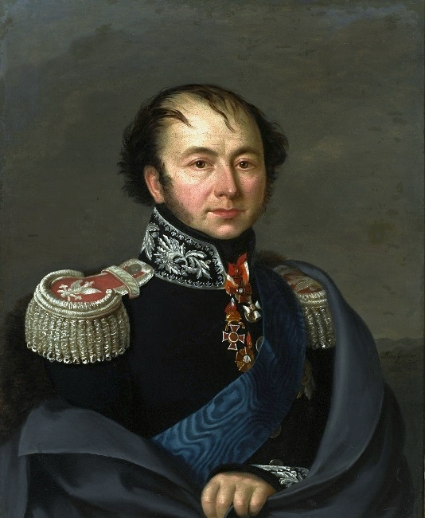
Franciszek Ksawery Drucki-Lubecki
He was born on December 16, 1779 in Pohost and he died on May 28, 1846 in Sankt Petersburg. He was a politician and a prince. He’s a founder of Bank Polski and Towarzystwo Kredytowe Ziemskie.

Slide 4
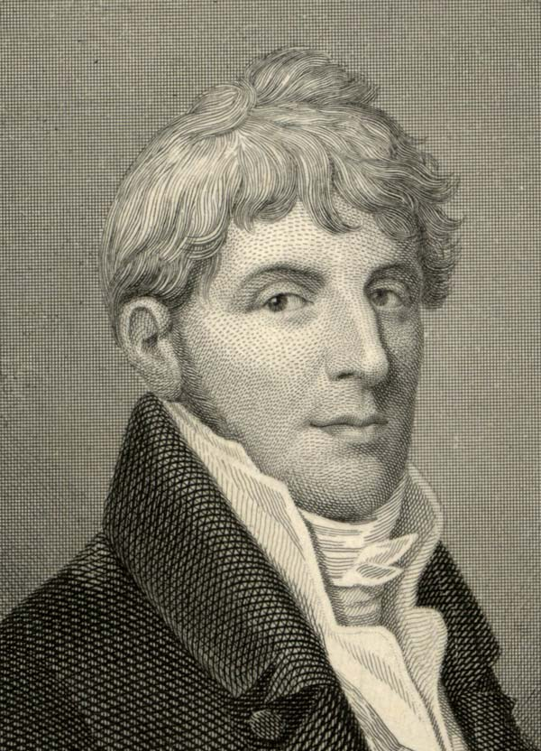
The Zgierz agreement
This agreement was signed on March 30, 1821. This was the beggining of the textile industry. The originator of this agreement was Rajmund Rembieliński.

Slide 5
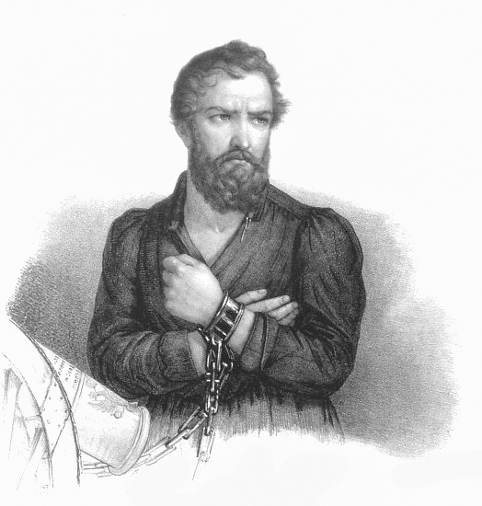
Towarzystwo Patriotyczne
This secret organization was founded on May 1, 1821 by major Walerian Łukasiński. The organization had 240 members and they wanted to rebuild Poland and its borders.

Slide 6
Magazines published since 1821
Astrea – published in Warsaw by Franciszek Grzymała. It was about literature, culture, economy and policy. In this magazine Grzymała appereciated the poetic talent of Adam Mickiewicz.
Mrówka Poznańska – published in Poznań every month. This magazine contributed to the development of the polish language and culture.

Slide 7
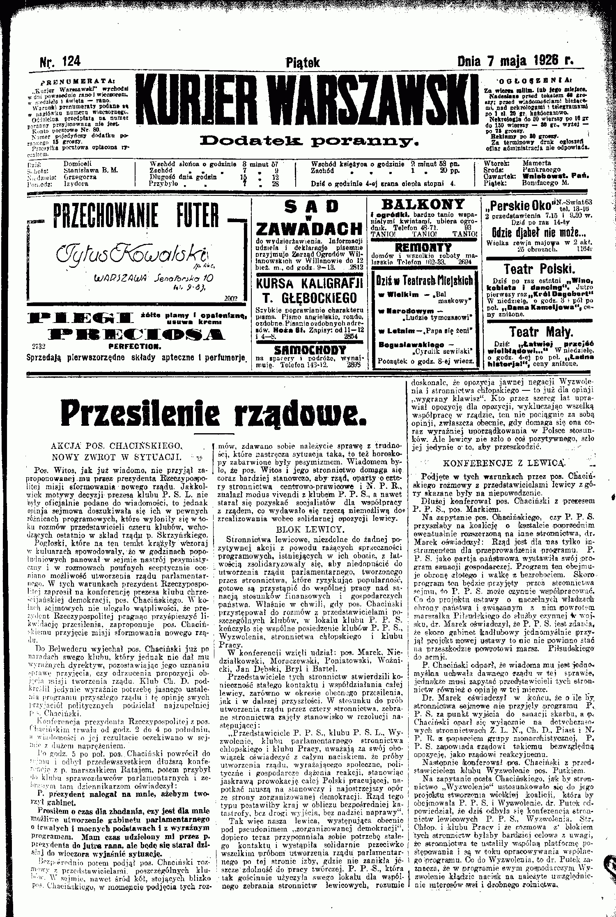
Kurier warszawski
It was a daily newspaper published in Warsaw and founded by Bruno Kiciński. The first number was published on January 1, 1821. This newspaper was popular with officials.

Slide 8
Thank you for attention

