Slide 1
1880

Slide 2
TABLE OF CONTENTS
Political situation
Economic and social situation
Culture
Art

Slide 3
POLITICAL SITUATION

Slide 4
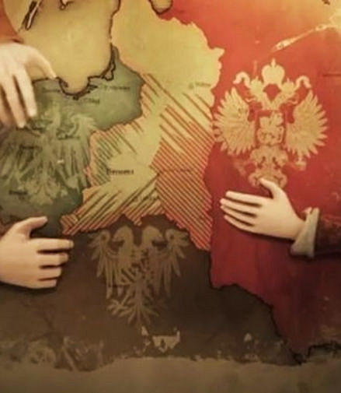
Poland under partitions Poland in the years 1795-1918 was under the partitions of Prussia, Russia and Austria. There was no country on the map, but the Polish nation and its culture still existed.

Slide 5
ECONOMIC AND SOCIAL SITUATION

Slide 6
PRUSSIA
In the territories annexed by Prussia developed agriculture. People used modern agricultural machinery. The processing industry was still developing.

Slide 7
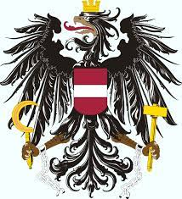
AUSTRIA
Social life developed freely in these areas. The Jagiellonian University was active. Mining was very important. Economical situation was very weak.

Slide 8
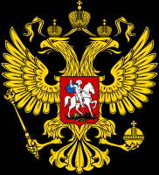
RUSSIA
There was strong censorship on this territory. People and culture were being Russified. Industry and processing developed over the years.

Slide 9
CULTURE

Slide 10
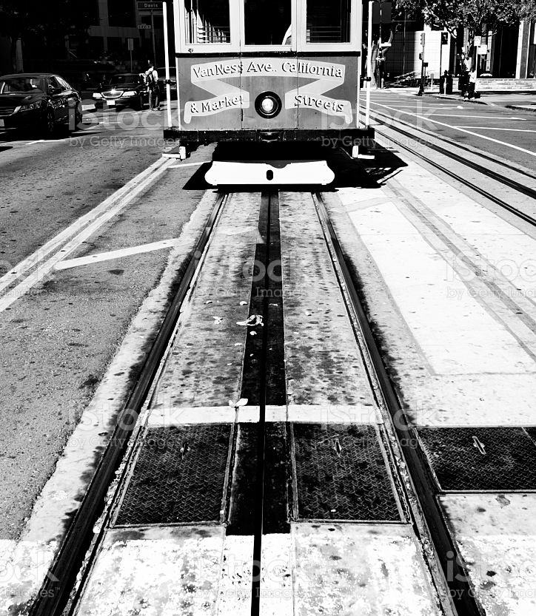
The tram transport was launched in Lwów on 5 May.

Slide 11
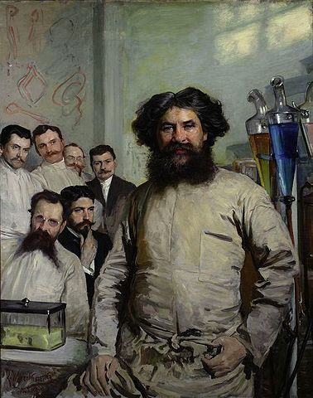
Ludwik Rydygier performed the first in Poland excision of the pylorus due to stomach cancer.

Slide 12
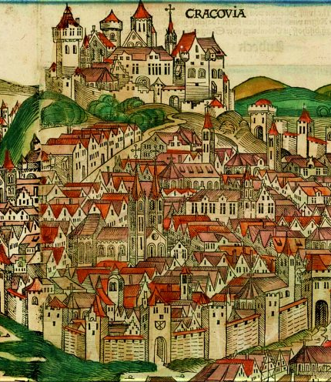
The first historians' convention was held in Krakow.

Slide 13
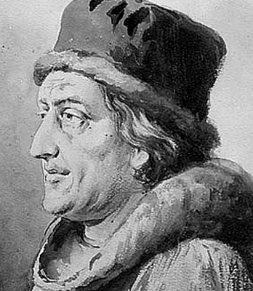
Jan Długosz's ashes were transferred to the Crypt of Merit at Skałka in Krakow on the 400th anniversary of his death.

Slide 14
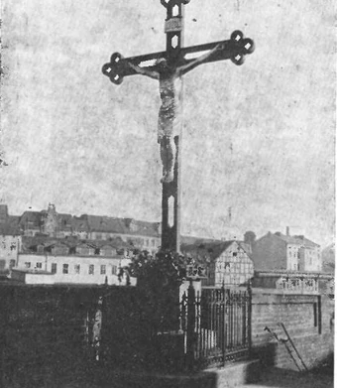
The Golden Cross was consecrated in Poznań after long fight with the Prussian government.

Slide 15
ART

Slide 16
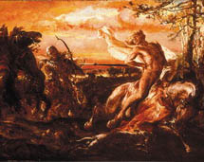
Jan Matejko was one of the most popular painters in Poland in 1880. He painted lots of historical paintings. He painted „Zabicie Leszka Białego w Gąsowie " in 1880.

Slide 17
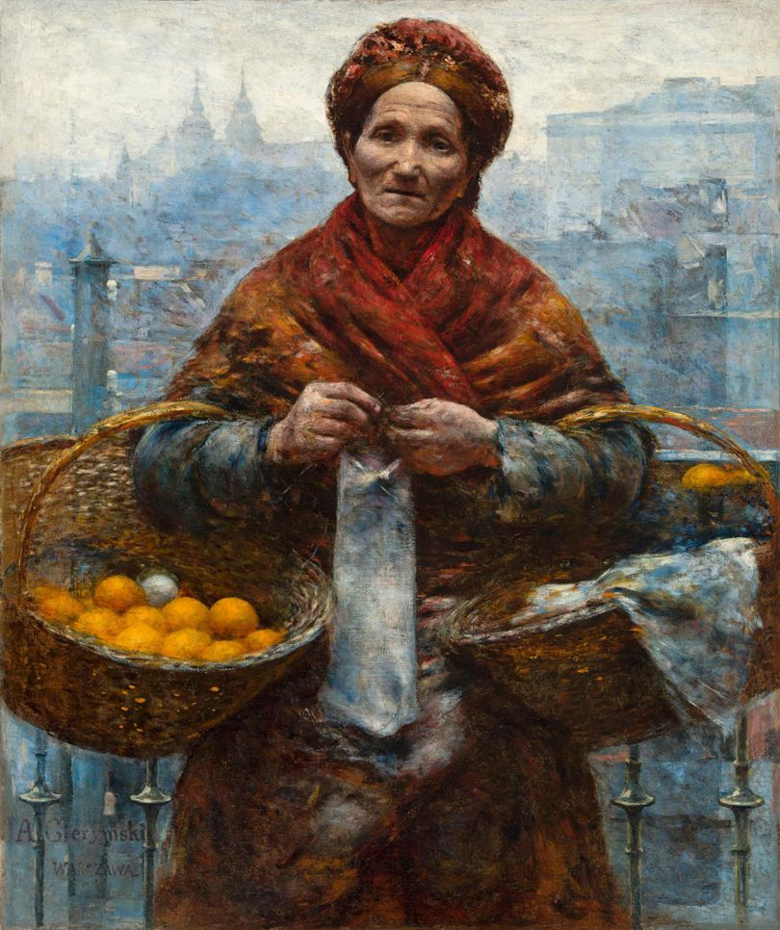
„Żydówka z pomarańczami” was painted by Aleksander Gierymski. It is a masterpiece of polish realistic art.

Slide 18
„Katarynka” was written by Bolesław Prus who was one of the most popular writer of positivism.

Slide 19
THE END Bibliography: - wikipedia - Encyklopedia PWN

