Slide 1
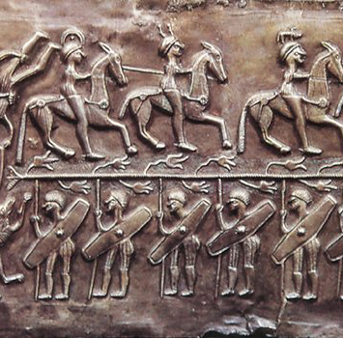
1st century in Europe and on current Polish lands

Slide 2
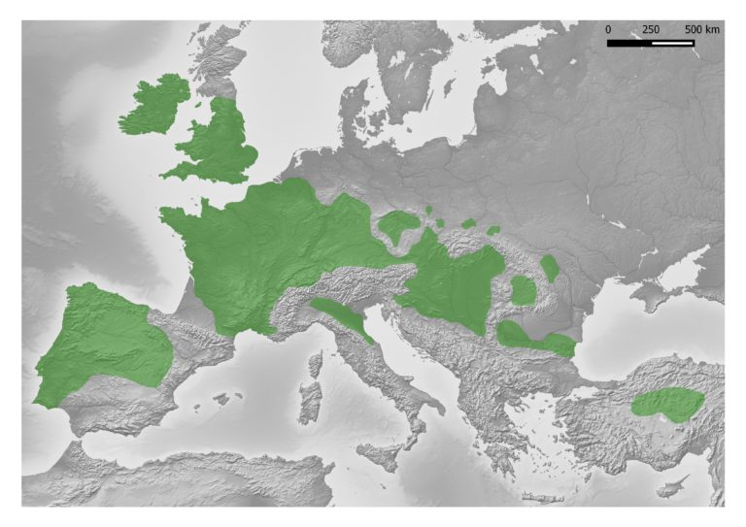
Economy
The peak of amber trade between Celtic people and Romans fell on 1st-2nd century CE. Both those peoples lived on the majority of European lands.
the Amber Route
Thanks to amber trade a big technological progress in day-to-day activities was observed. Tools were imported from the Roman Empire, old techniques of plant cultivation were replaced and animal farming advanced.
That is the Roman Empire of course
Extent of Celtic tribes

Slide 3
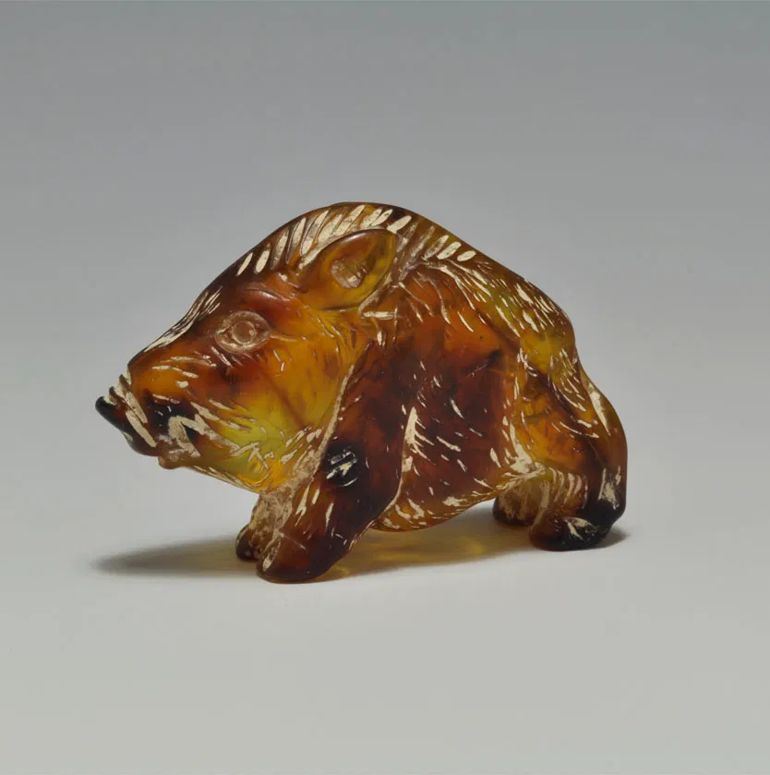
During 1st century CE Roman influence started to intensify. Luxorious goods started to flood in. Weapons of war and the art of warfare advanced as well. Of course, people ranked socially higher were influenced the most.
Romans helped Slavs to become more of a modern civilisation. A lot of foreign import was discovered, such as bronze dishes, earthen dishes, wine, coins, which were melten down for gold by Slavs, javelins, swords.
That one is actually from the Roman Empire, 1st or 2nd century and it is a boar. :)))
Earthen-gliniane
Javelin- oszczep

Slide 4
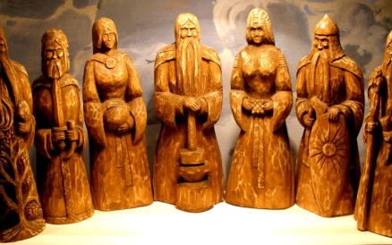
Beliefs
Due to the influence of the Romans, deities such as Jupiter, Mars, Minerva, as well as some animals, e.g. dogs and horses (considered sacred) were worshiped, and the worship of the sun and water was carried out. Due to the influx of paintings and figurines of gods, the pagan religion passed into the Slavic culture.
Deity - bóstwo, bożek
Influx - napływ
Figurine – figurka, posążek

Slide 5
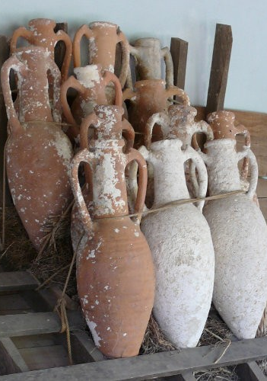
Culture
Culture and art changed too. Pottery and paitings were made after the fashion of the Romans. Slavs took over many of roman beliefs like cremation and burial rite. All that development led to the creations of ,,pre-polish-country" communities.
Pottery-ceramika
Rite-obrzęd

Slide 6
Roman coins
Various amounts of coins were delivered to Poland at different times. Firstly, we received republican coins, and a bit later imperial coins. Many coins were found that had holes in them. These coins served as amulets. Medicinal herbs were usually placed in them. It was believed that it could protect people against many diseases.
Medicinal herbs - zioła lecznicze

Slide 7
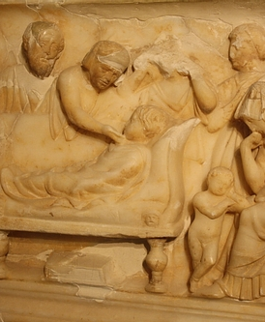
Roman ceremonies
Various celebrations also came to Poland from the Roman Empire. People practiced various rites in cemeteries, such as ancestor worship. People believed that the dead could contact and influence the living. Feasts and games were also an important part of the funeral. Various items were found in the graves of wealthy people, people who were hierarchically taller had valuable items brought from Rome, such as ornaments or utensils.
Ancestor worship – kult przodków
Ornamnet – ozdoba
Utensil – naczynie, narzędzie

Slide 8
Thank you for your attention!

