Slide 1
year 1453 and XV century in poland

Slide 2
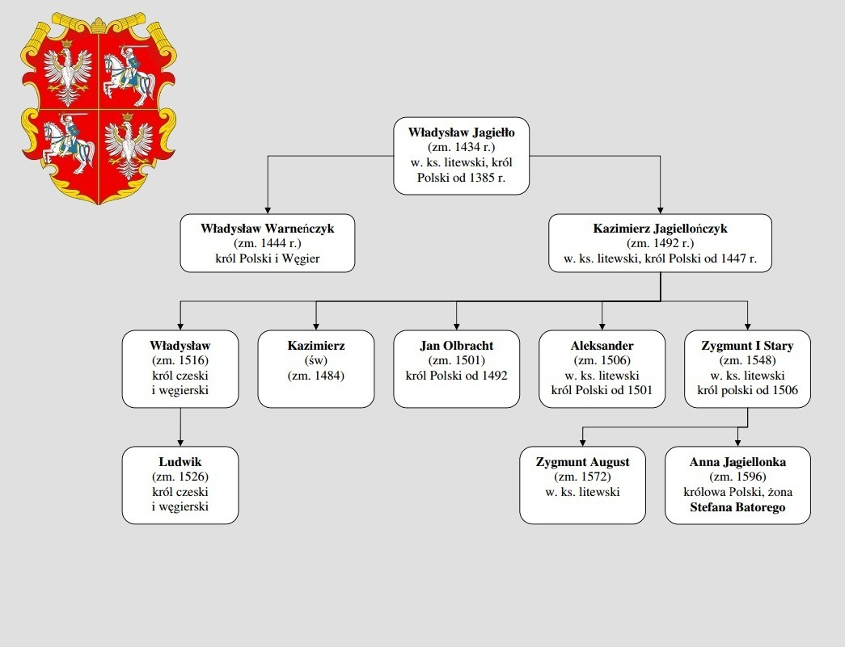
Jagielonian dynasty

Slide 3
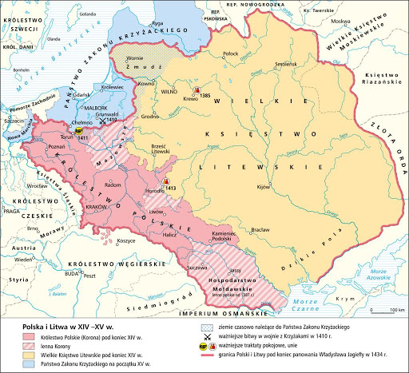
Political situation
One of the greatest Polish kings of that time was Kazimierz Jagielończyk . He’s goverments were the time of the bigest raise
of Polish power in
XV th Century .

Slide 4
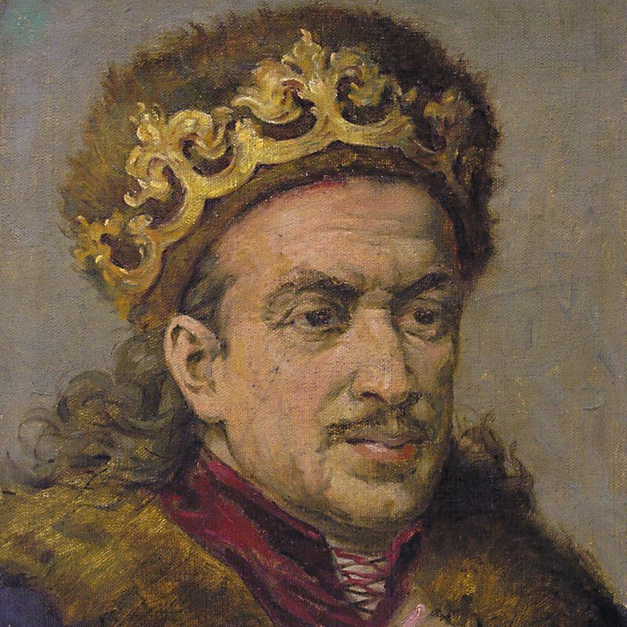

Slide 5
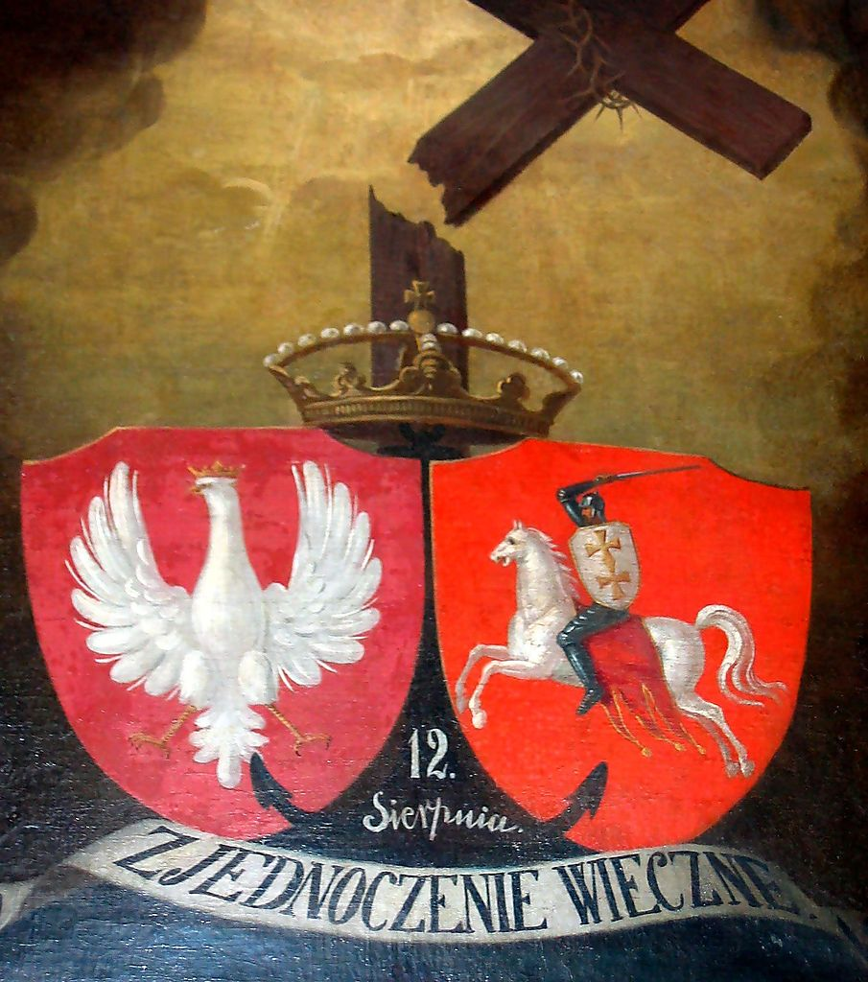
Union in krewa
Poland had personal union with Lithuanian Kingdom since 1385 to 1569 …

Slide 6
Parliaments and political system
Parliaments were popular way of debating mainly about money , law and both domestic and external policy.
Who took part ? – King obviously with magnates and knighthood.
Speaking of which – There was one division which distributed people in 3 groups :
-Priesthood,
-Knighthood,
-Middle class.

Slide 7
Economy
In the 15th century, there was a rapid development of art and culture. At that time, Poland was at peak moment in terms of economy and importance on the international arena. Farms and kmiece farms were of great importance for the Polish economy, while the revolution in prices that took place in Europe at that time meant that the craft lost its value and was not very profitable.

Slide 8
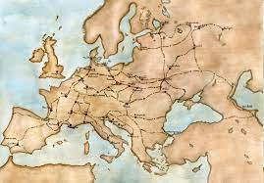
Economy
Poland was center of European busienss , with many trade routes .

Slide 9
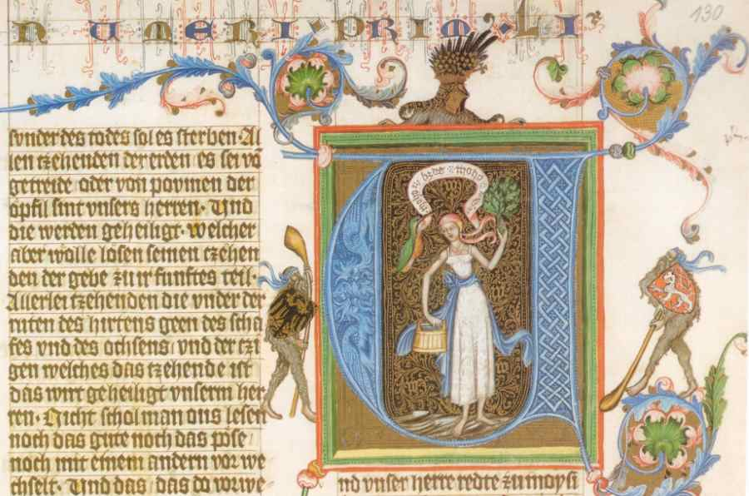
Development of writing
Traditional writing was used by the church in its activities, while in the 14th and 15th centuries the role of writing in politics and administration increased, which contributed to the development of education.

Slide 10
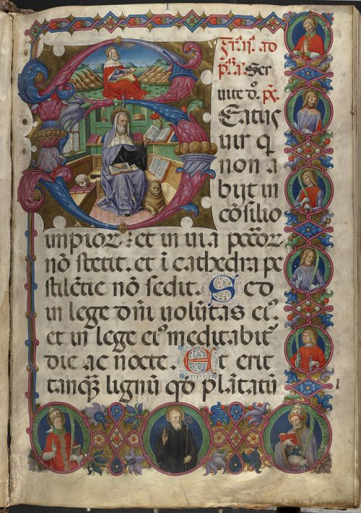
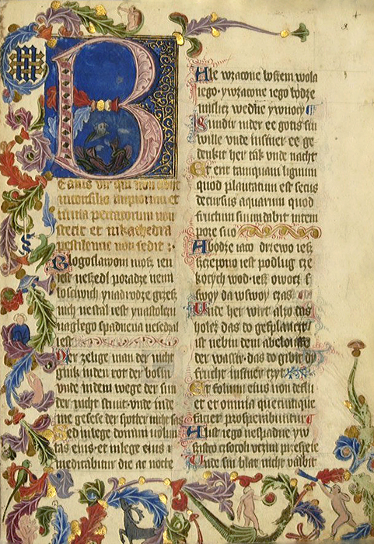

Slide 11
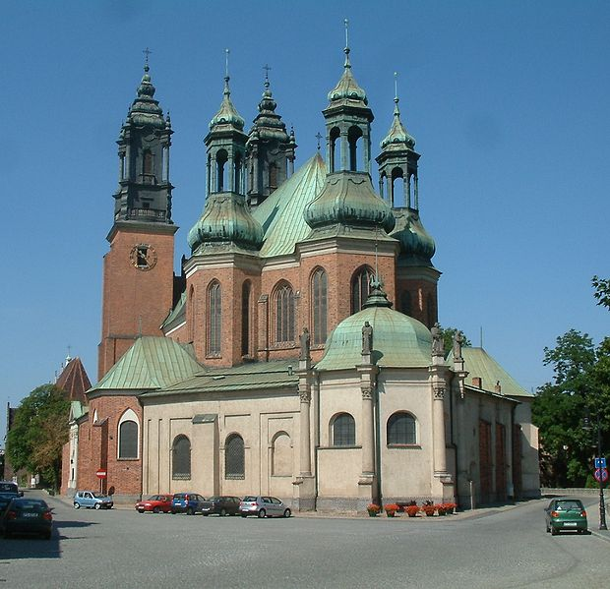
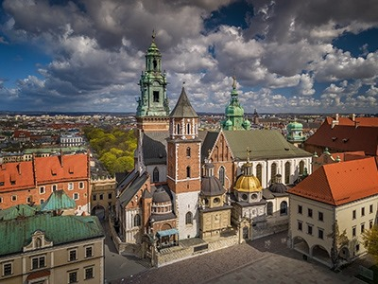
ART- Gothic Architecture
In Poland, major Gothic cathedrals were built in the 15th century. For example, Wawel Cathedral in Cracow, or the cathedral in Poznan.

Slide 12
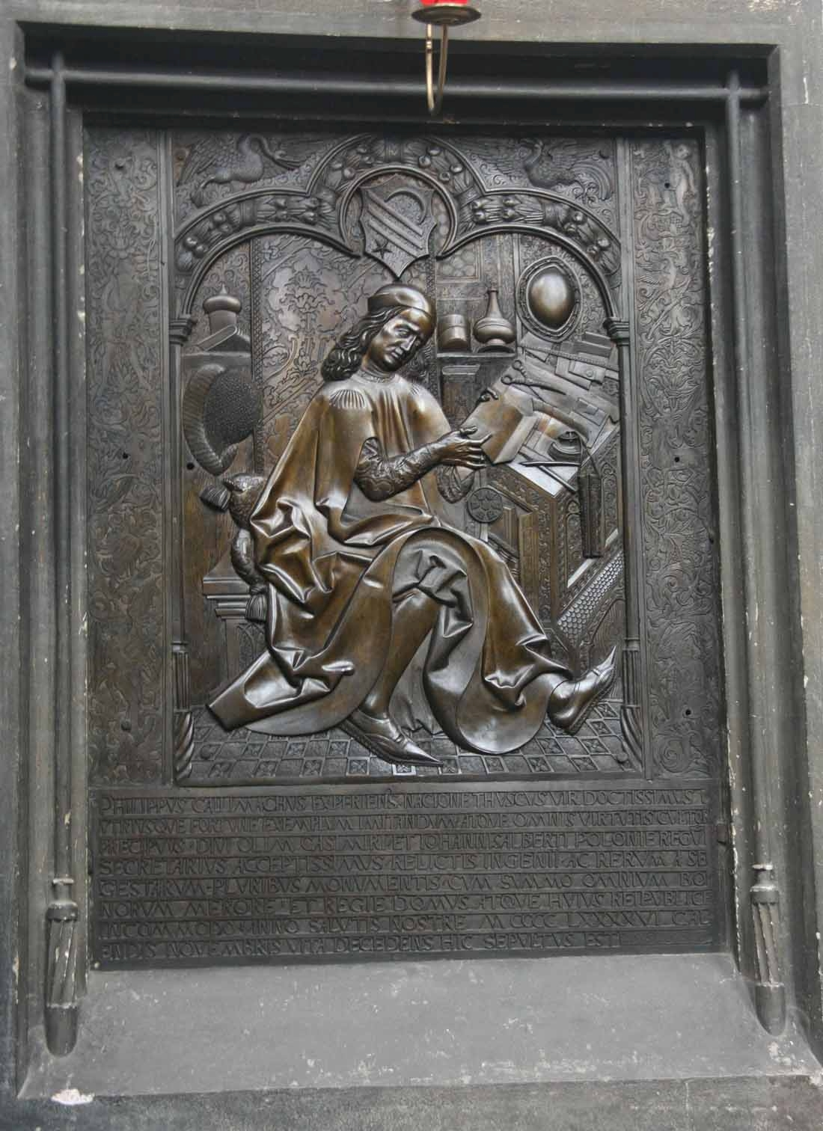
Epitafium Kallimacha
Epitatfium Kallimacha is located in the Dominican church in Krakow, created by Wit Stwosz. It is an iron plate depicting the figure of Kallimach as a scholar.

Slide 13
Thank You for your attention

