Slide 1
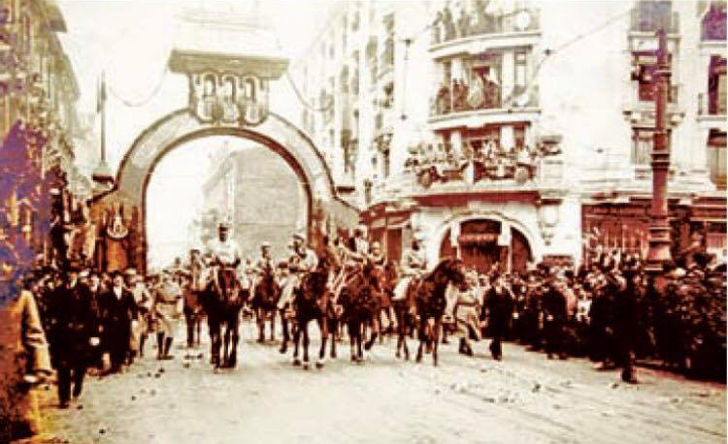
Romania 1918
In the memory of the heroes who died on the battlefield serving their nation
Project made by Berescu Andra, Paraschiv Roberta and Rusu Stefan

Slide 2
Content
Introduction
Politic Situation
Soldiers
Economic Situation
Artistic Situation
Artists on the Battlefield
Portofolio
Ending

Slide 3
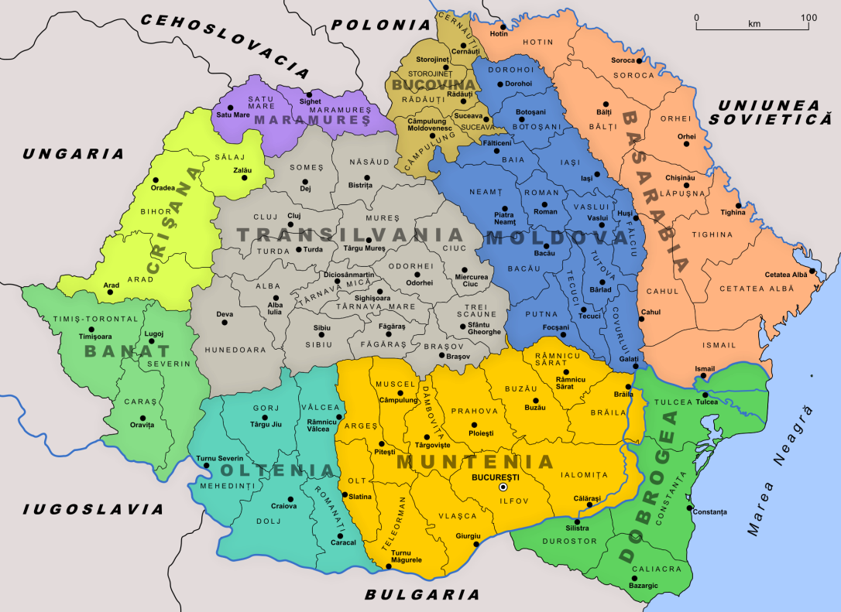
Introduction A short story
For Romania, the year 1918 represents the triumph of the national ideal, the year of the victorious crowning, the long series of human and material struggles and sacrifices made for building a unitary national state.
At the end of the First World War Transylvania, Bessarabia and Bukovina joined the Kingdom of Romania. Thus, the surface and population of Romania doubled in only 5 years, and most importantly,all romanian people were for the first time included in the borders of a single state.

Slide 4
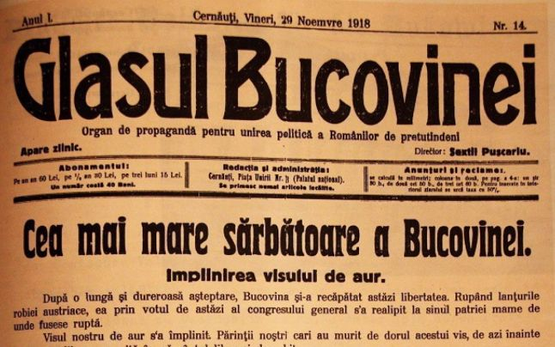
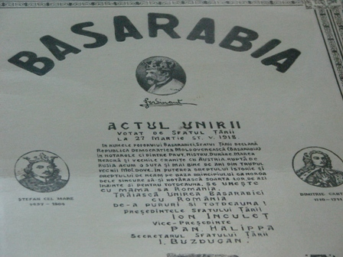
Political situation
The foudation of the Romanian national state wasn’t represented by a military victory, but by the act of will of said nation. Its sacrifices in the 1916th and 1917th campaign were rewarded by succeeding the national ideal in the conditions of the autocracy collapsing followed by the breakdown of the Austro-Hungarian monarchy and the establishment of the communist regime.

Slide 5
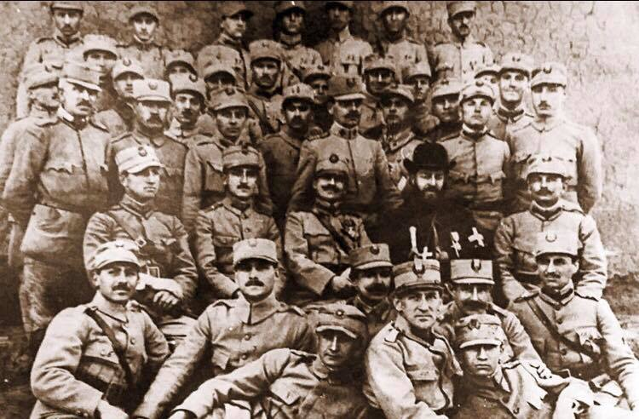
Political Situation
The completion of the national unity of Romania at the end of the first world conflict must be understood as a natural fulfillment, as a historical necessity imposed by the evolution of the national state and not by the military effort of Romania. World War I did not create Great Romania; it was just the occasion.

Slide 6
Economic situation
The achievement of the national state allowed the Romanian nation to capitalize on its energy and its creative capacities for the economic progress of the development of science, education and culture. Evolving within the parliamentary democracy regime, Romania enrolled in the interwar years on the trajectory of a modern life, bringing to the international level a substantial contribution to peace and security.

Slide 7
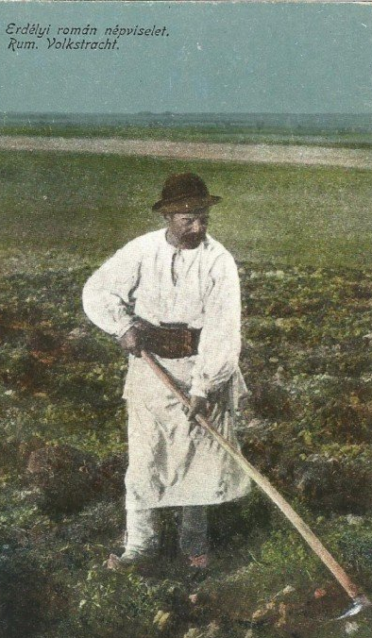
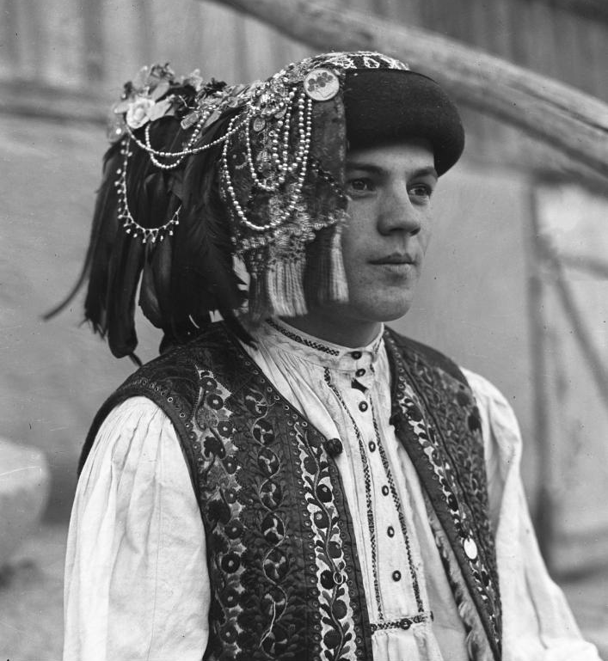
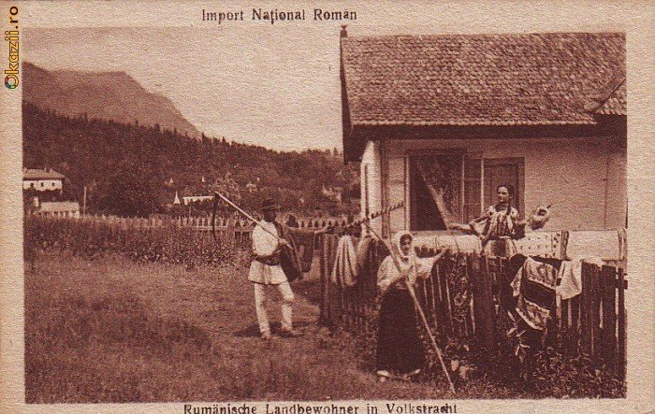
Economic situation
In that period, the country’s population doubled,the agricultural area grew from 6,5 million ha to 14,5 million ha,the railway network extended from 4200Km to 11000 Km.
But Romania’s economy was ruined after WW1, and from a cereal exporter became an importer after the war.
To restore the economy and to ensure Romania's economic independence as soon as possible, the Romanian state has been involved in supporting Romania's rebuilding and economic recovery.

Slide 8
Artistic Situation
Works inspired both by the moments of glory of the Romanian soldiers during the battles and the everyday life of those under arms, in trenches, resting, or in preparation for combat are presented in portraits of suggestive figures and emblematic personalities of the time such as: King Ferdinand I and Queen Maria, generals, officers and simple soldiers, whether they became heroes or anonymous men.
Two classics of interwar Romanian painting, Camil Ressu and Costin Petrescu were direct participants in the campaigns during the War, as well as a collection of weapons and uniforms from 1914-1918. 1918 it’s also known as the Gold Era for art.

Slide 9
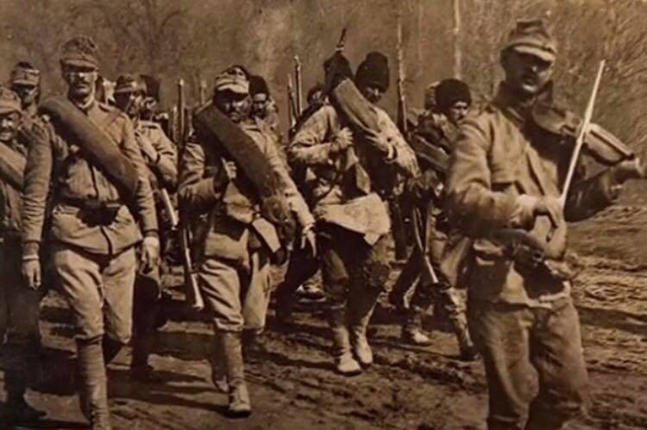
Artists on the battlefield

Slide 10
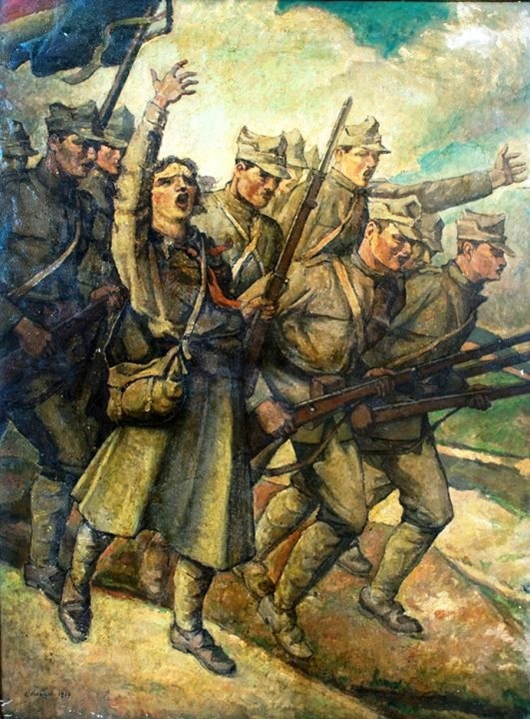
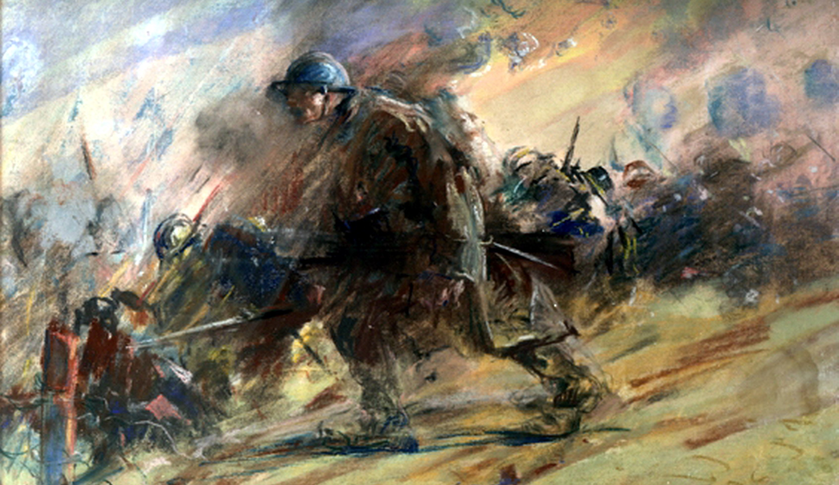
Portofolio
Paintings from the battlefield

Slide 11
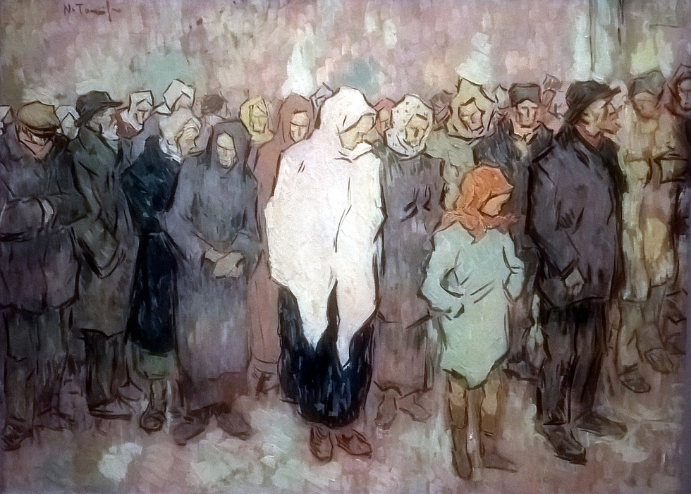
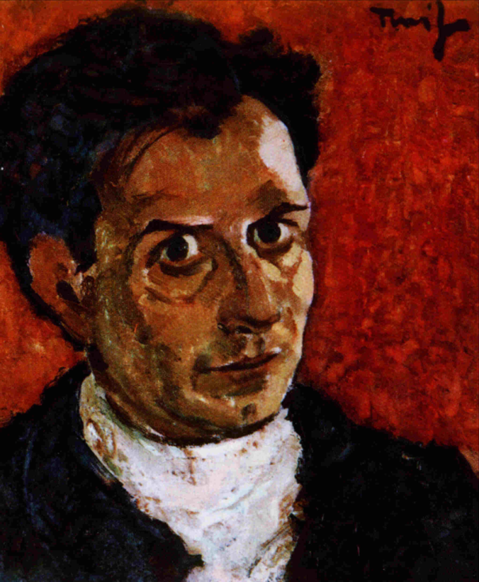
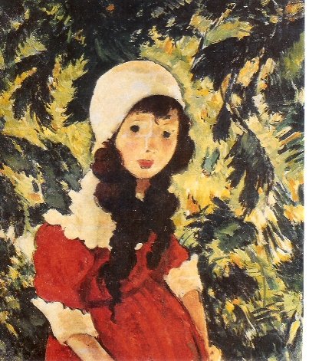
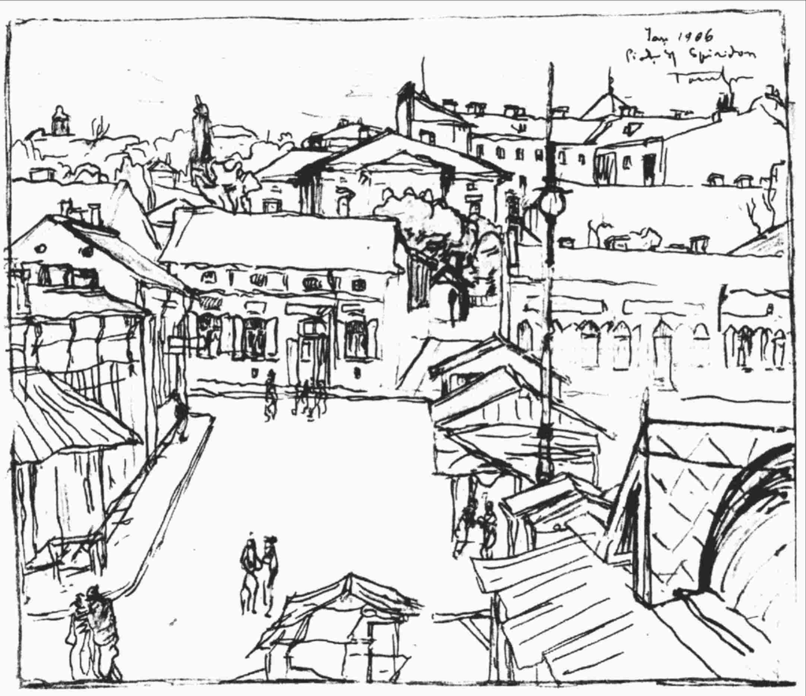
Portofolio
Coada la paine
Self Portrait
Fetița Pădurarului
Saint Spiridon Plaza

Slide 12
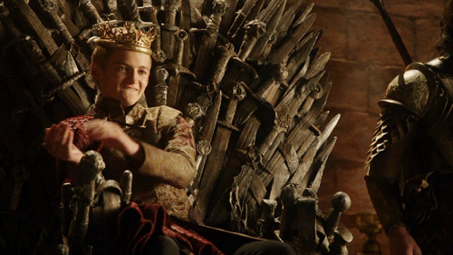
Ending

