Slide 1
TURKISH HISTORY

Slide 2
CONTENT
451-551
1453
1930-1939
1970
1980
1918
1461

Slide 3
451-551

Slide 4
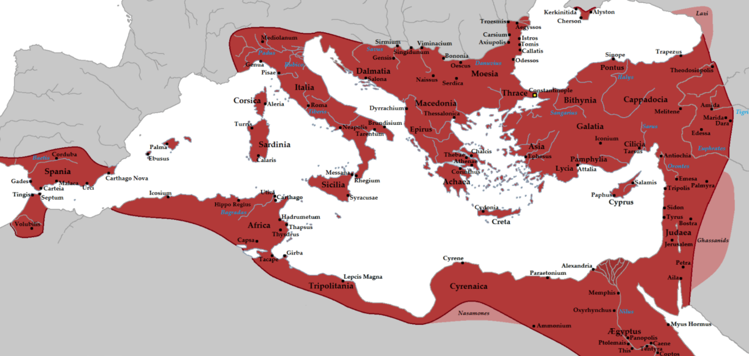
Eastern Roman Empire
The Byzantine Empire, also referred to as the Eastern Roman Empire, was the continuation of the Roman Empire in its eastern provinces during Late Antiquity and the Middle Ages, when its capital city was Constantinople (modern Istanbul). It survived the fragmentation and fall of the Western Roman Empire in the 5th century AD and continued to exist for an additional thousand years until it fell to the Ottoman Empire in 1453.During most of its existence, the empire was the most powerful economic, cultural, and military force in Europe.
Several signal events from the 4th to 6th centuries mark the period of transition during which the Roman Empire's Greek East and Latin West diverged. Constantine I (r. 324–337) reorganised the empire, made Constantinople the new capital and legalised Christianity. Under Theodosius I (r. 379–395), Christianity became the state religion and other religious practices were proscribed. In the reign of Heraclius (r. 610–641), the Empire's military and administration were restructured and adopted Greek for official use in place of Latin.

Slide 5
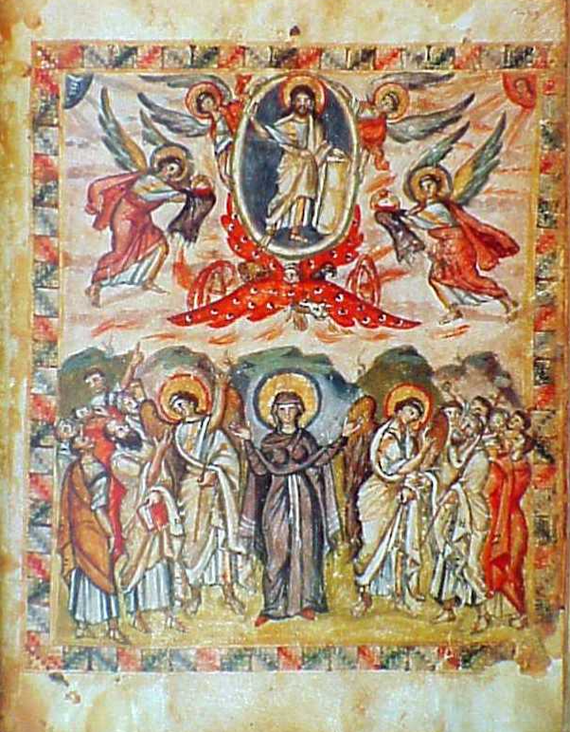
Eastern Roman Empire
Surviving Byzantine art is mostly religious and with exceptions at certain periods is highly conventionalised, following traditional models that translate carefully controlled church theology into artistic terms. Painting in fresco, illuminated manuscripts and on wood panel and, especially in earlier periods, mosaic were the main media, and figurative sculpture very rare except for small carved ivories. Manuscript painting preserved to the end some of the classical realist tradition that was missing in larger works.[Byzantine art was highly prestigious and sought-after in Western Europe, where it maintained a continuous influence on medieval art until near the end of the period. This was especially so in Italy, where Byzantine styles persisted in modified form through the 12th century, and became formative influences on Italian Renaissance art. Influences from Byzantine architecture, particularly in religious buildings, can be found in diverse regions from Egypt and Arabia to Russia and Romania.

Slide 6
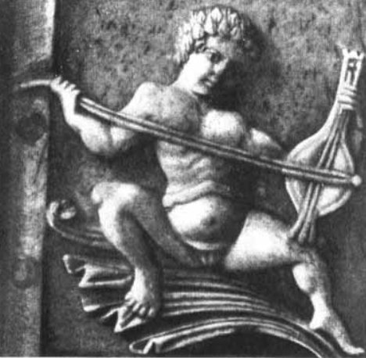
Eastern Roman Empire
The ecclesiastical forms of Byzantine music, composed to Greek texts as ceremonial, festival, or church music,are, today, the most well-known forms. Ecclesiastical chants were a fundamental part of this genre. Greek and foreign historians agree that the ecclesiastical tones and in general the whole system of Byzantine music is closely related to the ancient Greek system.
It remains the oldest genre of extant music, of which the manner of performance and (with increasing accuracy from the 5th century onwards) the names of the composers, and sometimes the particulars of each musical work's circumstances, are known.

Slide 7
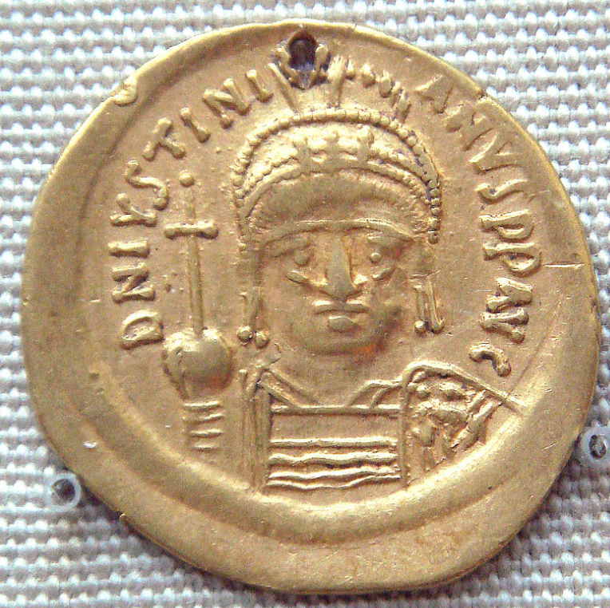
Eastern Roman Empire
The Byzantine economy was among the most advanced in Europe and the Mediterranean for many centuries. Europe, in particular, could not match Byzantine economic strength until late in the Middle Ages. Constantinople operated as a prime hub in a trading network that at various times extended across nearly all of Eurasia and North Africa, in particular as the primary western terminus of the famous Silk Road.
Until the first half of the 6th century and in sharp contrast with the decaying West, the Byzantine economy was flourishing and resilient.

Slide 8
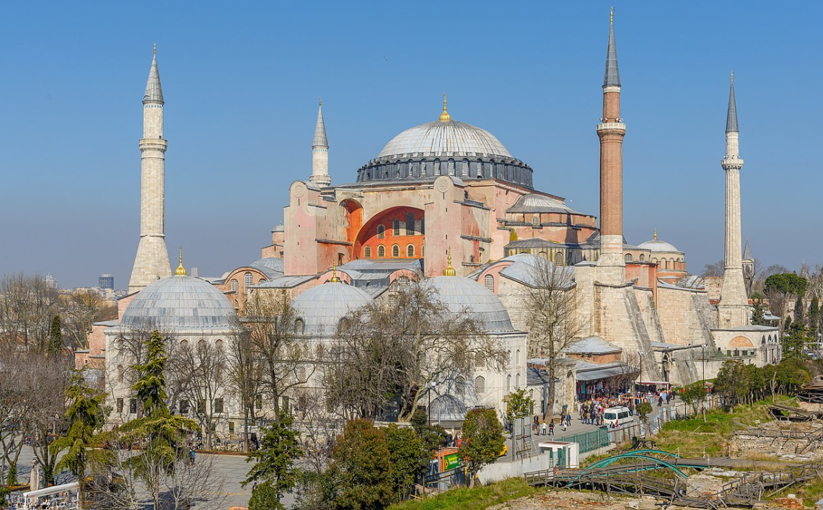
Hagia Sophia
Hagia Sophia is a Late Antique place of worship in Istanbul. Built in 537 as the patriarchal cathedral of the imperial capital of Constantinople, it was the largest Christian church of the eastern Roman Empire (the Byzantine Empire) and the Eastern Orthodox Church, except during the Latin Empire from 1204 to 1261, when it became the city's Roman Catholic cathedral. In 1453, after the Fall of Constantinople to the Ottoman Empire, it was converted into a mosque. In 1935 the secular Turkish Republic established it as a museum.Built by the eastern Roman emperor Justinian I as the Christian cathedral of Constantinople for the state church of the Roman Empire between 532 and 537, the church was then the world's largest interior space and among the first to employ a fully pendentive dome. It is considered the epitome of Byzantine architecture and is said to have "changed the history of architecture".The building was designed by the Greek geometers Isidore of Miletus and Anthemius of Tralles[]

Slide 9
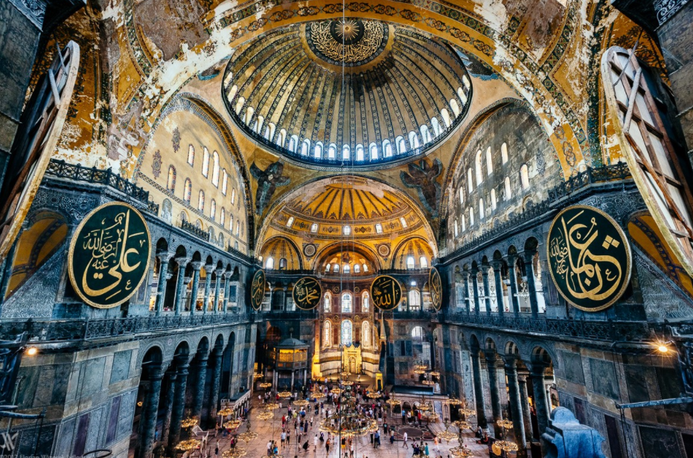
Eastern Roman Empire
After the Fall of Constantinople to the Ottoman Empire in 1453,it was converted to a mosque by Mehmed the Conqueror. The patriarchate moved to the Church of the Holy Apostles, which became the city's cathedral. Although some parts of the city had fallen into disrepair, the cathedral had been maintained with funds set aside for this purpose, and the Christian cathedral made a strong impression on the new Ottoman rulers who conceived its conversion. Islamic architectural features were added, such as a minbar (pulpit), four minarets, and a mihrab – a niche indicating the direction of prayer (qibla). From its initial conversion until the construction in 1616 of the nearby Sultan Ahmed Mosque, aka the Blue Mosque, it was the principal mosque of Istanbul. The complex remained a mosque until 1931, when it was closed to the public for four years. It was re-opened in 1935 as a museum by the secular Republic of Turkey.^{[17]} According to data released by the Ministry of Culture and Tourism, Hagia Sophia was Turkey's most visited tourist attraction in 2015[

Slide 10
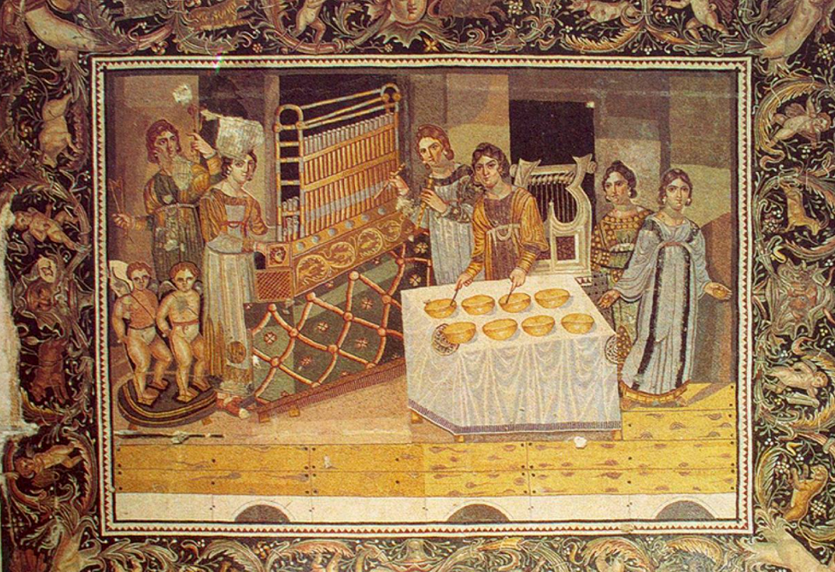
Eastern Roman Empire
In Byzantine literature, three different cultural elements are recognised: the Greek, the Christian, and the Oriental. Byzantine literature is often classified in five groups: historians and annalists, encyclopaedists (Patriarch Photios, Michael Psellus, and Michael Choniates are regarded as the greatest encyclopaedists of Byzantium) and essayists, and writers of secular poetry. The only genuine heroic epic of the Byzantines is the Digenis Acritas. The remaining two groups include the new literary species: ecclesiastical and theological literature, and popular poetry.
Of the approximately two to three thousand volumes of Byzantine literature that survive, only 330 consist of secular poetry, history, science and pseudo-science.While the most flourishing period of the secular literature of Byzantium runs from the 9th to the 12th century, its religious literature (sermons, liturgical books and poetry, theology, devotional treatises, etc.) developed much earlier with Romanos the Melodist being its most prominent representative.

Slide 11
1453

Slide 12
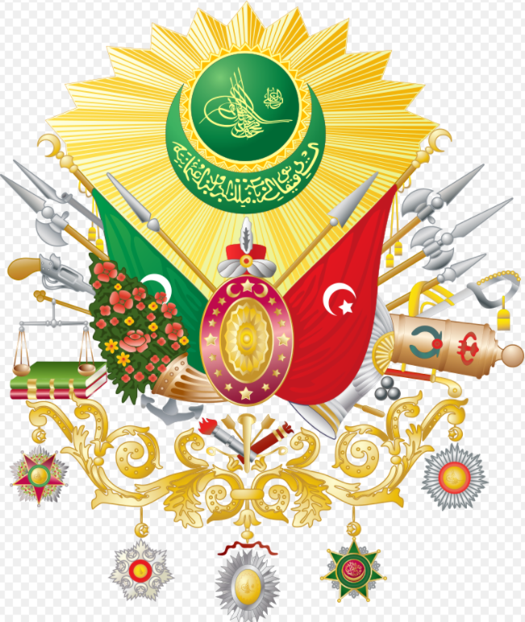
The Rise Of Ottoman Empire
The Ottoman Empire controlled much of Southeastern Europe, Western Asia and North Africa between the 14th and early 20th centuries. It was founded at the end of the 13th century in Northwestern Anatolia. Istanbul was (Constantinople) surrounded 7 times until 29 May 1453. Seventh Emperor of Ottoman Empire Fatih Sultan Mehmet conquested Istanbul. This was named “The Rise of Ottoman Empire”

Slide 13
Map of Ottoman Empire

Slide 14
Before Ottoman Empire: Constantinople
Before 1453, there was Byzantine Empire in these lands.
Constantin was the emperor. There was slave trade.
Generally people start school at the age of fifth
Byzantium most attractive features was giant dommes.
Espacially; wally decorations and ivory crafting improved.
Byzantine Architecture
*Chora Church *Sergio and Bakhos Church
*Hagia Sofia *San Vitale Church

Slide 15
Several Examples
From Architecture

Slide 16
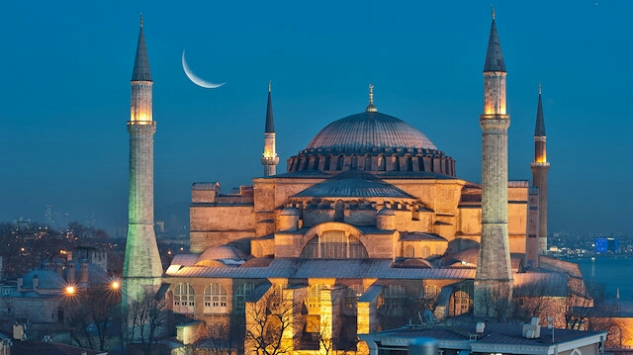
Hagia Sofia
Hagia Sophia was built in IStanbul in 537 as the patriarchal cathedral of the imperial capital of Constantinople, it was the largest Christian church of the eastern Roman Empire (the Byzantine Empire) and the Eastern Orthodox Church, except during the Latin Empire from 1204 to 1261, when it became the city's Roman Catholic cathedral. In 1453, after the Fall of Constantinople to the Ottoman Empire, it was converted into a mosque. In 1935 the secular Turkish Republic established it as a museum. In 2020, it re-opened as a mosque.

Slide 17
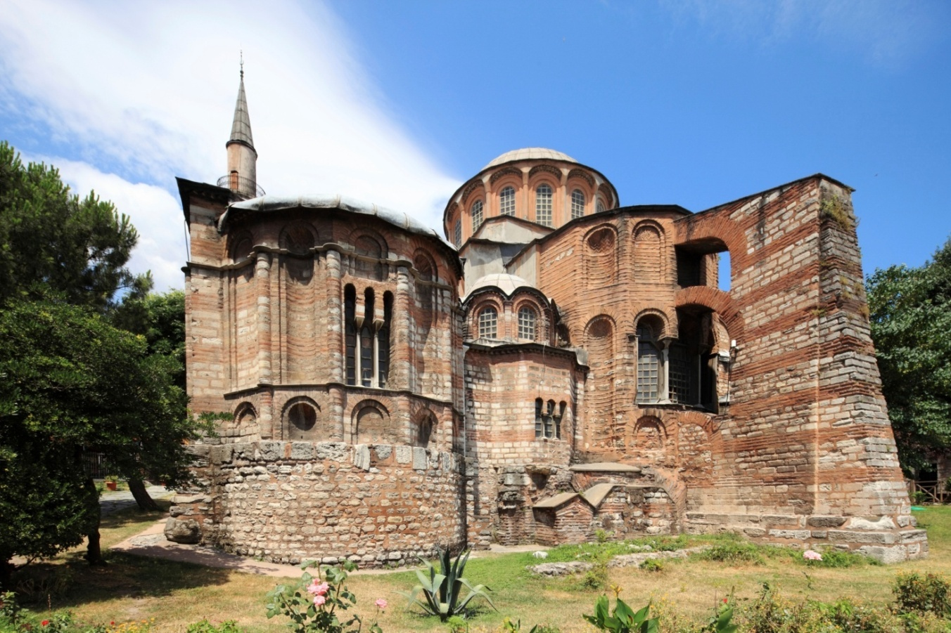
Chora Church
The Church of the Holy Saviour in Chora was built in the style of Byzantine architecture. In the 16th century, during the Ottoman era, the Christian church was converted into a mosque; it became a museum in 1945. The interior of the building is covered with some of the oldest and finest surviving Byzantine Christian mosaics and frescoes; they were uncovered and restored after the building was secularized and turned into a museum.

Slide 18
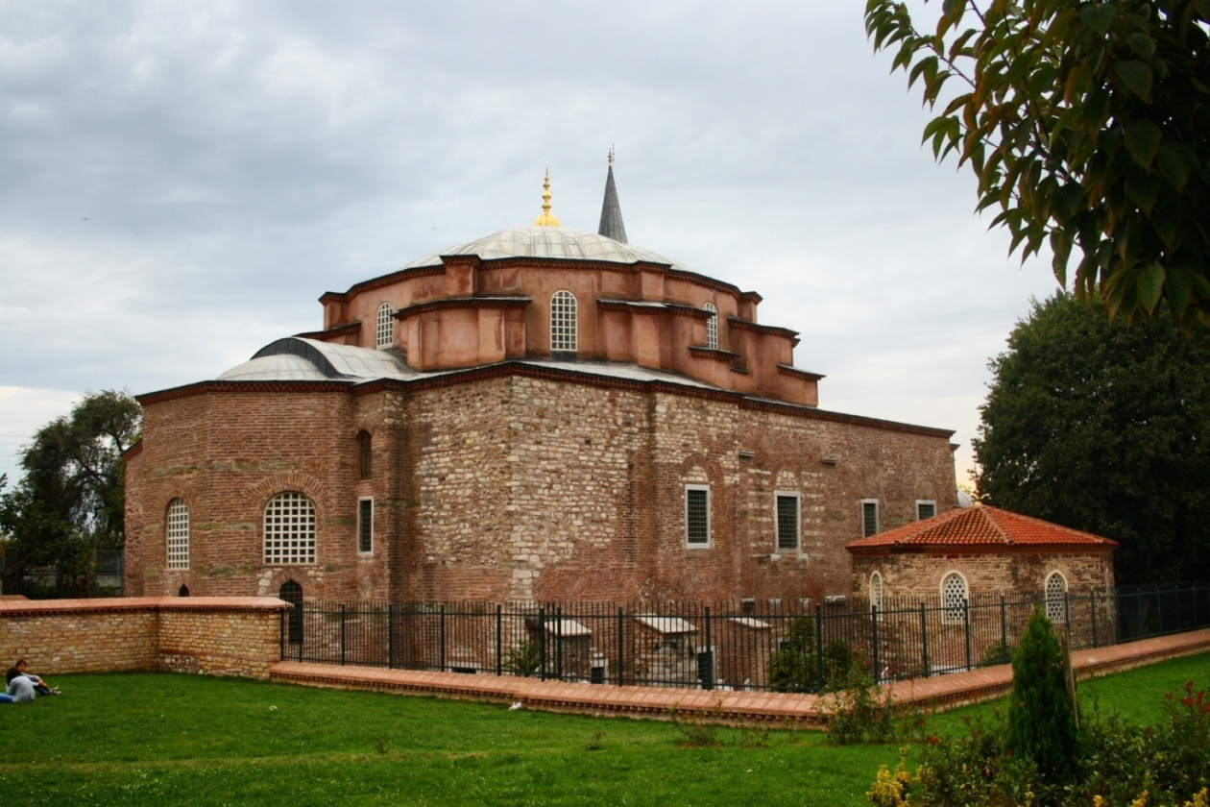
Sergio And Bakhos Church
Sergios and Bakhos Church which was built by Emperor Iustinianus before he accession to the throne. The building has a extentive restoration and opened to the public service recently. During this restoration process the zaviya rooms which lies inclose the complex were designed once again and organized as humble touristic bazaar.

Slide 19
After Rising: Ottoman Empire
Fatih Sultan Mehmet built Ottoman Empire again.
Economy got stronger Architecture reproduced.
Art was the highest level. Unique art was born.
İstanbul was the centure of the music.
Succesful poets grew up like Fuzuli,Nefi,Şeyhi
In the fields of ceramics, Hat,Ebru. Works exported.
When we say “Ottoman Empire” arthitecture comes our minds first. Second Mehmed builds many architecture works. There were 300 mosques and giant palaces.
Ottoman Architecture
*Topkapı Palace *Fatih Mosque *Grand Bazaar

Slide 20
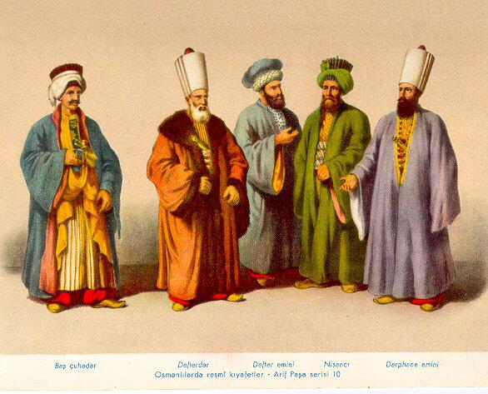
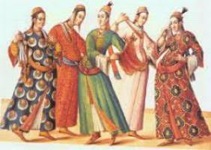
Several examples of Ottoman Designs

Slide 21
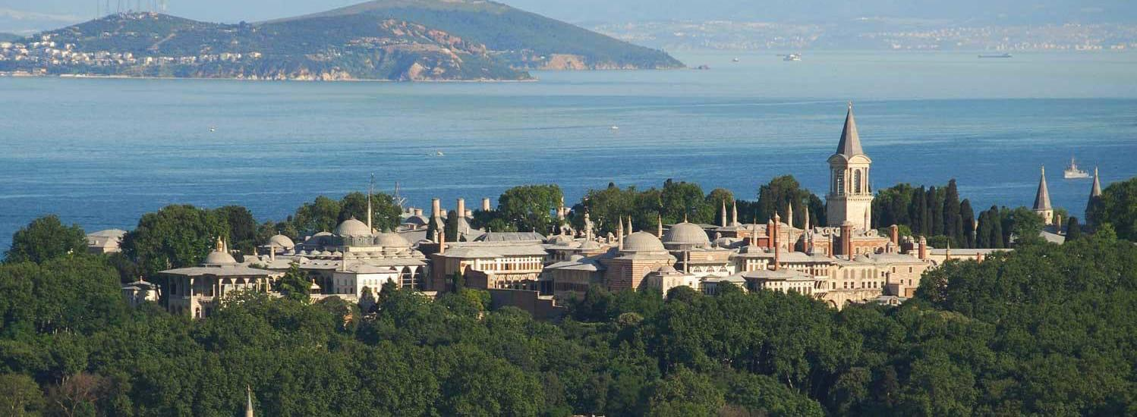
Topkapı Palace
Topkapı Palace is a large museum in the east of Istanbul in Turkey. In the 15th and 16th centuries it served as the main residence and administrative headquarters of the Ottoman Sultans.
Construction, ordered by the Sultan Mehmed the Conqueror, began in 1459, six years after the conquest of Constantinople.

Slide 22
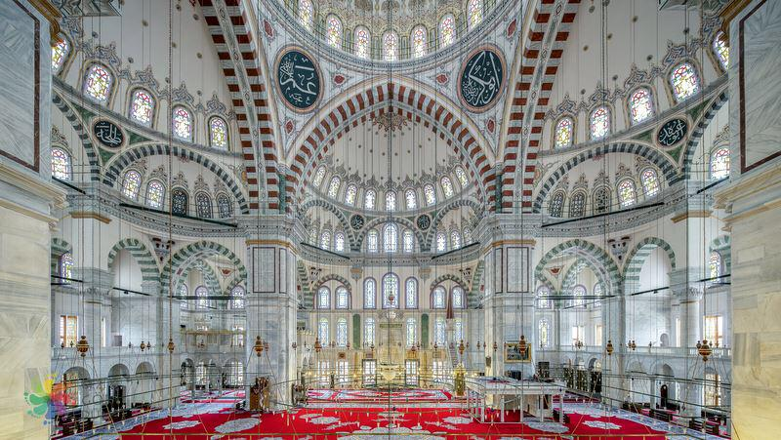
Fatih Mosque
The Fatih Mosque is an Ottoman mosque in Istanbul,Turkey. The original mosque on the site was constructed between 1463 and 1470 on the site of the Curch of the Holy Apostles. It was seriously damaged in the 1766 earthquake and was rebuilt in 1771 to a different design. It is one of the largest examples of Ottoman-Islamic architecture in Istanbul and represents an important stage in the development of classic Ottoman architecture.

Slide 23
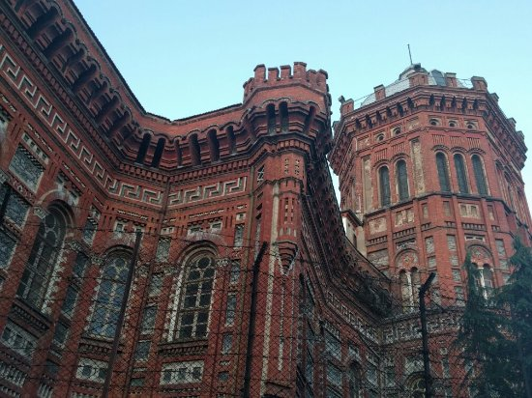
Orthodox Church
Nearly 300 millions are Orthodox around the world. Center of the Orthodox Church’s is İstanbul Fener Greek
Patriarch in the Byzantine territories, people believed in christianty (Eastern Orthodoxy). First christian state in history was Byzantium.
After 1453, emperor Fatih recognized freedom of religion. Fener Greek Patriarch is still in use in 2019 at İstanbul.
Art
Using symbol was important.
Divine was popular.

Slide 24
Several Examples From Art

Slide 25
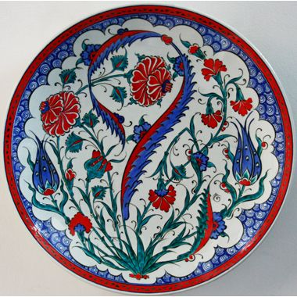
Ottoman Tiles / Çini
The art of Turkish tiles and ceramics occupies a place of prominence in the history of Islamic art. Its roots can be traced at least as far back as the Uighurs of the 8th and 9th centuries. Its subsequent development was influenced by Karakhanid, Ghaznavid, and (especially) Iranian Seljuk art. With the Seljuks' victory over the Byzantines at Malazgirt in 1071, the art followed them into Anatolia and embarked upon a new period of strong development fostered by the Anatolian Seljuk sultanate.

Slide 26
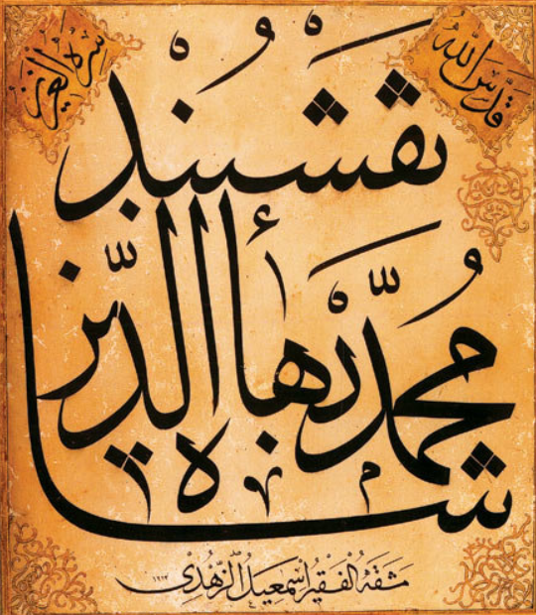
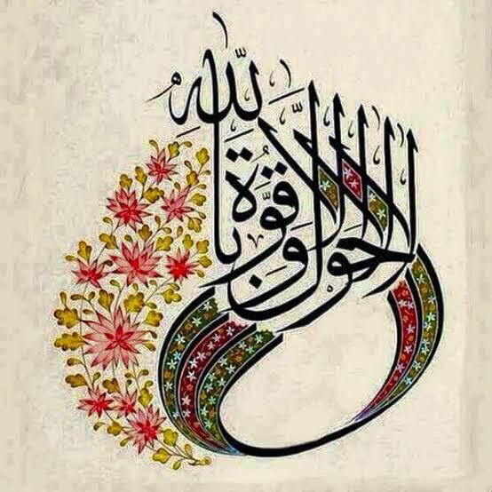
Hat Art / Ottoman Calligraphy
Ottoman Turks produced and perfected several varieties of Arabic script. All the various branches of the art of calligraphy, an art greatly loved and respected by the Ottoman Turks, were flourished particularly in the city of Istanbul.

Slide 27
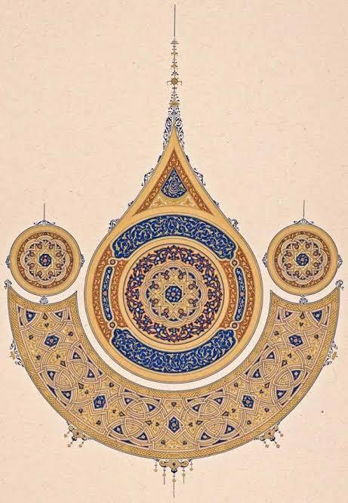
Ebru / Marbling
Marbling is the art of creating colorful patterns by sprinkling and brushing color pigments on a pan of oily water and then transforming this pattern to paper. The special tools of the trade are brushes of horsehair bound to straight rose twigs, a deep tray made of unknotted pinewood, natural earth pigments, cattle gall and tragacanth. It is believed to be invented in the thirteenth century Turkistan. This decorative art then spread to China, India and Persia and Anatolia. Seljuk and Ottoman calligraphers and artists used marbling to decorate books, imperial decrees, official correspondence and documents.

Slide 28
Science/Literature/Philosophy

Slide 29
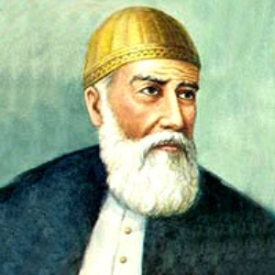
Fuzuli
Poet, writer and thinker. Often considered one of the greatest contributors to the divan tradition of Azerbaijani Literature , Fuzuli in fact wrote his collected poems (divan) in three different languages: in his native Azerbaijani, Arabic and Persian. He was well-versed in both theOttoman and Chaqatai Turkic literary traditions as wella maths and astronomy.

Slide 30
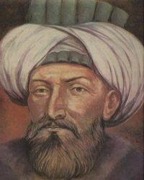
Nefi
Nefʿī came to the Ottoman capital of Istanbul sometime before the year 1606, when he is noted to have been working in the bureaucracy as the comptroller of mines (maden mukataacısı). Nef'i attempted to gain the sultan’s favor for his poetry, but was unsuccessful with sultan Ahmet I. However, finally, Sultan Murad IV recognized his skill and granted him a stipend.
Because of his vicious literary attacks on government officials, he was executed

Slide 31
The War / The Conquest of Istanbul
*Ottoman Empire first preparation was Rumeli Fortress.
Rumeli Fortress splits the sea and Istanbul.
*Mehmed the second, made heavy,strong balls. It made to loud voice and it damaged so many people at one throw.
*Mehmed the second , cared fleet a lot. Old ships were fixed. The ships carried out on the land to Haliç.
*They built war towers and ditches.
*Before the war began, he had sends a vizier to Constantine. Vizier asked to Byzantine Emperor to deliver the Constantinople. And he said no.

Slide 32
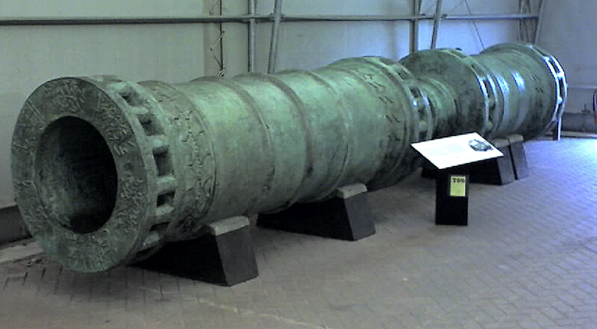
*23 March; the date of Ottomans attacked the Byzantine Empire. 5-6 April, the famous walls of Istanbul were already surrounded.Then the war began.
*All this difficulty, we took Constantinople, we called Istanbul.
*At the end of this war; Ottoman Empire won. The history called; “The Rise Of OTTOMAN EMPİRE”

Slide 33
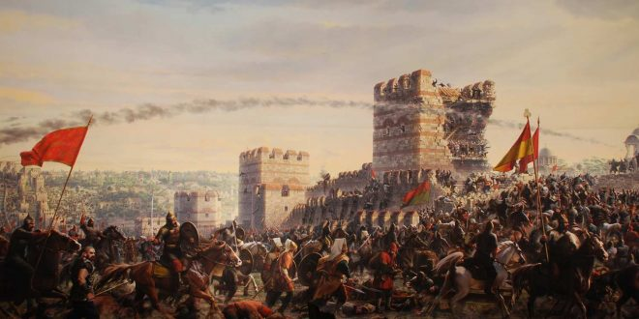
'Conquest of Istanbul') was the capture of the Byzantine Empire’s capital by the Ottoman Empire. The city fell on 29 May 1453,the culmination of a 53-day siege which had begun on 6 April 1453.

Slide 34
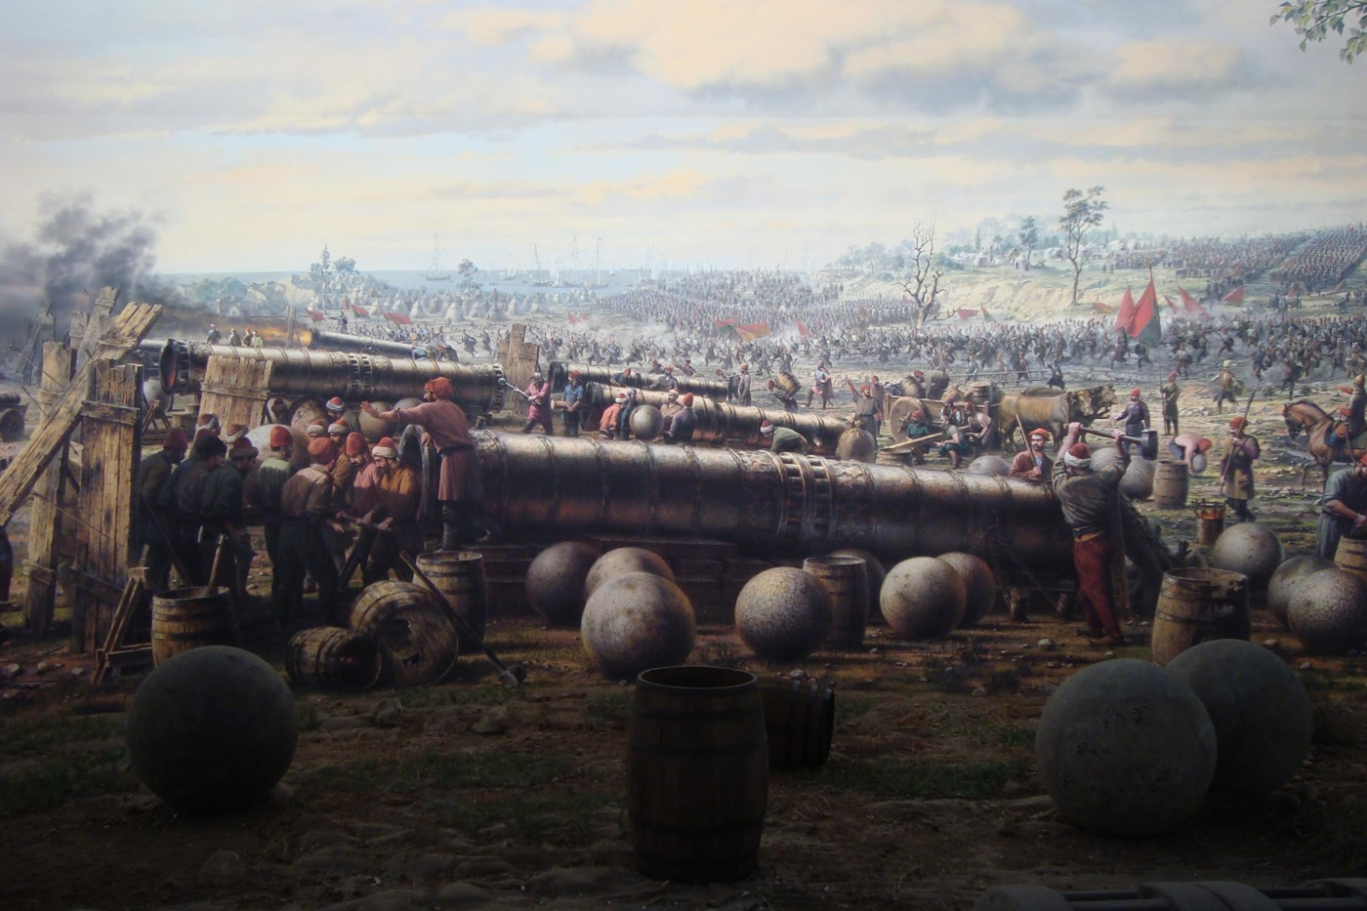
The Fall of Constantinople marked the end of the Byzantine Empire, and effectively the end of the Roman Empire, a state which dated back to 27 BC and lasted nearly 1,500 years.The capture of Constantinople, a city which marked the divide between Europe and Asia Minor, also allowed the Ottomans to more effectively invade mainland Europe, eventually leading to Ottoman control of much of the Balkan peninsula.

Slide 35
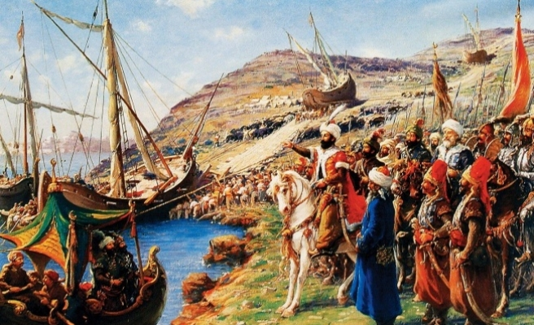
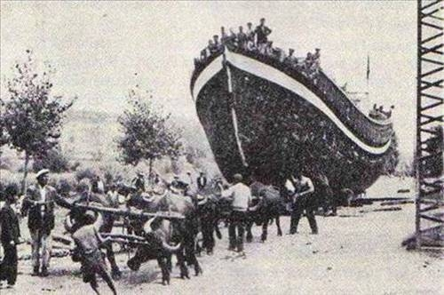
The conquest of Constantinople and the fall of the Byzantine Empire[ was a key event of the Late Middle Ages and is sometimes considered the end of the Medieval period. The city's fall also stood as a turning point in military history. Since ancient times, cities and castles had depended upon ramparts and walls to repel invaders. However, Constantinople's substantial fortifications were overcome with the use of gunpowder, specifically in the form of large cannons and bombards.

Slide 36
1918

Slide 37
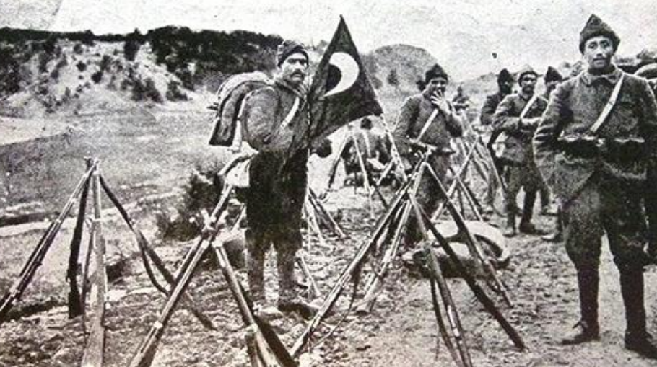
World War I
The Ottoman Empire came into World War I as one of the Central Powers. The Ottoman Empire entered the war by carrying out a surprise attack on Russia's Black Sea coast on 29 October 1914, with Russia responding by declaring war on 5 November 1914.
Ottoman forces fought the Entente in the Balkans and the Middle Eastern theatre of World War I. The Ottoman Empire's defeat in the war in 1918 was crucial in the eventual dissolution of the empire in 1921.

Slide 38
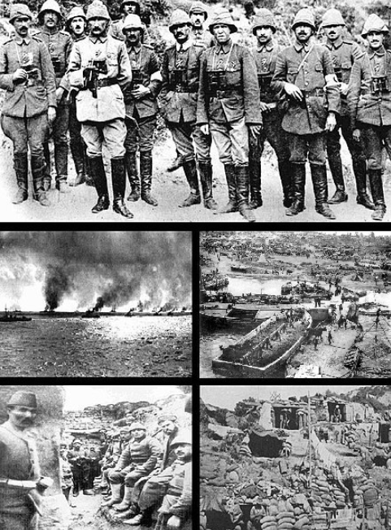
Gallipoli campaign
The Gallipoli campaign, was a military campaign in the First World War that took place on the Gallipoli peninsula from 17 February 1915 to 9 January 1916. The Entente powers, Britain, France and Russia, sought to weaken the Ottoman Empire, one of the Central Powers, by taking control of the Turkish straits. This would expose the Ottoman capital at Constantinople to bombardment by Allied battleships and cut it off from the Asian part of the empire. With Turkey defeated, the Suez canal would be safe, and a year-round Allied supply route could be opened through the Black Sea to warm water ports in Russia.

Slide 39
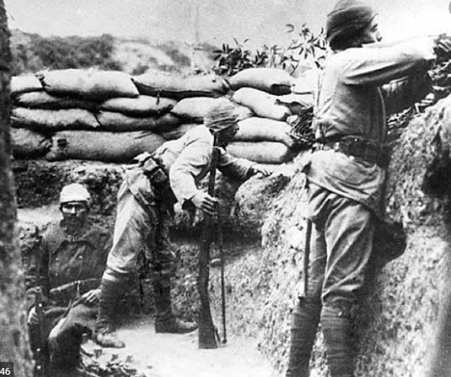
Gallipoli campaign
The Allied fleet's attempt to force the Dardanelles in February 1915 failed and was followed by an amphibious landing on the Gallipoli peninsula in April 1915. In January 1916, after eight months' fighting, with approximately 250,000 casualties on each side, the land campaign was abandoned and the invasion force withdrawn.
It was a costly defeat for the Entente powers and for the sponsors, especially First Lord of the Admiralty (1911–1915), Winston Churchill. The campaign was considered a great Ottoman victory.

Slide 40
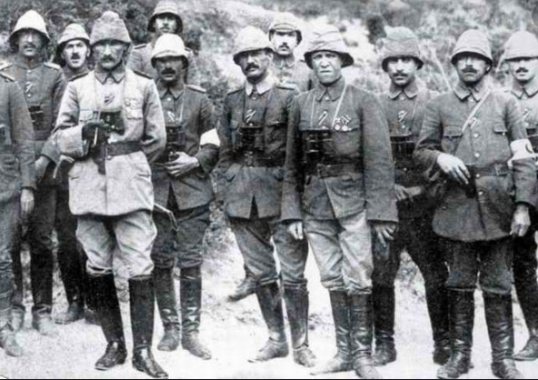
Gallipoli campaign
In Turkey, it is regarded as a defining moment in the history of the state, a final surge in the defence of the motherland as the Ottoman Empire retreated.
The struggle formed the basis for the Turkish War of Independence and the declaration of the Republic of Turkey eight years later, with Mustafa Kemal Atatürk, who rose to prominence as a commander at Gallipoli, as founder and president.

Slide 41
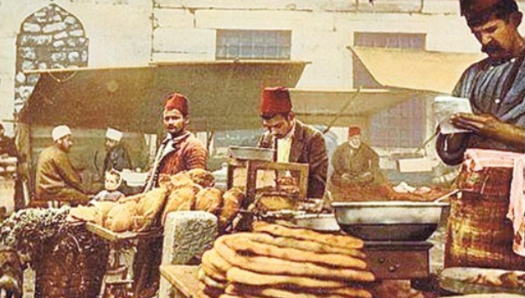
Economy
On 10 September 1915, Interior Minister Talat Pasha abolished the "Capitulations". On 10 September 1915 Grand Vizier Said Halim Pasha annulled (Vizer had the authority on annuls) the Capitulations, which ended the special privileges they granted to foreign nationals. The capitulation holders refused to recognize his action (unilateral action).[. Beside the capitulations, there was another issue which evolved under the shadow of capitulations. The debt and financial control (revenue generation) of the empire was intertwined under single institution, which its board was constituted from Great Powers rather than Ottomans. There is no sovereignty in this design. The public debt could and did interfere in state affairs because it controlled (collected) one-quarter of state revenues.[

Slide 42
Economy
The debt was administered by the Ottoman Public Debt Administration and its power extended to the Imperial Ottoman Bank (equates to modern central banks). Debt Administration controlled many of the important revenues of the empire. The council had power over every financial affairs. Its control extended to determine the tax on livestock in districts.
Ottoman public debt was part of a larger scheme of political control, through which the commercial interests of the world had sought to gain advantages that may not be to Empire's interest. The immediate purpose of the abolition of capitulations and the cancellation of foreign debt repayments was to reduce the foreign stranglehold on the Ottoman economy; a second purpose — and one to which great political weight was attached – was to extirpate non—Muslims from the economy by transferring assets to Muslim Turks and encouraging their participation with government contracts and subsidies.[

Slide 43
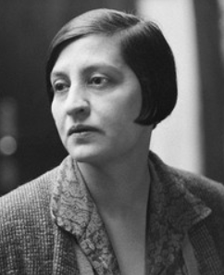
Culture
Halide Edib Adıvar (11 June 1884 – 9 January 1964) was a Turkish novelist, nationalist, kemalist, teacher and political leader for women's rights. She was best known for her novels criticizing the low social status of Turkish women and what she saw from her observation as the lack of interest of most women in changing their situation.
She was a Pan-Turkist and several of her novels promoted Turanism
Common themes in Halide Edib's novels were strong, independent female characters who succeeded in reaching their goals against strong opposition. She was also a fervent Turkish nationalist, and several stories highlight the role of women in Turkish independence.

Slide 44
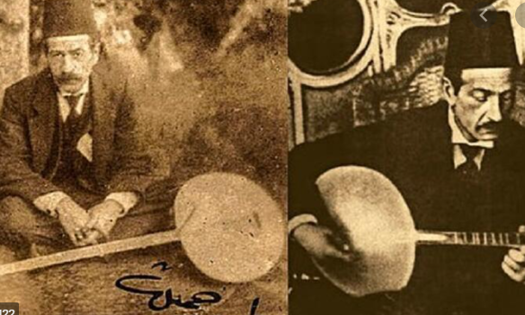
Culture
Tamburi Cemil Bey or Tanburi Cemil Bey was an Ottoman tambur, yaylı tambur, kemençe, and lavta virtuoso and composer, who has greatly contributed to the taksim (improvisation on a makam/maqam) genre in Ottoman classical music. His son, Mesut Cemil Bey, was an equally renowned Turkish tambur virtuoso.
His taksims and instrumental works he recorded on 78rpms with tanbur , kemençe, lavta, cello and yaylı tanbur had considerable impact on generations of musicians following him. The peşrevs and sazsemais he composed are pieces of great taste, requiring a developed performance technique.

Slide 45
1930-39

Slide 46
MUSTAFA KEMAL ATATÜRK
Mustafa Kemal Atatürk was a Turkish field marshal, revolutionary statesman, author, and the founding father of the Republic of Turkey, serving as its first president from 1923 until his death in 1938. He undertook sweeping progressive reforms, which modernized Turkey into a secular, industrial nation.Ideologically a secularist and nationalist, his policies and theories became known as Kemalism. Due to his military and political accomplishments, Atatürk is regarded as one of the most important political leaders of the 20th century.^{[7]}

Slide 47
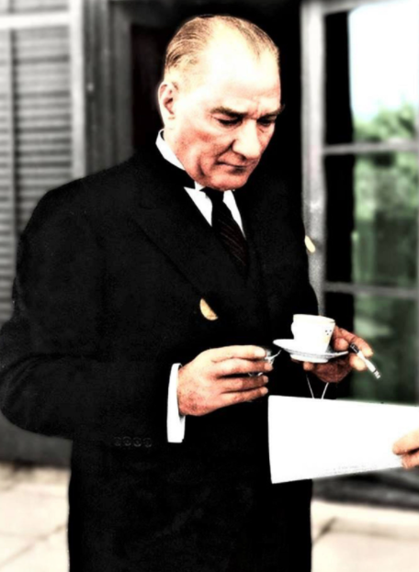
First, we will talk about the death of Atatürk.Mustafa Kemal Atatürk was born in the city of Thessaloniki, which was located at the time of the Ottoman State in 1881. Her mother's name is Mrs. Zübeyde, and her father's name is Mr. Ali Rıza. Mustafa Kemal Atatürk completed his military education in schools such as Neighborhood School, Şemsi Efendi School, Thessaloniki Civil School, Thessaloniki Military School, Monastery Military High School, Military College and the Military Academy. In 1893, when he was a student at the Military High School, his favorite mathematics teacher was changed to Mustafa Kemal by saying that we should add "Kemal" to Mustafa on your behalf. He played a huge role in achieving countless victories by leading and leading many important battles.

Slide 48
If we come to the worst event of 1938, Atatürk passed away on 10 November 1938. The health problems of Mustafa Kemal Atatürk started to become more frequent since 1937. In the early days of 1938, the year of his death, Mustafa Kemal Atatürk was diagnosed with cirrhosis. In addition to Turkish doctors, specialist doctors from Europe were brought in and treatment was started for Mustafa Kemal Atatürk. On 1 November 1938 he was unable to attend due to illness the opening of the Grand National Assembly of Turkey. Unfortunately, Mustafa Kemal Atatürk, who could not respond to the treatments applied, died on Thursday, November 10, 1938, at 09:05 in the morning at Dolmabahçe Palace, located in the borders of Beşiktaş district of Istanbul.

Slide 49
On November 16, 1938, the coffin of Mustafa Kemal Atatürk was placed on a catafalk covered with the Turkish flag and placed in the big ceremony hall in Dolmabahçe Palace. Everyone who wanted to see him for the last time to come to Dolmabahçe Palace. His funeral was sent to the capital Ankara on 20 November 1938 with a great ceremony, pain and sadness. His funeral was temporarily taken to Ankara Ethnography Museum with a magnificent ceremony held in Ankara on November 21, 1938. In addition to the community and important Turkish names, there were many foreign troops from all over the world. Anıtkabir which is located in Ankara, the capital of the Republic of Turkey, is Mustafa Kemal Ataturk's mausoleum. On November 10, 1953, the funeral of Mustafa Kemal Atatürk was moved to Anıtkabir and he was eternally buried.

Slide 50
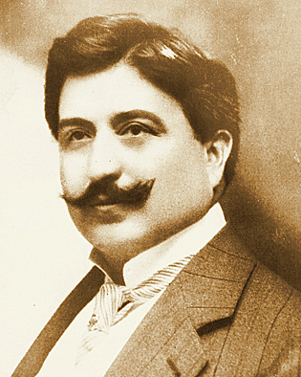
ARCHITECTURE
Ahmet Kemalettin widely known as Mimar Kemalettin (Kemalettin the Architect) and Kemalettin Bey, was a renowned Turkish architect of the very late period of the Ottoman architecture and the early years of the newly established Republic. He was among the pioneers of the first national architectural movement.
His lifetime saw intense and important changes for Turkish history and culture. promoted by his scholar German architect August Jachmund, designer of the Sirkeci Railway Terminal in Istanbul, and supported by a state scholarship, he went to Germany, where he was educated two years in architecture.

Slide 51
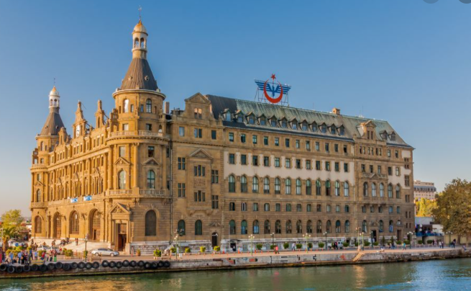
ARCHITECTURE
Sirkeci Railway Terminal
The terminal is located on the tip of İstanbul's historic peninsula right next to the Golden Horn and just northwest of Gülhane Park and the Topkapı Palace. Sirkeci Terminal, along with HaydarpaşaTerminal on the other side of the Bosphorus are İstanbul's two intercity and commuter railway terminals.
Haydarpaşa is a railway station in Istanbul. Until 2012 the station was a major intercity, regional and commuter rail hub as well as thebusiest railway station in Turkey Haydarpaşa, along with Sirkeci station (on the other side of the Bosphorus), are Istanbul's two intercity and commuter railway terminals.

Slide 52
ART
If we mention developments about music, art exhibition ; it started to open painting exhibition all over of Turkey in 1930’s. Then in 1932, first sculpture exhibition is opened by Zühtü Mürdüoğlu. In 1934, national music and play academy opened ; finally in 1935, general directorate of fine arts established. If we talk about the events developed in the theater, in 1930 excise tax has been abolished for cinema and theater. For encouragement the artists; the state paid high salaries, the state paid the costumes. With goverment support, nearly 100 plays were written and played between 1930-1950. In 1935, 782 play played in 100 communıty home.

Slide 53
ART
Also, playesacross the country of communıty homes are watched by 1 mıllıon people. Owıng to communıty home tours Eastern people met with theatre too. For examples; in 1933 ‘Hamlet’ played in Elazığ, again in 1933 ‘Monster’ and ‘Hamlet’ played Muş. The drama club of Elazığ communıty home played exact 92 play in 6 months. In 1944, 3000 play played in 400 communıty home and 360 publıc room.thıs plays is generally about Turkısh culture and Turkısh hıstory. Some of these games are: İstiklal, Akın, Mavi Yıldırım, Özyurt…

Slide 54
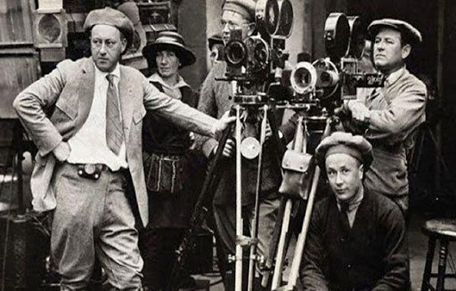
ART
Bedia Muvahhit went to Greece, Muhsin Ertuğrul went Russia and they introduced Turkısh yheater. And fınally, if we talk about cinema in 1930’s. Cinema started to develop. Portable cinema application started and educational Films displayed to people in communıty homes. In 1932, there was 120 cinema at Turkey. The pionner of Turkısh theater Muhsin Ertuğrul, became also pionner of Turkish cinema.The play shown in 1932 ‘Ordeal’, the play Shown in 1929 ‘Ankara Post’, the play shown in 1932 ‘A National Is Walkıng Up ’ attracted great attentıon.

Slide 55
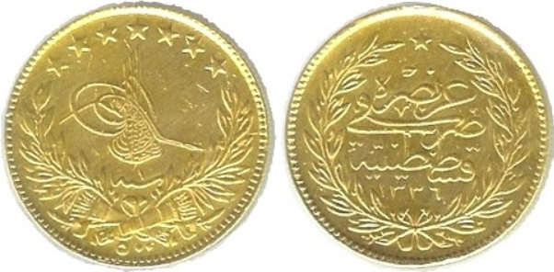
ECONOMY
At the time of the collapse of the Ottoman Empire during World War I and the subsequent birth of the Republic, the Turkish economy was underdeveloped: agriculture depended on outmoded techniques and poor-quality livestock, and Turkey's industrial base was weak; the few factories producing basic products such as sugar and flour were under foreign control as a result of the capitulations.
Turkey's economy recovered remarkably once hostilities ceased. From 1923 to 1926, agricultural output rose by eighty-seven percent, as agricultural production returned to pre-war levels. Industry and services grew at more than nine percent per year from 1923 to 1929; however, their share of the economy remained quite low at the end of the decade. The government stepped in during the early 1930s to promote economic recovery, following a doctrine known as statism. Growth slowed during the worst years of the depression, except between 1935 and 1939 when it reached six percent per year.

Slide 56
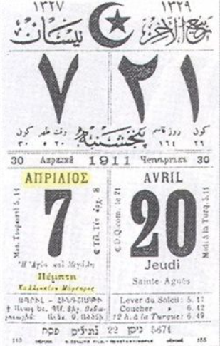
ECONOMY
The clocks, calendars and measurements used in the Ottoman Empire were different from those used in the European countries. This situation made social, commercial and official relations difficult and caused some confusion. Some efforts were made to overcome this difference in the last period of the Ottoman Empire, but it was not enough. After the declaration of the republic, efforts were started to overcome these difficulties. Firstly, with a law passed on 26 December 1925, the Gregorian calendar was adopted instead of the Hijri and Rumî calendars and then and it was started to be used as of January 1, 1926. In addition to this change in the calendar, the clock system used by the modern world was adopted instead of the clock, called turquoise which was adjusted to the sunset. With the measure of time taken from the west, one day was divided into 24 hours and daily life was organized. With an amendment made in 1928, international figures were accepted. With a law adopted in 1931, the old weight and length measures were changed. Measurement units such as arch, endaze and okka, which were used in the past, were removed. Instead of these, the meter was accepted as the measure of length and kilo as the measure of weight. With these changes in length and weight measurements, unity in the country was achieved.

Slide 57
1970

Slide 58
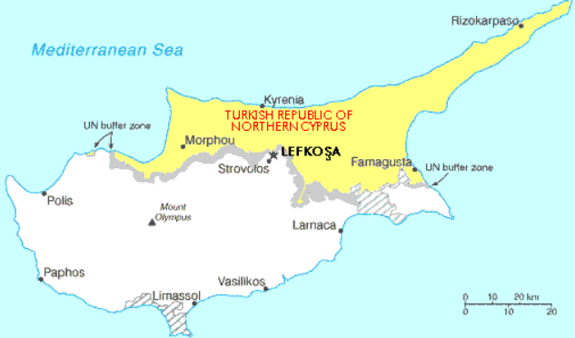
TURKISH PEACE OPERATION
The Turkish invasion of Cypruswas a Turkish military peace operation of the island countr of Cyprus. It was launched on 20 July 1974, following the Cypriot coup d'état on 15 July 1974.
The coup had been ordered by the military Junta in Greece and staged by the Cypriot National Guard in conjunction with EOKA-B. It deposed the Cypriot president Archbishop Makarios IIIand installed Nikos Sampson. The aim of the coup was the union (enosis) of Cyprus with Greece, and the Hellenic Republic of Cyprus to be declared.
In July 1974, Turkish forces invaded and captured 3% of the island before a ceasefire was declared. The Greek military junta collapsed and was replaced by a democratic government. In August 1974 another Turkish invasion resulted in the capture of approximately 36% of the island. The ceasefire line from August 1974 became the United Nations Buffer Zone in Cyprus and is commonly referred to as the Green Line.

Slide 59
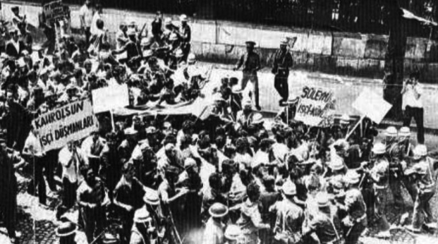
POLITICS
The ten-year period between 1970-1980, the country's administration has changed hands constantly. Following the 1971 military intervention in time and especially towards the end of the 70's, political violence has reached an inextricable level.
Continuous shifting powers, multiple governments, the actions of radical "left" and "right" groups, and events such as the counter-violence against them pointed to a tense, depressed and complex period.

Slide 60
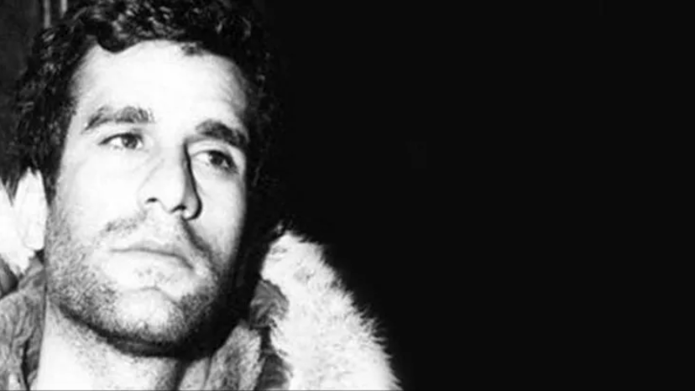
POLITICS
Deniz Gezmiş (27 February 1947 – 6 May 1972) was a Turkish Marxist-Lennist revolutionary, student leader, and political activist in Turkey in the late 1960s.^{[1]} He was one of the founding members of the People's Liberation Army of Turkey (THKO).^{[2]}
He was educated in various Turkish cities. He spent most of his childhood in Sivas, where his father grew up. He graduated from high school in Istanbul where he first encountered left wing ideas. Gezmiş and companions are considered by some as "Turkey's Ché Guevara and compañeros".^{[4]}

Slide 61
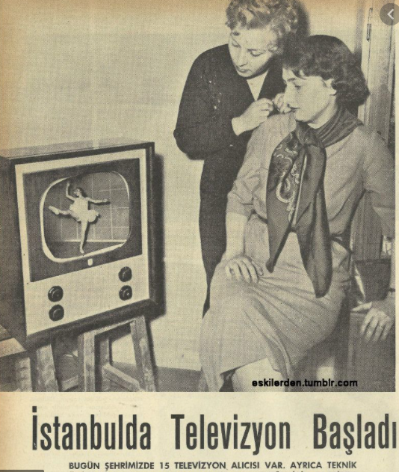
TELEVISION IN TURKEY
The television industry in Turkey includes high-tech program production, transmission and coverage. Turkish Radio and Television Corporation is Turkey's largest and most powerful national television station. As of 1 August 2019, RTÜK there a total of 536 television channels in Turkey.] Television in Turkey was introduced in 1952 with the launch of ITU TV. The first television broadcast work carried out as closed-circuit television broadcast in Turkey was prepared in June-July 1966. The first national television channel in Turkey was TRT 1, which was introduced in 1968. Color television was introduced in 1981. Turkey's first private television channel, Star, began broadcasting on 26 May 1989. There was only one television channel controlled by the state until the wave of liberalization in the 1990s which began privately owned broadcasting

Slide 62
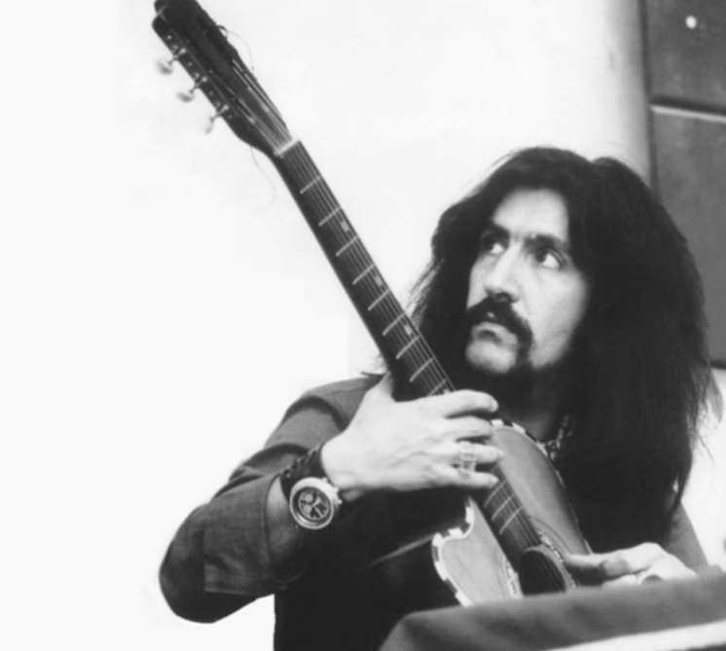
CULTURE
Barış Manço was a Turkish rock musician, singer, songwriter, composer, actor, television producer and show host.Beginning his musical career while attending Galatasaray High School, he was a pioneer of rock music in Turkey and one of the founders of the Anatolian rock genre. Manço composed around 200 songs and is among the best-selling and most awarded Turkish artists to date. Many of his songs were translated into a variety of languages including English, French, Japanese, Greek, Italian, Bulgaria, Romanian, Persian, Hebrew, Urdu, Arabic, and German among others.Through his TV program, 7'den 77'ye ("From 7 to 77"), Manço traveled the world and visited many countries on the globe.^{[5]} He remains one of the most popular public figures of Turkey.

Slide 63
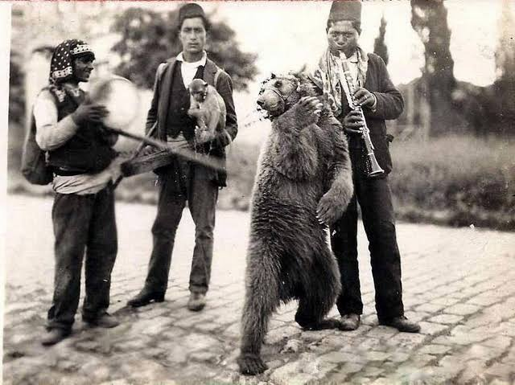
CULTURE
Despite being banned completely in 1929, the habit of playing bear on the street continued. Bears were danced in the streets, especially by our gypsy citizens. The bear was held by a chain from the ring on its nose and danced in the street with music played. Then money was collected from the audience. Later, this activity was banned completely because of animal rights and not safe. Bears were rehabilitated in shelters.

Slide 64
1980s

Slide 65
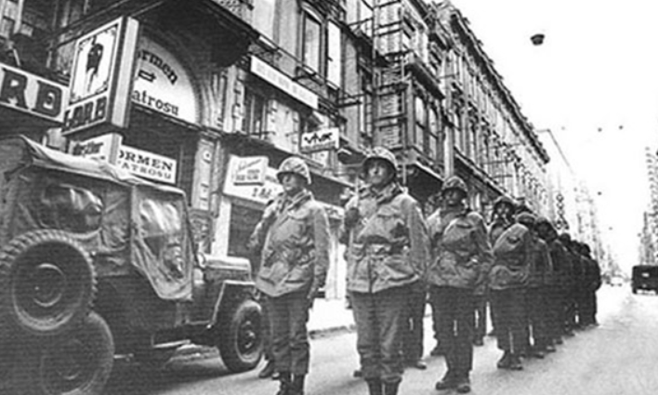
POLITICS
The 1980 Turkish coup d'état headed by Chief of the General Staff General Kenan Evren, was the third coup d'état in the history of the Republic, the previous having been the 1960 coup and the 1971 coup by memorandum.
During the Cold War era, Turkey saw political violence (1976–1980) between far-left, far-right and Islamist militant groups, and the state. The violence saw a sharp downturn for a period after the coup, which was welcomed by some for restoring order by quickly executing 50 people and arresting 500,000 hundreds of whom would die in prison. For the next three years the Turkish Armed Forces ruled the country through the National Security Council, before democracy was restored with the 1983 Turkish general election.

Slide 66
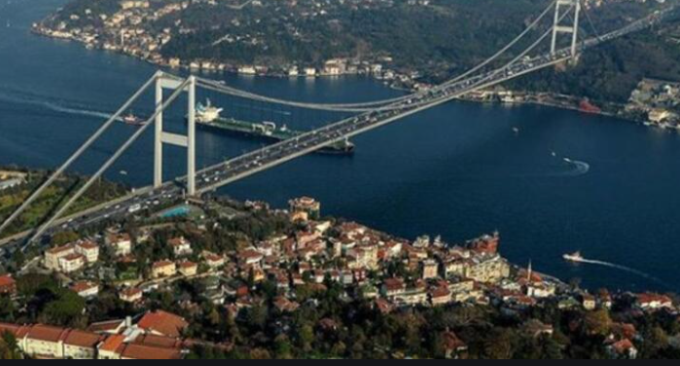
POLITICS
The Fatih Sultan Mehmet Bridge ("Sultan Mehmed the Conqueror Bridge"), also known as the Second Bosphorus Bridge , is a bridge in Istanbul, Turkey spanning Bosphorus strait (Turkish: Boğaziçi). When completed in 1988, it was the 5th-longest suspension bridge span in the world; today it is the 24th.
The bridge is named after the 15th-century Ottoman Sultan Mehmed the Conqueror, who conquered the Byzantine capital, Constantinople (Istanbul), in 1453. It carries the European route E80, Asian Highway 1, Asian Highway 5 and Otoyol 2 highways. There are two other bridges that connect Europe and Asia located in Istanbul which are named Yavuz Sultan Selim Bridge and 15 July Martyrs Bridge (formerly known as Bosphorus Bridge).

Slide 67
ECONOMY
One of the sectors that became institutionalized right after the 1980 revolution was "Bankers". These institutions, which were formerly wolf moneylenders, took names such as "Kastelli", "Bako", and some even started to advertise on newspapers and television.
Famous artists and actors of that period featured in these advertisements. The bankers, who started to gain prestige, were common goals: to collect the savings of the people with very high interest rates ... As a result of the failure of the account at home to match the market, all bankers went bankrupt one by one and started to flee abroad with the money they collected.

Slide 68
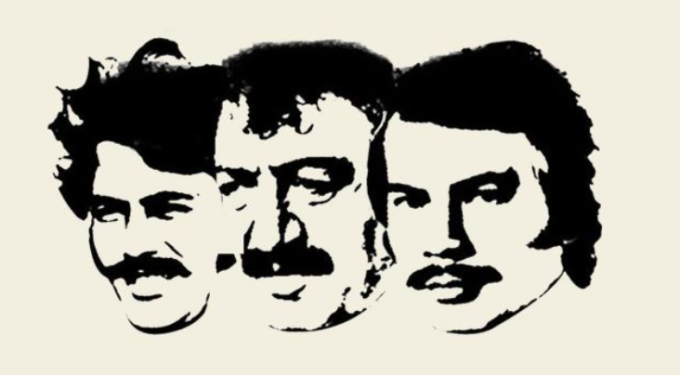
CULTURE
Arabesque (Turkish: Arabesk) is a term created by Turkish musicologists for an Arabic style of music created in Turkey. The genre was particularly popular in Turkey in the decades from the 1960s through the 1990s. As with Arabic music itself, its aesthetics have evolved over the decades.
Although melodies and rhythms are predominantly Byzantine and Arabic influenced, it also draws ideas from other aspects of Balkan and Middle Eastern music, including bağlama music and Ottoman forms of oriental music. Arabesque music are mostly in a minor key, typically in the Phrygian mode, and themes tend to focus on longing, melancholy, strife and love issues.

Slide 69
1461

Slide 70
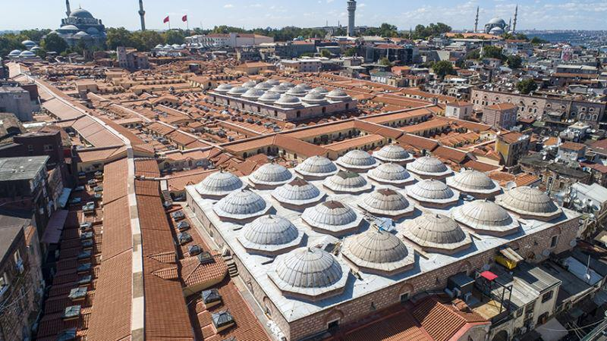
Grand Bazaar
Grand Bazaar in Istanbul is one of the largest and oldest covered markets in the world, with 61 covered streets and over 4,000 shops[on a total area of 30,700 m²,[attracting between 250,000 and 400,000 visitors daily. In 2014, it was listed No.1 among the world's most-visited tourist attractions with 91,250,000 annual visitors.

Slide 71
Grand Bazaar
The construction of the future Grand Bazaar's core started during the winter of 1455/56, shortly after the Ottoman conquest of Constantinople and was part of a broader initiative to stimulate economic prosperity in Istanbul. Sultan Mehmed IIhad an edifice erected devoted to the trading of textiles and jewels near his palace in Constantinople.^{[9]}

Slide 72
Grand Bazaar
Today the Grand Bazaar is a thriving complex, employing 26,000 people[visited by between 250,000 and 400,000 visitors daily, and one of the major landmarks of Istanbul.It must compete with modern shopping malls common in Istanbul, but its beauty and fascination represent a formidable advantage for it. The head of the Grand Bazaar Artisans Association claimed that the complex was in 2011 – the year of its 550th birthday – the most visited monument in the world.

